Slide 1

Performance Management @ Stanford
Pat Keating, L&OE
"Mind Bugs: The Ordinary Origins of Bias" - Dr. Brian Nosek
"Mind Bugs: The Ordinary Origins of Bias" - Dr. Brian Nosek
"Mind Bugs: The Ordinary Origins of Bias" - Dr. Brian Nosek
"Mind Bugs: The Ordinary Origins of Bias" - Dr. Brian Nosek

Slide 2
Agenda
Why should you care?
What is our approach/objectives/outcomes?
Who involved?
When will we execute?
How can you participate?

Slide 3
Change Drivers
76%
78%
79%
79%
80%
80%
68%
69%
66%
54%
57%
Notes:
% Favorable is based on responses in the Strongly Agree or Agree ratings.

Slide 4
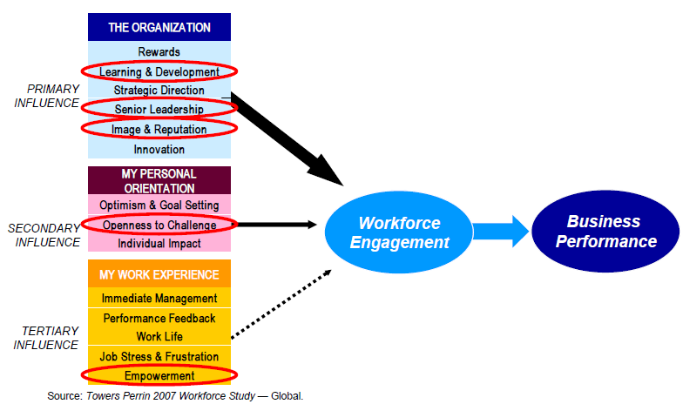
The Business Case

Slide 5
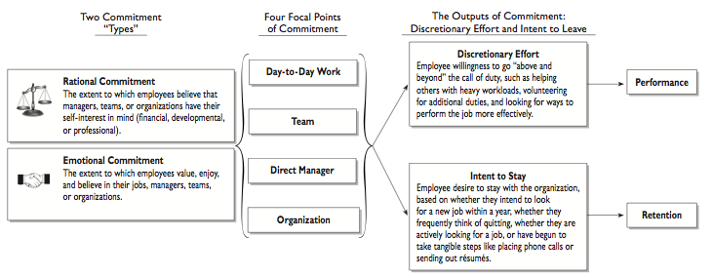
Engagement, Performance and Retention

Slide 6
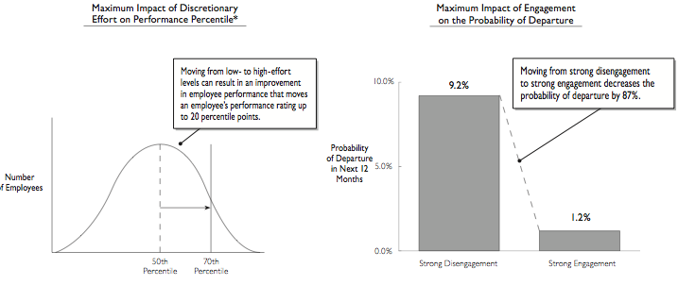
Business Value of Engaged Employees

Slide 7
The Manager, Employee Development and Performance
Employees of managers who are very effective at development can outperform their peers by up to 25 percent
Impact of Manager-Led Development on Employee Performance
Employees Reporting to Manager A
Manager A is very ineffective at developing employees
Employees Reporting to Manager B
Manager B is very
effective at developing employees
}
25%
Performance Improvement
directly attributable to Manager B’s effectiveness at employee development
Source: Learning and Development Roundtable 2003 Employee Development Survey
Notes:
Talking Points:
The business case for playing an effective role in the development of your direct reports is pretty clear: the direct reports of managers who are very effective at development activities tend to outperform those with very ineffective managers by as much as 25 percent.
The example on this page serves to illustrate this point. Employees reporting to Manager B (a strong developer of employees) will tend to outperform employees reporting to Manager A (a weak developer of employees) by a margin of 25 percent. Without spending too much time on methodology, let me explain the researchers’ calculation:
Take two groups of employees, and assume that the only thing that’s different about these two groups is the effectiveness of their managers at employee development—one group reports to managers who are very effective at employee development, the other group reports to managers who are very ineffective at employee development. Remember, that’s the only thing that differentiates these two groups. On average, the researchers found that the group reporting to the very effective managers will have performance review scores that are 25 percent higher.
What’s important to note on this page, and for all the numbers you’ll see in this presentation, is that the 25 percent improvement occurs when the least effective manager at employee development becomes the most effective manager. So if you are already pretty effective and become very effective, you won’t get the full 25% improvement--you’ll get a portion of that. In essence, for every point that you move up on the 7 point scale for effectiveness at employee development, you can expect your employees’ performance to improve by a little more than 4 percent.
Answers to Possible Audience Questions:
What does the number 100 represent in white bar to the left?
The scores here are indexed. That means 100 serves as a baseline score—it represents the performance score of an employee reporting to a manager that’s very ineffective at employee development.
Who decides if a manager is effective or ineffective?
Employees were asked to rate their managers on a scale of 1 to 7. Manager A represents all managers with the lowest or weakest score, a 1. Manager B represents all managers with the highest or strongest score, a 7.
How did you determine the baseline scores and the degree of performance improvement?
The performance score of the Employee reporting to Manager A represents the average performance score of all employees reporting to managers who were rated as very ineffective at employee development. Roughly speaking, the performance score of the Employee reporting to Manager B represents the average performance score of all employees reporting to managers who are rated as very effective. The numbers 100 and 125 are used to simplify the chart and minimize confusion.
Introduction to This Slide: This page demonstrates why your efforts to develop employees are so important: the more effective you are at employee development, the better your employees perform.
Transition to the Next Slide: Employee performance is not the only area where we see the impact of effective employee development. As we’ll see on the next slide, there are a host of positive effects on the team metrics that all of us care about. So, I hope that what this page demonstrates is that employee development isn’t a nice to have—it’s a need to have. It has a very clear impact on performance—the one metric that we all care about.
Questions for Discussion:
Does this align with your experiences and observations?
To what extent does this data solidify the business case for your role in employee development?

Slide 8

FIVE LEAD ROLES FOR MANAGERS
The manager-led development activities that impact employee performance fall into five basic roles
Planning
Execution
Evaluation
Performance and
Development
Strategist
Solutions
Enabler
Learning-
Experience
Architect
Opportunity
Broker
Honest
Appraiser
This role consists of activities
that ensure employees
know performance evaluation
criteria, have development
plans, and acquire
needed knowledge and skills.
This role includes activities
undertaken to help
employees apply newfound
skills and knowledge or to
help employees learn from
their managers’ experiences.
This role consists of
activities that enable
employees to learn from the
experiences acquired
through their projects
and assignments.
This role includes activities
undertaken to help
employees locate
development opportunities,
in their current jobs and
beyond.
Activities falling into this role
consist of apprising direct
reports of their job
performance and progress
against their development
plans.
Activity & Impact
Explain Performance
Evaluation Standards
19.8%
Create Individual
Development Plans (IDPs)
12.0%
Ensure Necessary
Skills/Knowledge
6.7%
Activity & Impact
Help Employees Apply
New Skills/Knowledge
11.6%
Teach New Skill
or Procedure
7.7%
Give Advice from Own
Experience
6.7%
Activity & Impact
Ensure Projects Are
Learning Experiences
19.8%
Provide Experiences That
Develop Employees
19.1%
Activity & Impact
Help Employees Find
Training
13.6%
Pass Along Job Openings
10.3%
Pass Along Development
Opportunities
8.7%
Activity & Impact
Assess Development
Progress
13.8%
Give Feedback on
Personality Strengths
13.3%
Give Feedback on
Performance Weaknesses
11.9%
Give Feedback on
Performance Strengths
8.0%
Average Impact of Role Activities on Employee Performance
12.8%
8.7%
19.4%
10.9%
11.8%
Source: Learning and Development Roundtable 2003 Employee Development Survey.
Notes:
Talking Points:
Rather than ask you to keep track of the 15 manager-led development activities that matter most to employee performance, we’ve grouped them into five basic roles that you should play in the process: performance and development strategist, solutions enabler, learning-experience architect, opportunity broker, and honest appraiser. As you look across those roles, you’ll likely find that they look familiar—and, that’s the point. By and large, they’re already part of your jobs.
This slide demonstrates how the activities align with these roles. Beneath each column, you’ll see the average performance impact for each role. For example, if we look at the first column, “Performance and Development Strategist,” we see that this role comprises three activities: explaining performance evaluation standards, which has a 19.8 percent impact on employee performance, creating IDPs has a 12 percent impact, and ensuring employees have the skills and knowledge they need to do their jobs has a 6.7 percent impact. Beneath the column, we see 12.8 percent--that’s the average impact all of the activities within this role have on performance.
Above the rectangles, you’ll see arrows that indicate how these roles group into the three basic phases of the development cycle—planning, execution, and evaluation.
If you’re like most managers, you’re best on the “bookends” on this chart—setting development strategy and evaluating development progress. As you’ll note, though, the roles associated with the day-to-day execution of development activities merit managers’ best efforts as well.
Let’s look at “Learning-Experience Architect”—this role has the greatest average impact on employee performance at 19.4 percent. This role pretty much covers project assignments—it means looking at where your employees are and assigning projects that provide learning experiences now, and planning to assign projects that help your employees build on those learning experiences later. By putting some extra thought into your assignments, you can increase employee performance by up to 19.4 percent.
Again, it’s difficult to remember 15 separate activities. But if you place them into 5 roles you already play, you can concentrate on a role rather than on a slate of activities and have an easier time focusing your development efforts.
Answers to Possible Questions:
How were these five roles created?
The roles were identified through qualitative analysis by the Roundtable’s research team. In essence, researchers examined the similarities of various activities and clustered them.
Discussion Questions:
Who currently attempts to make sure that employees get assignments that will help them grow and develop? How do you determine who needs certain types of assignments?
Would you agree that you’re better at the “bookends” of this process? Which areas do you think most managers perform most/least effectively?
Introduction to This Slide: We’ve looked at fifteen activities that impact employee performance. Although the list is important, it can be a little overwhelming. On this slide we’ll simplify this list, by grouping the activities into five roles managers already play.
Transition to the Next Slide: Now that we’ve covered the “what,” we’ll turn to the “how” – namely, “how” you can create work environments that make it more likely that you’ll be successful at employee development.

Slide 9
Our Goals
To design a best-in-class performance management system that aligns employee performance and development with Stanford’s mission and culture of excellence.
People
Process
Technology

Slide 10
Expected Outcomes
An easier, less cumbersome process
  An “easy-to-use” performance management process
  A common rating scale and set of competencies
Better performance conversations
  Managers and employees will have the skills and knowledge to have more meaningful performance conversations
  A fresh focus on employee development
Technology that drives efficiency
  Easier to complete the process online
  Reduces the burden on managers by reducing paperwork and time taken to complete the process

Slide 11
Two-pronged Approach
DESIGN & IMPLEMENTATION
Focus on defining the new process and competencies
Creating the tools, the content and the training etc.
Planning the logistics for implementing the new program
Performance Management Program
CHANGE MANAGEMENT & COMMUNICATION
Focus on getting leader engagement and buy-in
Creating the plan to ensure that changes are seamless at all levels in the organization
Develop communications

Slide 12
Performance Management Maturity Model
Performance Management
Drives Development
Performance Management Drives
Accountability and Compensation
Performance Management as
Required Mandate
Performance Management as
Fragmented HR Process

Slide 13


Benchmarking Ivy Leagues
School | Uniform Process | Online | Goals and Year-end Appraisals | Mid-year check-ins | One Rating Scale | Universal set of Competencies
Stanford |  | Pilot phase |  | Some units
Penn |  | Reviewing options |  | Some units
MIT | Recommended baseline process across university | Reviewing options |  | Informal process
Harvard | Forms, scales differ, components of performance management are uniform | Reviewing options |  | Some units
= Not a current practice
= Consistently practiced

Slide 14
Common Themes at Stanford
Ineffective Process
No line level sponsorship
“Managers don’t want to deliver tough messages around performance.”
“Managers and employees are only evaluated on goals and not people skills, therefore, how you achieve your goals is not important. People can display bad behaviors and are not accountable.”
“People here have been in their jobs for a long time, there really aren’t any ‘goals’ to set.”
“Faculty don’t want to be bothered with performance management.”
“Performance management is seen as an HR practice.”
“This is not a true ‘pay-for-performance’ culture.”
Managers Are Unskilled at PM
Lack Effective Tools for PM
“Managers lack the skills to manage performance effectively.”
“There are no career growth opportunities here, therefore development planning isn’t that beneficial.”
“Faculty and staff would rather hold on to their people than help them advance their careers.”
“There is limited training for managers around how to conduct good performance management conversations.”
“Managers don’t have the time to focus on performance management.”
“Merit increases are awarded evenly across teams to avoid employee dissatisfaction.”

Slide 15

Current State Summary
Over 40 performance management forms across Stanford
Rating scales vary from a 3 point scale to a 7 point scale and include numbers, letters and descriptors, makes managing talent across the organization a challenge
At least 3 different technologies are being used for performance management across Stanford
Performance cycles vary greatly
We measure hundreds of competencies and up to 17 competencies in one review
Certain key elements of performance management that impact high performance including multi-rater feedback, development planning etc. are not done consistently
Lack the ability to track performance year-over-year
Senior leaders cannot get a snapshot of their organization (unless using an online system)
People management skills are not evaluated resulting in an over-emphasis on goals
$1.5 BILLION “unmanaged asset” in payroll!!

Slide 16
PM Objectives:
What Are We Trying to Change Or Improve?
Poor Performance
Stellar Performance
Poor Performance
Stellar Performance
Improving performance across the organization (raising the bar)
Improving manager effectiveness with performance management
Greater recognition of top talent and ready now successors
Getting rid of old behaviors and rewarding new behaviors
Retention & Succession
Behavior Change

Slide 17
Best in Class Performance Management Programs
Managers meet to calibrate performance
Final ratings are assigned
Compensation pools are distributed according
to performance
“Pay-for-
performance”
approach
Set organizational , team and individual goals
  Communicate goals, develop strategy
    Discuss development
      Create plan
Goal Setting & Development Planning
On-going feedback and coaching throughout the year
Performance Check-in/ Feedback/ Mid-year review
Compensation Decisions
Solicit feedback
Solicit feedback
Formal review, employee
Formal or informal
writes self-review, gives self-ratings, manager adds and rates
performance check-in
via a mid-year review
or feedback session
Year-end Review
Communicate clear messages around performance based on goals and competencies
Manager and employee meet to discuss performance

Slide 18
Components of the PMP - Outline
Process
Competencies
Goal Setting
Development Planning
Mid-Year Reviews
Coaching and Feedback
Multi-rater feedback
Year-End Reviews
Rating scales & Calibration
Link to Compensation
Competency Model
Application
Measurement of competencies
Behavioral Descriptors
PMP
People
Tools/Technology
University and School/Business unit Leadership
Manager commitment, capability, confidence
Employee commitment, capability, confidence
Form for goal setting, dev planning, appraisals etc.
Forced distribution curves
Training curriculum and format
Job- aids to learn the new process

Slide 19
Performance Management
Talent
Management
Compensation
Performance Management
Employee Survey
Experience

Slide 20
Pilot Issues
Focus
Scope
Leadership

Slide 21
Pilot Group – Focus and Scope
Unit | Focus | Scope
GSB | Changing behavior, driving innovation | Whole organization
H&S | Improving manager effectiveness with the PMP, recognizing top talent, challenged with faculty supervisor reviews | Sub group within H&S, including some faculty supervisors
OOD | Retention of top talent, succession planning | Whole central OOD organization (excludes schools)
R&DE | Improving performance, compliance, influencing the design of the new PMP | Sub group within R&DE based on leaders’ support and interest, will not include bargaining unit employees
SOM | Employee satisfaction and retention, challenged with faculty supervisor reviews | Sub-group within SOM based on leader interest
SOE | Better PMP tools, Influencing the design of the PMP, challenged with faculty supervisor reviews | Sub-group within SOE

Slide 22
Executive Sponsors
David Jones, VP HR
Jeanne Berent, Executive Director of Finance and Administration, OOD
Marcia Cohen, Sr. Associate Dean, Finance and Administration, SOM
Shirley Everett, Sr. Associate Vice Provost, R&DE
Adam Daniel, Sr. Associate Dean, H&S
Clare Hansen-Shinnerl, Sr. Associate Dean, Finance and Administration, SOE
Gary Edwards, Performance and Culture Strategist, GSB

Slide 23

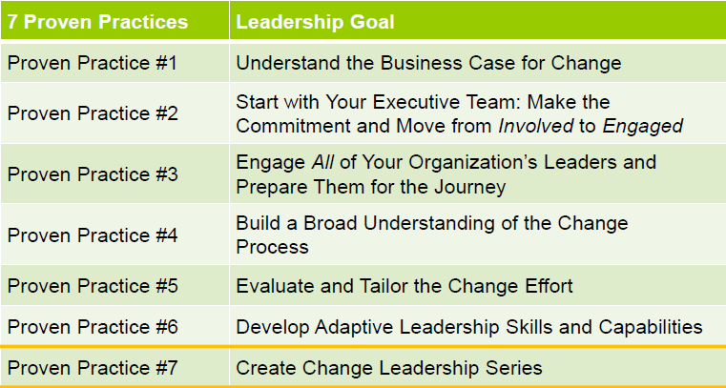
Successful Change

Slide 24
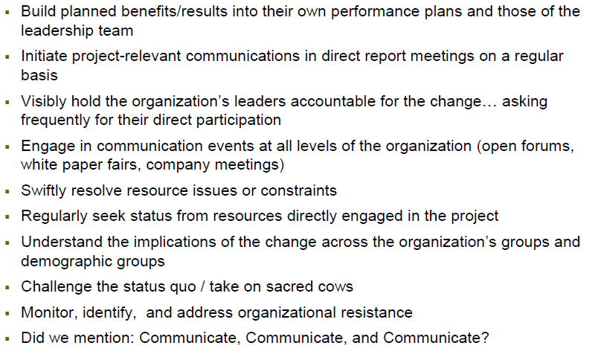
Engaged Leadership

Slide 25
A Phased Approach (PILOT)
Phase 1 (Year 2011)
Phase 1 (FY2011)
Program Design & Implementation
A select pilot group will participate in Phase 1 of the program.
Define a high level university-wide program which will include a performance management philosophy and recommended steps as part of the program including development planning
Review university wide and organization specific competencies to create a model that can be broadly applied
Create a common rating scale and definitions
Recommend a format for writing appraisals
Gain line level sponsorship
Assess ePerformance to see if it will meet the organization’s needs
Design appropriate training tools for managers and employees
Create a robust change management plan for implementation
Phase 2 (FY2012)
Review various technology options, costs etc. based on the needs defined in Phase 1
Design and test online performance management tool
Test new technology
Create appropriate training and job-aids for employees and managers
Launch new technology

Slide 26
Multi-Year Timeline
FY2011
FY2012
FY2013
FY2014
Launching the refreshed program
Launching the online technology to the pilot group
in a paper process with pilot group
Launching the refreshed program in a paper process to the rest of the organization?
Introducing online performance management to the entire organization
Designing the refreshed program
Review and design
the technology for online performance management
Communicating the new program to the rest of the
organization
Evaluating the technology on an ongoing basis

Slide 27
Benefits of Participating in the Pilot
Influence and Co-create
Build Manager Capabilities
Higher Engagement and Productivity
Influence and co-create a performance management program that is meaningful to your organization
Be part of a pilot that will test best practices in a variety of settings
Collaborate with peers on a fast paced project
Improve manager effectiveness
  Improve results on the employee survey under “coaching and feedback”
Greater employee engagement and morale
    Higher productivity

Slide 28
Detailed Timeline
FEB
MARCH
APRIL
MAY
Refining the Stanford Competencies
Defining the components of our refreshed program?
Answering- what do we want to measure- single vs. dual rating?
Rating scales
Solidify timeline
Define our performance management philosophy
Understanding the unique challenges of performance management with faculty supervisors
Designing a new form
Designing a template for multi-rater feedback
Creating a change management and communication plan
Defining an implementation plan
Getting buy-in across all levels in the university
Testing the new appraisal form
Define the training needs, identify training format, vendors etc.
Completed
In Progress
Not Started

Slide 29
High Level Strategy and Metrics
Adoption to Impact
Adoption
Expertise
Engagement
Productivity
Staff is using the new program and ultimately the technology
Managers develop the skills to conduct effective performance reviews
Managers give more frequent and more effective coaching and feedback
Stanford University is able to track and manage performance and talent across the organization
Performance rating distributions are normalized
Employees understand
Employee engagement, professional development, employee recognition and employee commitment are higher
Discretionary effort and intent to stay are higher
High performing employees are identified and rewarded appropriately
Employee productivity is higher as a result of the new program
It is easier to identify poor performers and create an action plan
It is easier to identify and reward high performers
Turnover for high performing employees is lower
Better business results
Staff finds the new program and technology effective and easy to use
Performance management is established as a key accountability at every level in the organization and from the top down

Slide 30
The Business Case

Slide 31
Questions

Slide 32
Backup Slides

Slide 33
Recommended Plan & Deliverables
Defining a Meaningful Program
Line level Performance Champions
Define a high level university-wide program
  Performance Management Philosophy
  Recommended steps
Reviewing university wide and organization specific competencies to create a flexible model that can be broadly applied and easily customized
A common rating scale and definitions
Recommended format for writing appraisals
Shift from performance management being an HR initiative to being a line level initiative
Sponsorship and launch at the highest level
Identify line level performance champions who will support a culture of performance management
Champions model new behaviors
Build channels of accountability at the line level to ensure that managers are following the program
Selecting an Online Tool for PM
Training for Managers and Employees
Select an online performance management system based on refreshed program, feedback on current PeopleSoft pilot and defined needs
Pilot the new online system to a small population and solicit feedback
If feasible, roll-out new system across the university
Online training for managers to understand the refreshed philosophy and program
Support online training with classroom Q&A
Tools for managing performance are available online
Online training for employees to write an effective self-appraisal
Online and classroom seminar for web-based performance management training

Slide 34
FOCUSING ON WHAT MATTERS MOST
Impact of Specific Manager-Led Development Activities
A Refreshing Message:
The most powerful development activities are already part of you daily responsibilities.
*For a complete definition of each activity,
please see the previous slide.
Source: Learning and Development Roundtable 2003 Employee Development Survey.
Notes:
Talking Points:
As you’ll note from this slide, not all employee-development activities are created equal. While all of the activities listed here positively affect employee performance, some, such as experience-based learning activities, provide greater returns than others. The chart demonstrates the impact that the effective implementation of these activities will have on employee development.
As virtually all of these activities are already part of your daily responsibilities, placing greater emphasis on a few of the most powerful activities can improve your effectiveness without necessarily increasing your time commitment. Perhaps most notably, the top three activities are clearly part of the ongoing responsibilities of most managers—explaining performance standards and assigning/managing employee experiences. In fact, if there’s one lesson that you should take from this slide, it’s this: the development activities that are most closely linked to day-to-day work tend to have the greatest impact on employee performance. Managers will get the most impact from focusing on the activities that are already part of their jobs.
Also, you’ll see that effectively providing feedback on both performance strengths and weaknesses can have a positive impact on employee performance. So, even tough messages, when delivered effectively, can lead to positive results. That said, let me offer an important caveat on feedback on performance weaknesses: other research has demonstrated that managers who over-emphasize weaknesses can actually destroy performance. So, when providing this type of feedback, you need to proceed with caution: do it selectively, and make sure that you’re prepared to do it well.
Answers to Possible Audience Questions:
How did you determine the impact of individual activities?
The methodology to discern the impact of each activity is the same as the methodology used to discern the impact of overall effectiveness at manager-led development. For example, take two groups of employees, and assume that the only difference between them is that one reports to managers who are very effective at explaining performance standards and the other reports to managers who are very ineffective at this task. When we look at the performance of these two groups, we find that the group with the very effective managers outperforms the other group by almost 20 percent on average.
I thought the maximum impact on performance was 25 percent. Why is the largest performance gain on this chart only 19.8 percent?
This chart denotes the maximum impact of each activity performed in isolation. If we look at the first example, “Explain Performance Evaluation Standards,” a manager who goes from very ineffective, a 1 on our seven-point scale, to very effective, a 7 on our seven-point scale, in this area can increase performance by 19.8 percent. The 25 percent total represents the impact on performance improvement if you move from very ineffective to very effective in nearly all of these activities.
If I become more effective at more than one of these activities, isn’t it possible to improve employee performance by more than 25 percent?
Possibly, but probably not. These activities are not additive, that is, gaining the maximum impact from the first two activities will not yield a performance increase of 39.6 percent (19.8 percent + 19.8 percent). Through regression modeling, the research found that the biggest impact on employee performance tops out at an average of 25 percent when nearly all activities are performed well.
How do the second and third items on this list (Ensure projects provide learning; Provide experiences that develop) differ from each other?
When you ensure projects provide learning, you are helping employee learn from their current job assignments. When you provide experiences that develop, you’re assigning projects that are likely to promote growth and development.
Introduction to This Slide: On the previous slide you noted the five activities you thought were most important. On this slide, we’ll look at the activities that actually have the greatest impact on employee performance.
Transition to the Next Slide: I promised that the emphasis of this section would be focus, so its ironic that I’ve tried to help you focus by giving you 15 things to do. We have a large number of activities here—on the next slide, we’ll show you how to simplify this list, and I’ll offer more details on what some of these activities mean.

Slide 35
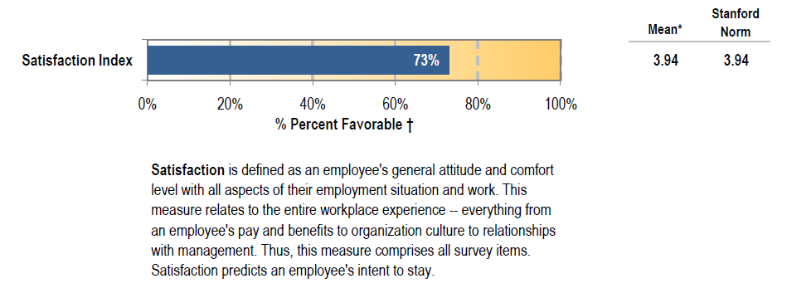
Overall Employee Satisfaction Rate: 73%
† Percent favorable = Total positive responses (“Strongly Agree,” “Agree”) divided by total valid responses.

Slide 36
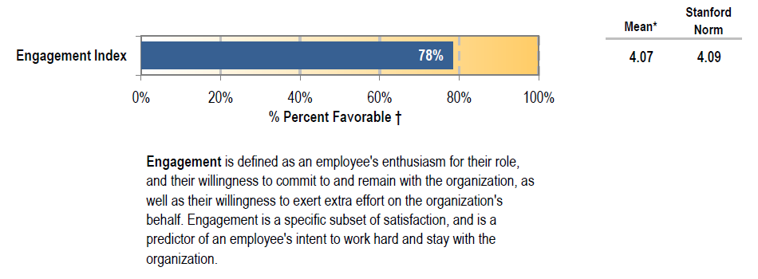
Overall Engagement Rate: 78%
† Percent favorable = Total positive responses (“Strongly Agree,” “Agree”) divided by total valid responses.

Slide 37
Strongest Dimension of Teamwork (tie)
Items in the Teamwork dimension:
I enjoy working with my co-workers.
My co-workers and I work well together as a team.
There is good cooperation between my team and others.
Teamwork is encouraged in my work group.

Slide 38
Strongest Dimension of Supervisory Consideration (tie)
Items in the Supervisory Consideration dimension:
My supervisor holds me accountable for my responsibilities.
When I face challenging situations at work, my supervisor supports me.
If I speak up, my supervisor will listen.
I know what is expected of me at work.
My supervisor distributes work appropriately.
My supervisor treats me fairly.
Notes:
Here are the individual rated items for Organizational Direction.

Slide 39
Weakest Dimension: Feedback and Coaching
Items in the Feedback and Coaching dimension:
My supervisor or someone at work coaches me on how to improve the way I do my job.
I regularly receive useful feedback about my work performance.
My last performance evaluation helped me understand my strengths.
My last performance evaluation helped me to improve.
Notes:
The weakest dimension was Feedback and Coaching. Here are the individual rated items within that dimension.

Slide 40
Strongest Rated Individual Items: ~ 90% or higher Favorable
Dimension | Item | % Favorable (scale of 0 to 100)
Organizational Direction | I genuinely care about my internal/external clients (such as students, staff, faculty, patients, parents, alumni). | 94%
Commitment | I plan to stay working at Stanford for more than one year. | 90%
Job Compatibility | The work I do is meaningful. | 90%
Supervisory Consideration | My supervisor holds me accountable for my responsibilities. | 92%
Commitment | I am proud to tell others that I work here. | 88%
Notes:
For the entire survey, these are the strongest five rated items out of the 53 total items. As a reminder, the rating scale was from 1 to 5, with 1 being low and 5 being high, and there was a Not Applicable choice. The dimension in which the item falls, and the mean score, is also listed.

Slide 41
Weakest Rated Individual Items: ~50% or lower Favorable
Dimension | Item | % Favorable (scale of 0 to 100)
Feedback and Coaching | My supervisor or someone at work coaches me on how to improve the way I do my job. | 51%
Change Management | When organizational changes occur, I understand the rationale for those changes. | 51%
Change Management | I am well informed in advance of organizational changes when they occur. | 49%
Professional Development | In the last year, I have been encouraged to advance my career. | 46%
Notes:
These are the five weakest items, each in a different dimension. Again, the rating scale was 1 is low, 5 is high, with a Not Applicable choice.

