Slide 1
Wants, Needs, and Addiction
Supplemental Slides

Slide 2
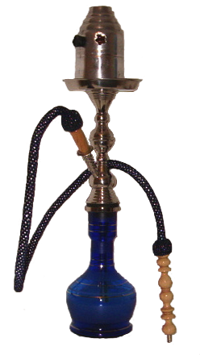
Is this a…want, need, or addiction?
tobaccopreventiontoolkit.stanford.edu
Notes:
List of items:
Water
Shopping
Cell phone
Email
Cigarette
Coffee
JUUL
Hookah
Social media
Injection

Slide 3
Want
noun
Definition of want
state or condition of not having any or enough of something
that is desired
tobaccopreventiontoolkit.stanford.edu

Slide 4
Need
noun
Definition of need
situation in which someone or something must do or have something
something that a person must have in order to live or succeed or be happy
strong feeling that you must have or do something
tobaccopreventiontoolkit.stanford.edu

Slide 5
Addiction
noun
Definition of addiction
compulsive need for and use of a habit-forming substance (as heroin, nicotine, or alcohol)
characterized by tolerance and by well-defined physiological symptoms upon withdrawal
persistent compulsive use of a substance known by the user to be harmful
tobaccopreventiontoolkit.stanford.edu

