Slide 1
A Little History to Set the Stage
© Stanford University
Notes:
Teacher Talking Points:
You are here to learn about e-cigarettes/vape pens, but it is also important to understand the history of the tobacco industry since many of the strategies being used by e-cigarette/vape pen manufacturers were those used, and are still being used, by cigarette companies.
New focus on increasing nicotine use with new and popular nicotine delivery devices, including e-cigarettes/vape pens.
Tobacco smoking causes around 480,000 deaths every year, yet people still decide to smoke.
In part, because the tobacco industry has become very good at hiding the risks of cigarette smoking.
Let’s take a look at the historical context and some of the tobacco industry’s tactics.

Slide 2
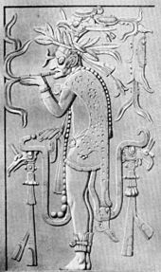
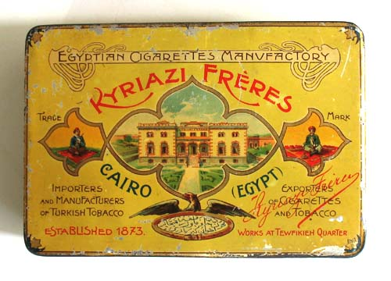
Cigarettes: From Past to Present
tobaccopreventiontoolkit.stanford.edu
Kyriazi Frères brand Egyptian cigarettes, 19th century
Reproduction of a carving depicting a Mayan priest smoking from a smoking tube
Notes:
Teacher Talking Points:
Cigarettes, tobacco leaves rolled in thin paper and smoked, have been around since the 9th century, originating in North, Central, and South America.
Cigarettes gained international popularity in the 1800s as global exploration began.
They became widespread in the 20th century.

Slide 3
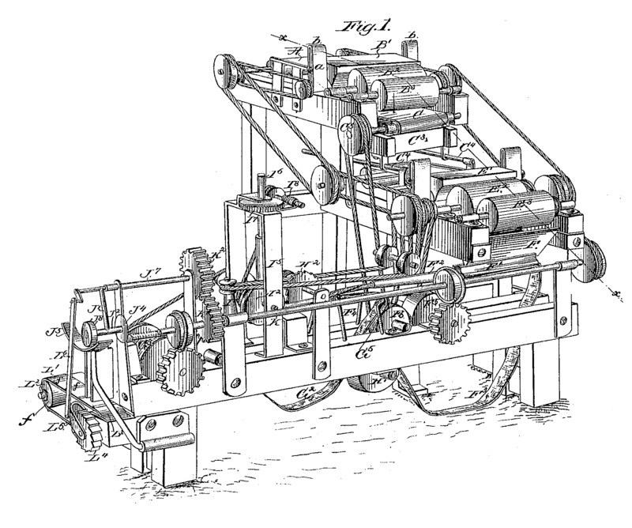
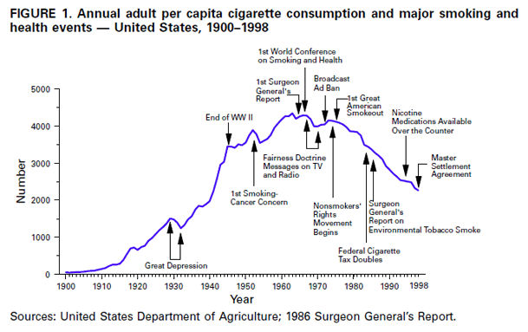
The Rise of the Tobacco Industry
tobaccopreventiontoolkit.stanford.edu
Image Credit: vox.com, www.cdc.gov
Notes:
Teacher Talking Points:
As tobacco became more common across the globe, new technology made cigarette production easier.
In the 1880s a cigarette making machine was invented, allowing the tobacco industry to begin and grow (left).
As production increased, so did consumption of cigarettes. In the U.S., cigarette use often fluctuated during major national events (right).

Slide 4
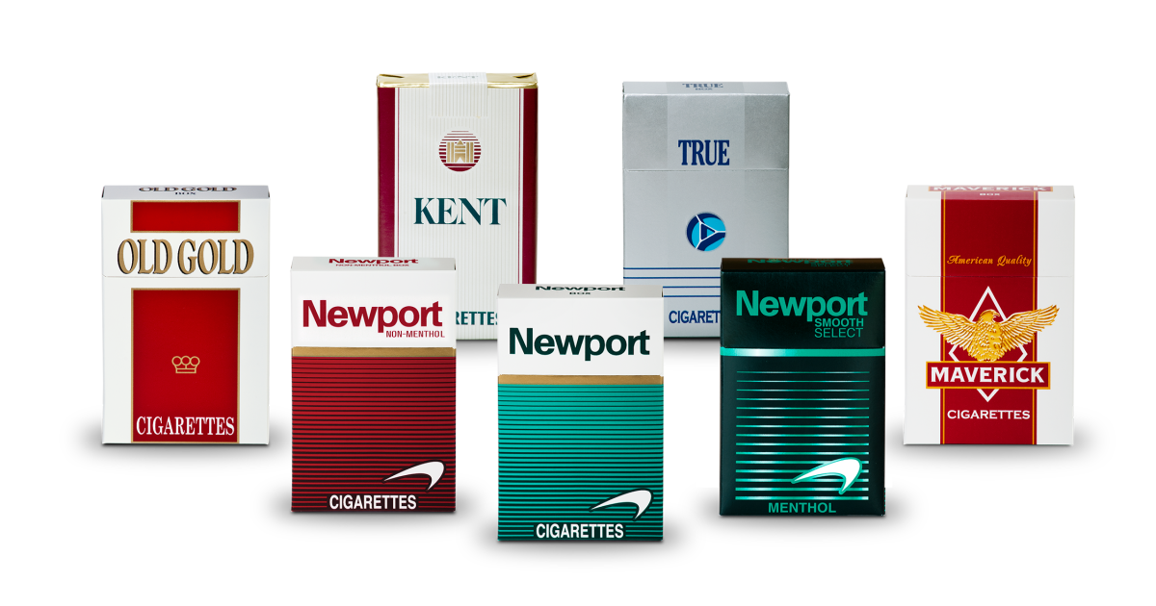
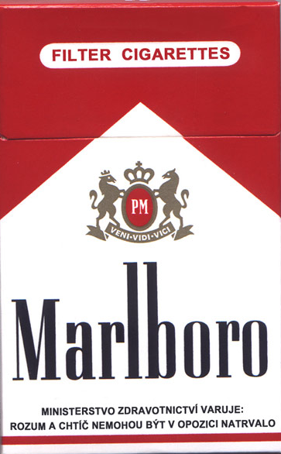
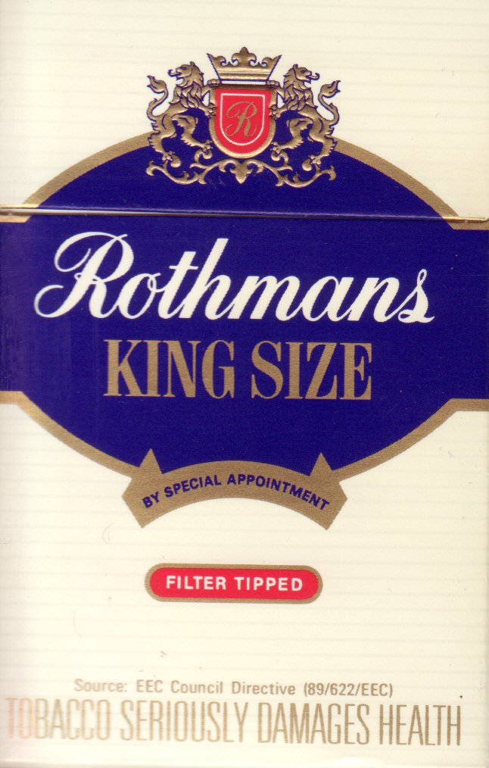
Making Customers: The Beginning of Big Tobacco
tobaccopreventiontoolkit.stanford.edu
Notes:
Teacher Talking Points:
Once cigarettes became easier to make, tobacco companies began to develop and expand on the cigarette market.
Many of these original companies are still around today.
These companies used advertising strategies to convince people to become their customers.

Slide 5
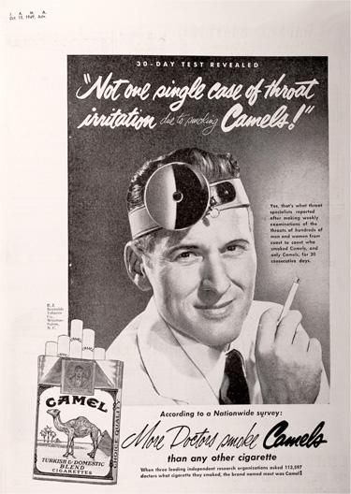
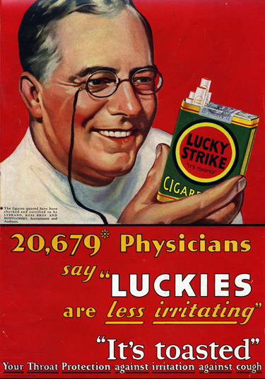
Doctor Recommended: It’s Good for You
tobaccopreventiontoolkit.stanford.edu
What do you notice about these ads?
Notes:
Teacher Talking Points:
“What do you notice about these ads?”
“Doctors” making strong claims about the lack of risk associated with cigarettes.
Figure 2 even cites a specific number of physicians who agree with the claim “Luckies are less irritating.”
Many tobacco companies tried to convince their customers that cigarettes were not only harmless, but good for your health!
“How believable are these ads to you?”
In reality, from the late 1920s to the 1930s, tobacco companies hired actors to play doctors and dentists to mislead the public.
Just like the “doctors” in these ads, the information about the cigarettes could be misleading or even completely made up.
Based on what you know about how tobacco affects health, where would you guess these “facts” came from?
Tobacco companies.
Most of our early research on tobacco wasn’t done by universities, hospitals, or the government.
It was actually done by the Tobacco Institute, which was funded by the tobacco industry.

Slide 6
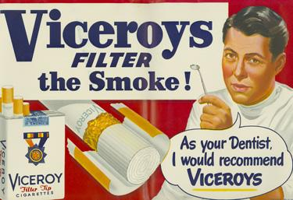
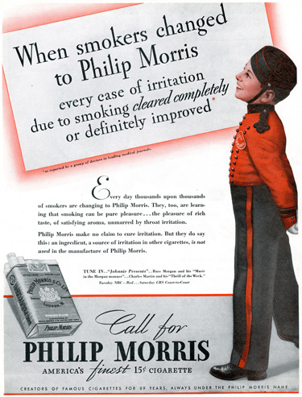
Ad Campaign Examples
tobaccopreventiontoolkit.stanford.edu
What are your thoughts about the messages here?
Notes:
Teacher Talking Points:
In the mid-1930s, a new advertising campaign for Philip Morris referred to research conducted by physicians.
In one ad, the company claimed that after prescribing Philip Morris brand cigarettes to patients with irritated throats, “every case of irritation cleared completely or definitely improved.”
After the launch of this series of advertisements, along with others referring to “proof” of superiority, Philip Morris became a major cigarette brand.
Is this example, and many others, misleading the public really paid off for tobacco companies
(Click) What are your thoughts about the messages here?

Slide 7
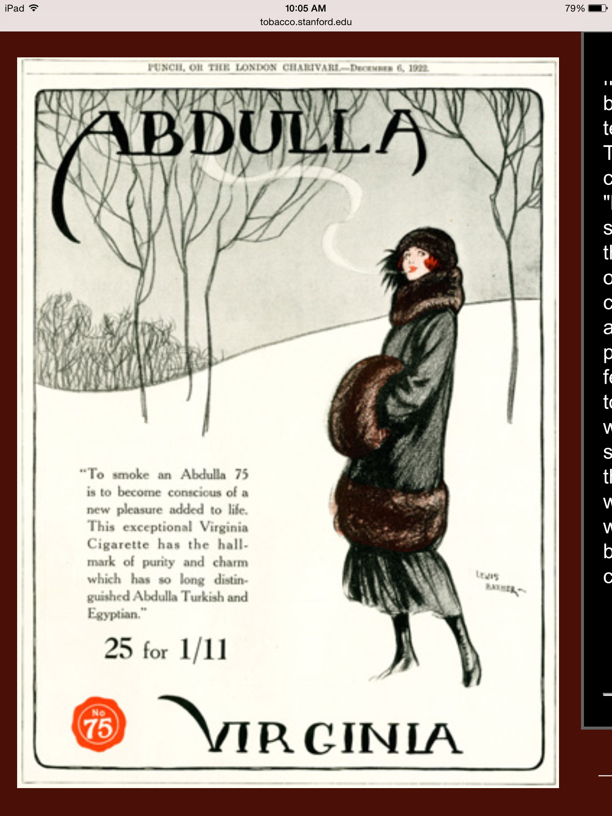
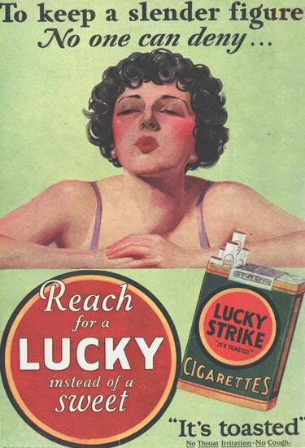
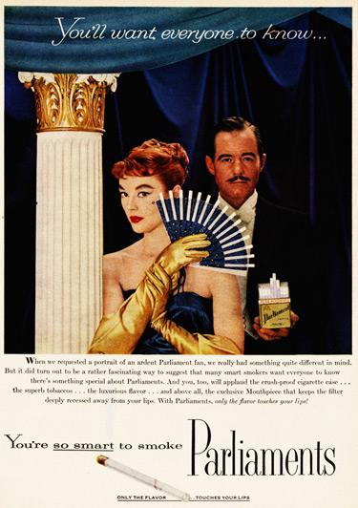
Skip a Sweet, Grab a Cigarette: Sexist Marketing
tobaccopreventiontoolkit.stanford.edu
Do you think ads like this would be effective today?
Notes:
Teacher Talking Points:
Early on in the history of cigarettes, it was considered “unladylike” to smoke in public until tobacco companies realized that marketing to women would get them new customers.
Women then became the focus of new ad campaigns. These campaigns often relied on sexist messages to convince women to smoke to be modern, fashionable, thin, and smart.
(Click) Do you think ads like this would be effective today?

Slide 8
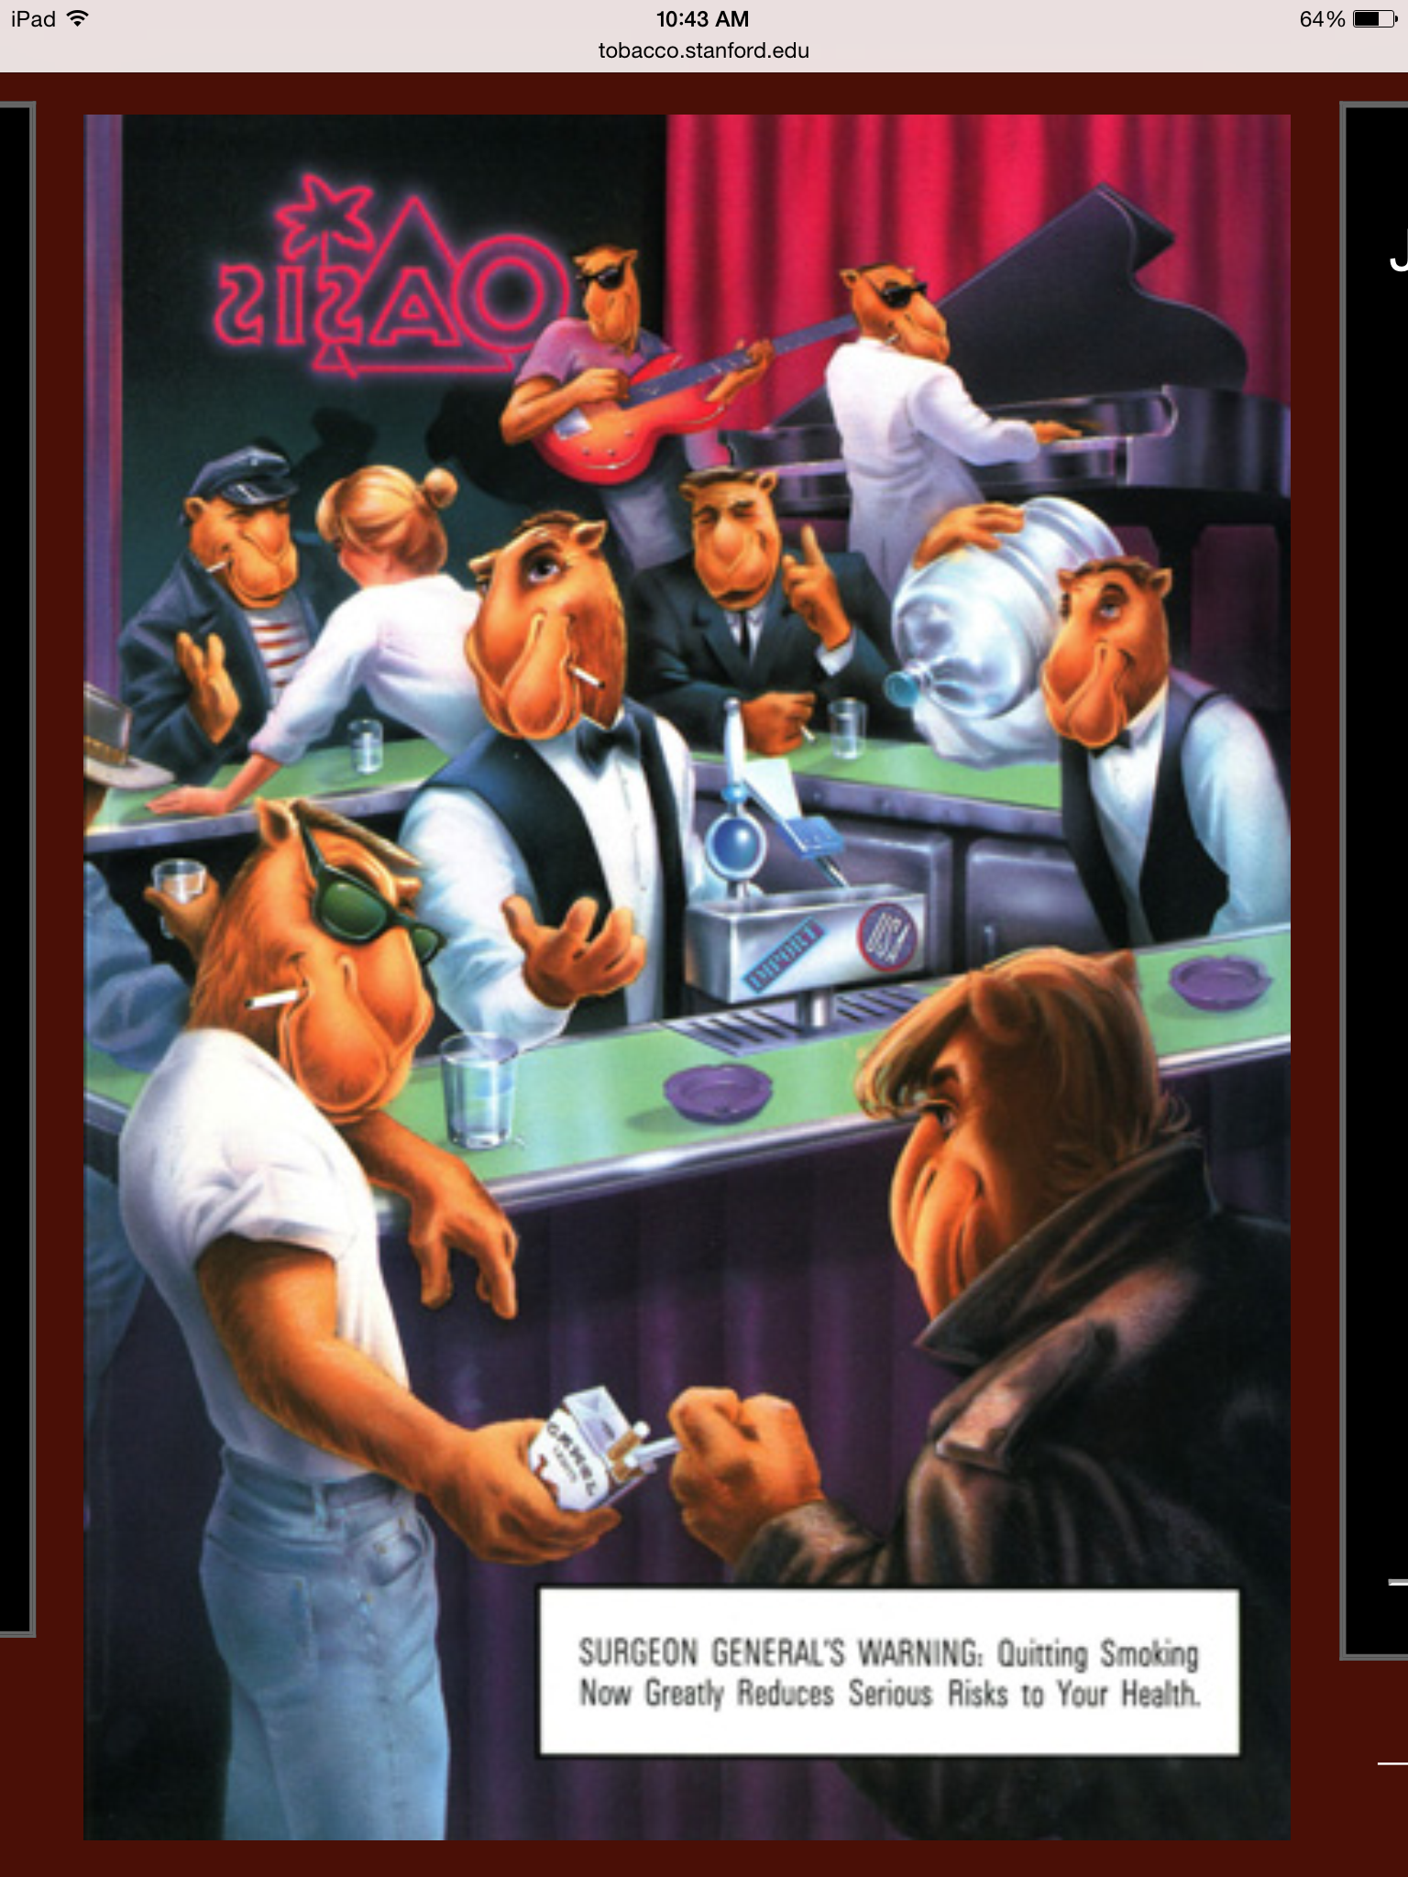
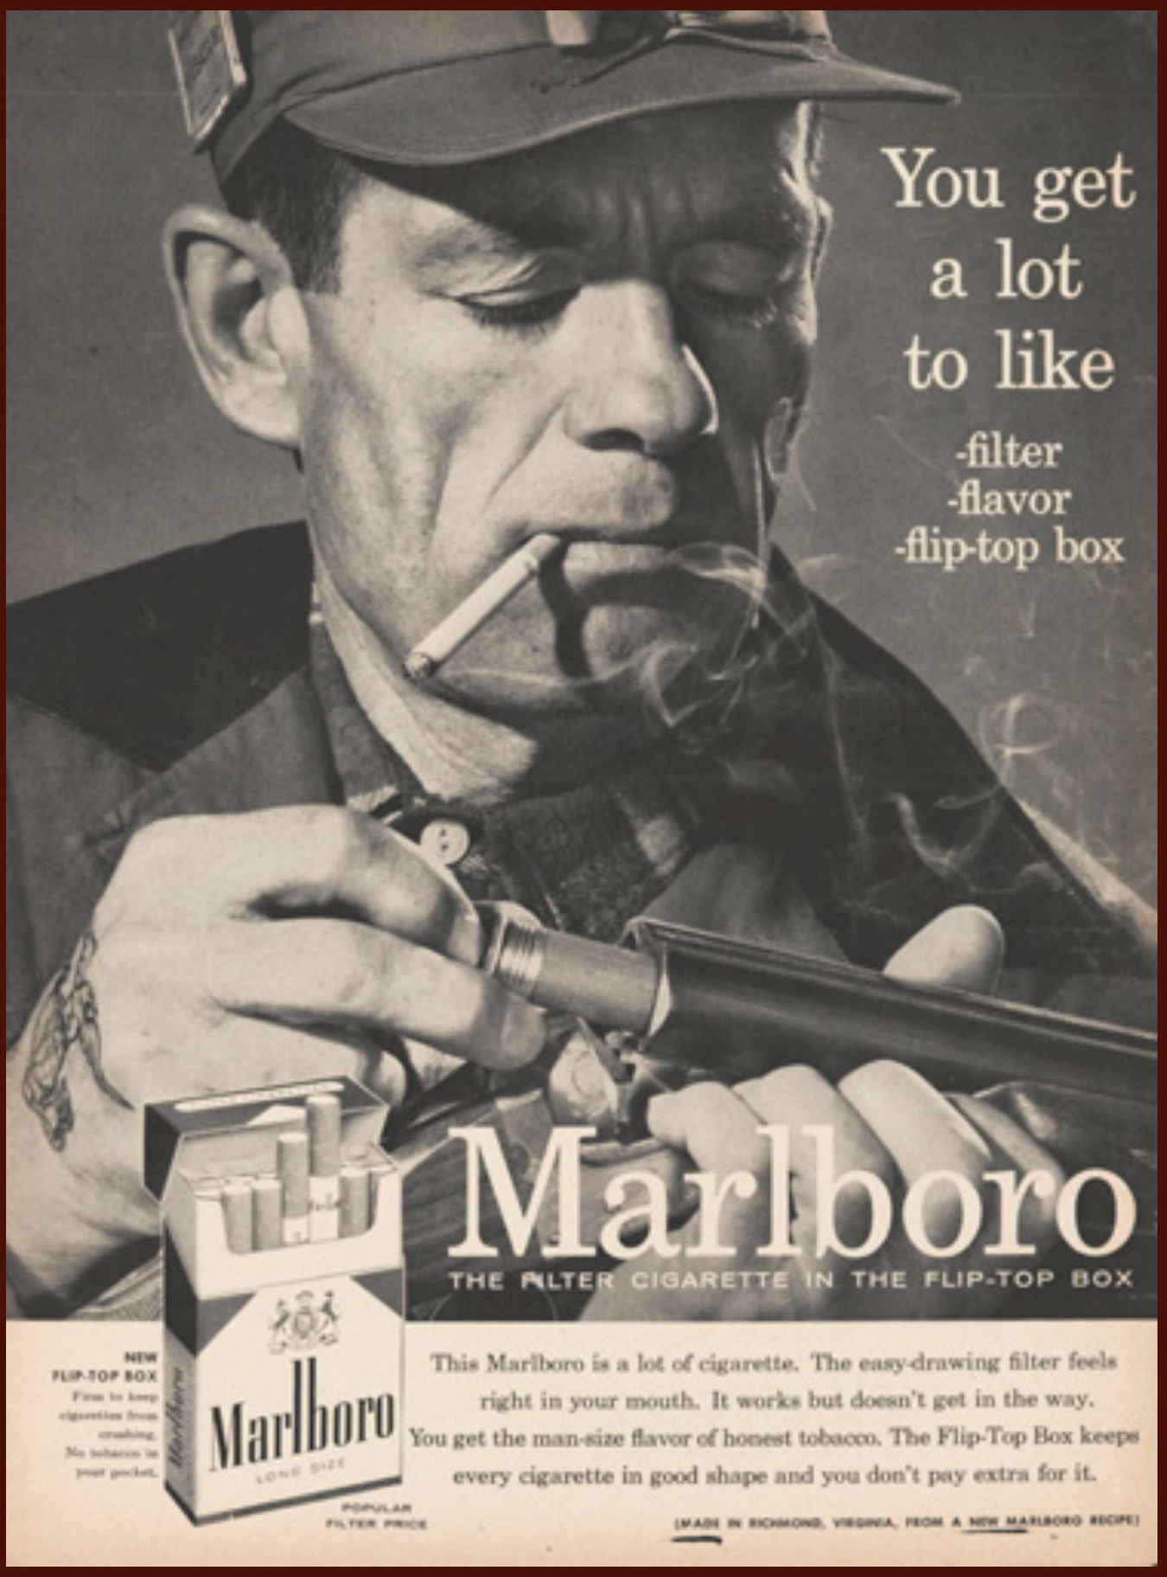
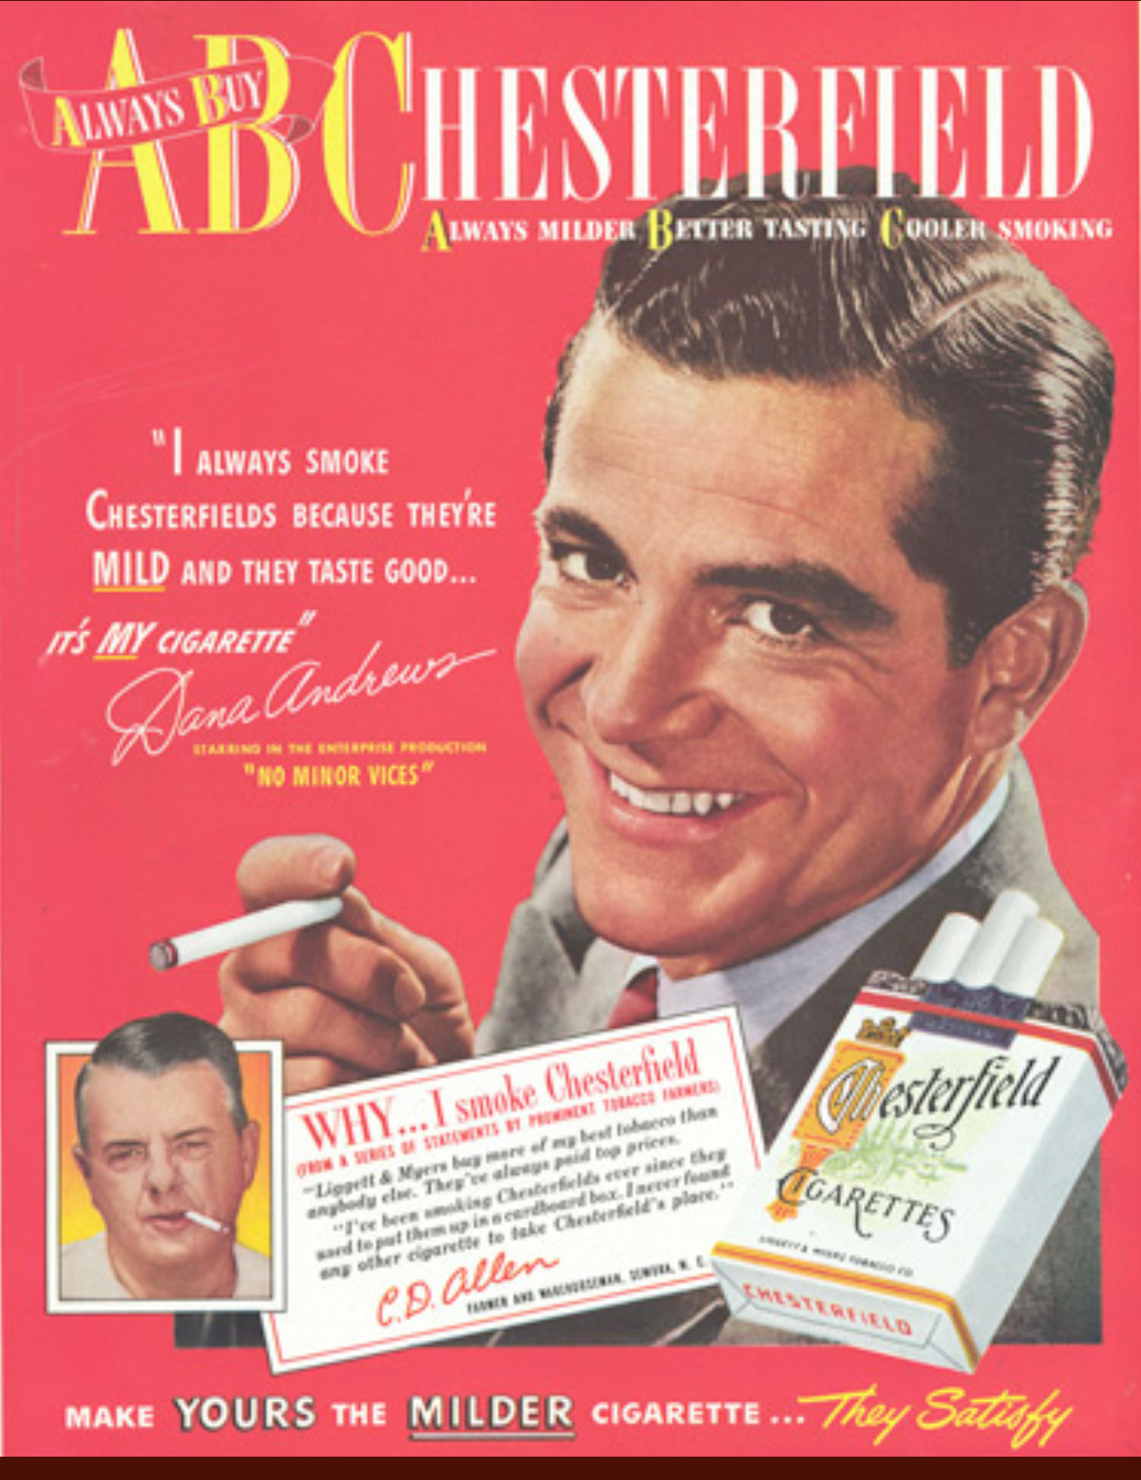
Make a Man Out of You
tobaccopreventiontoolkit.stanford.edu
Notes:
Teacher Talking Points:
Men were not spared from being targets of ad campaigns.
Numerous ad campaigns used hyper-masculine imagery to try and get the public to associate smoking with the “tough-guy” persona.
Well-known celebrities were even paid to endorse different tobacco brands to make them more appealing.
Men in cigarette ads were made to seem manly, cool, and attractive to women.

Slide 9
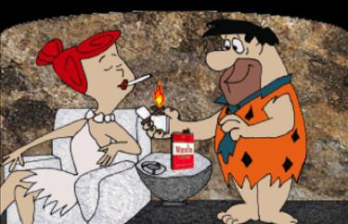
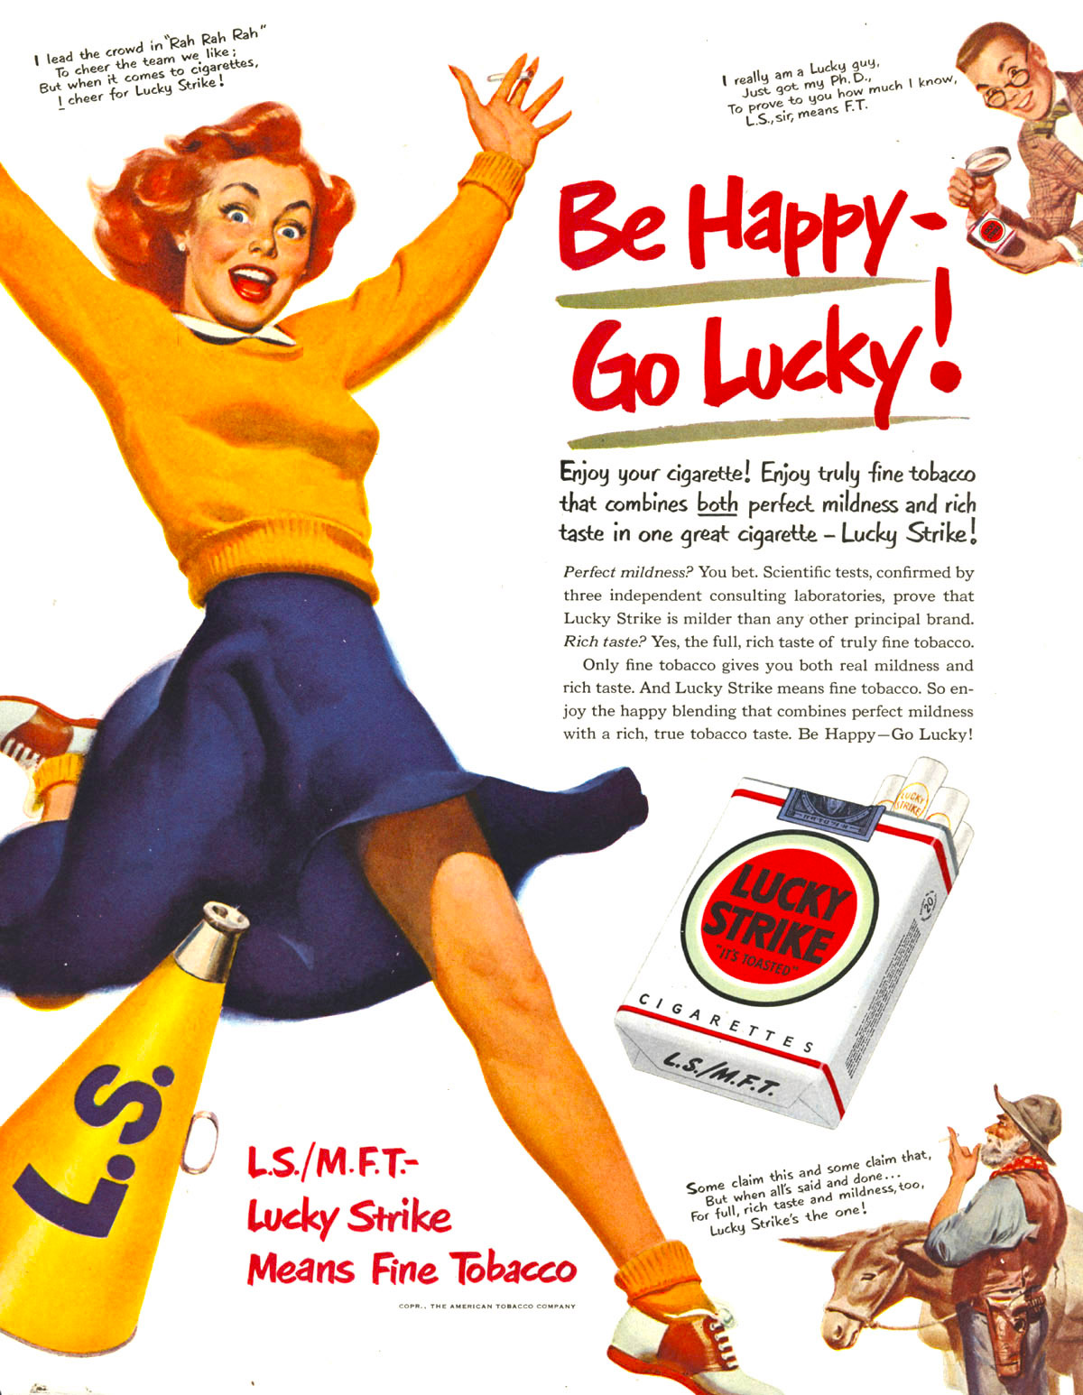
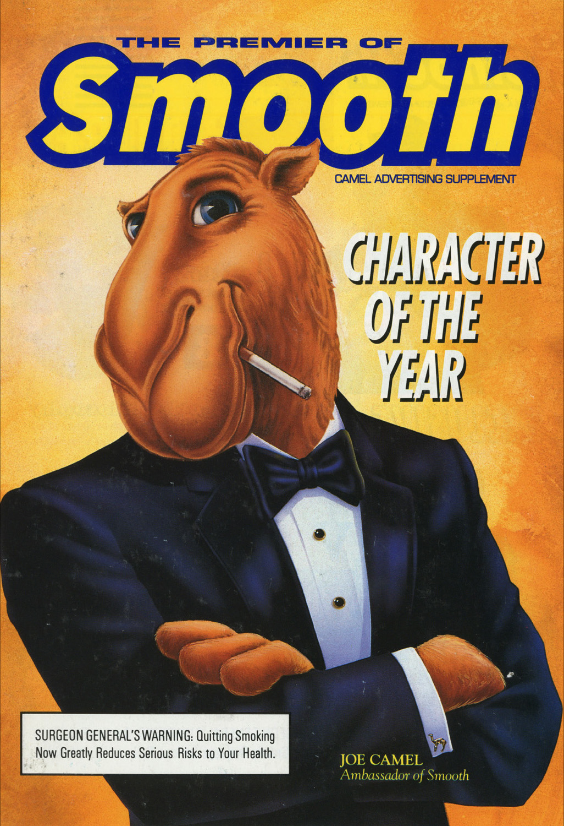
Catching Kids with Cartoons
tobaccopreventiontoolkit.stanford.edu
“Today’s teenager is tomorrow’s potential regular customer, and the overwhelming majority of smokers first begin to smoke while still in their teens.”
“The base of our business is the high school student.”
What do you think the industry’s message was in the cartoon and ads?
Who do you think found this cartoon and these ads the most appealing?
Notes:
Teacher Talking Points:
Let’s look at some examples of cigarette ads that may not be intended for adults only
(Click on the Flinstone image to follow link to view 50 sec clip of Flinstones Winston Commercial: https://vimeo.com/139530361)
What do you think the industry’s message was in the cartoon and ads? Who do you think found this cartoon and these ads the most appealing?
Most appealing to kids and teens
Trying to hook customers at a young age
Trying to have young people connect to their brands early in life
Let’s look at actual quotes from the tobacco industry.
(Click) "Today’s teenager is tomorrow’s potential regular customer, and the overwhelming majority of smokers first begin to smoke while still in their teens.”
"[T]he base of our business is the high school student.”
In fact, 88% of smokers are exposed to nicotine by the time they're 18 years old - -past that window, and they're way less likely to start smoking.
Tobacco companies know this and used their ads to find new customers.

Slide 10
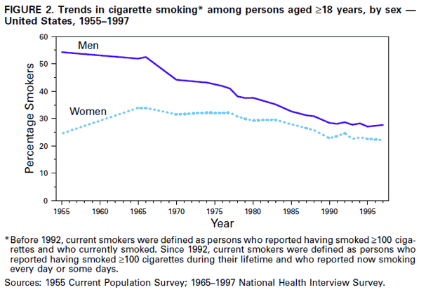
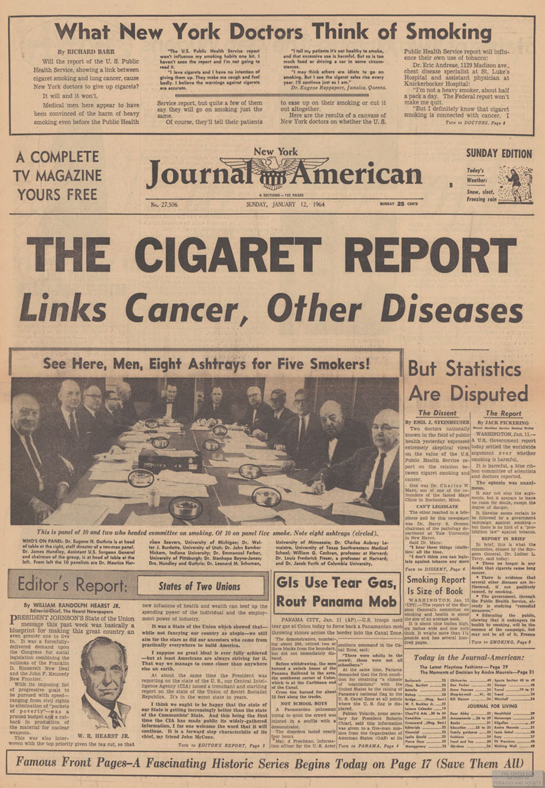
Tobacco Turning Point
tobaccopreventiontoolkit.stanford.edu
Why do you think this report had such a large impact?
Notes:
Teacher Talking Points:
Early tobacco advertising was really effective. Smoking became more and more common.
Smoking rates climbed until 1964, the year the Surgeon General published a report that explained many of the harmful effects of smoking.
Up until this point, the public suspected smoking may have been bad for your health and this groundbreaking report confirmed it.
After the release of the report, trends in smoking began to decrease.
(Click) Why do you think this report had such a large impact?
The report was impactful because the tobacco industry’s manipulation was exposed and accurate information from a trusted source was finally available to the public.
Sources: http://www.cdc.gov/tobacco/data_statistics/tables/trends/cig_smoking/
http://www.cdc.gov/mmwr/preview/mmwrhtml/mm4843a2.htm

Slide 11
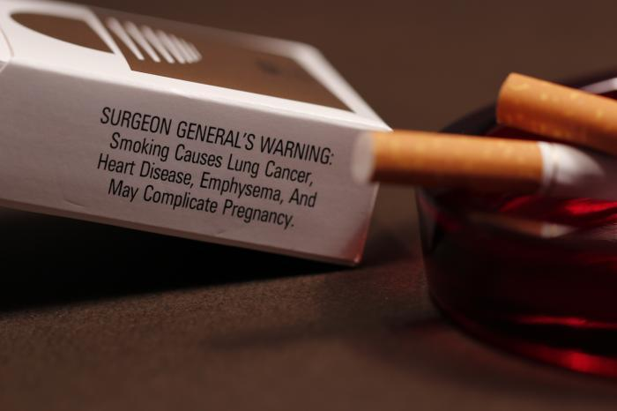
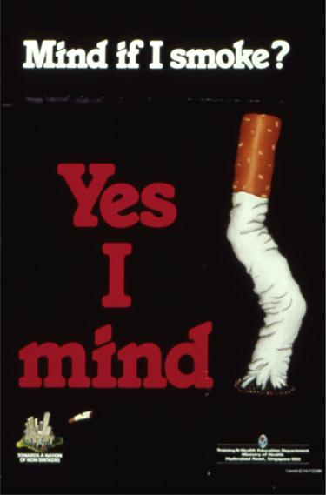
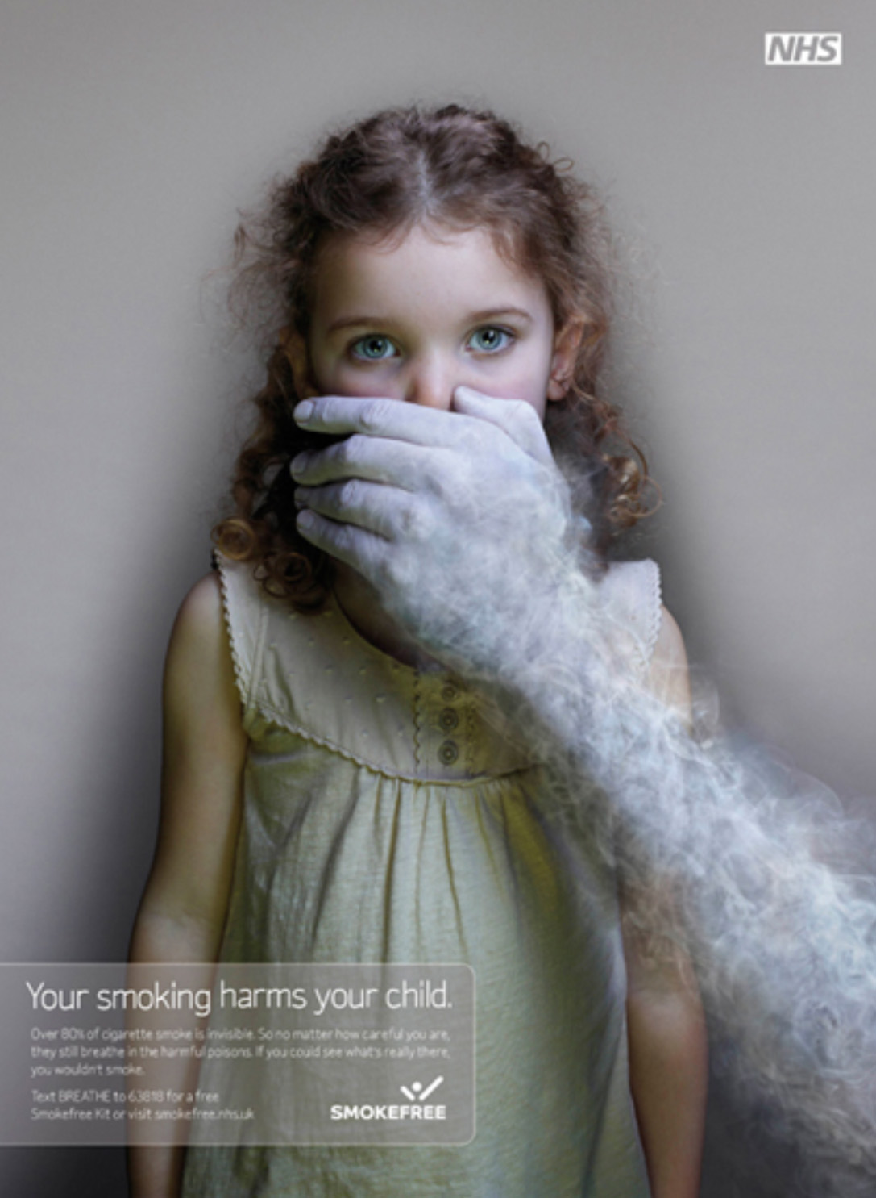
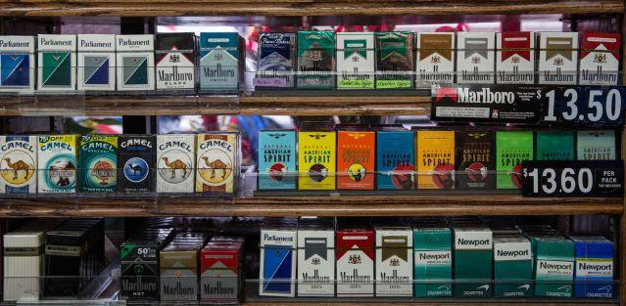
Tobacco Control
tobaccopreventiontoolkit.stanford.edu
Notes:
Teacher Talking Points:
The decline in smoking rates didn’t happen overnight.
Many public policies were put into place to discourage people from smoking.
In 1965 the Federal Cigarette Labeling and Advertising Act required large warning labels on cigarette cartoons.
In 1971, the Surgeon General proposed a smoking ban in public places.
In 1998, advertising targeted at young people was prohibited and higher taxes were placed on cigarettes to discourage use.
These kinds of policies helped to fight back against the big advertising push from large tobacco companies.

Slide 12
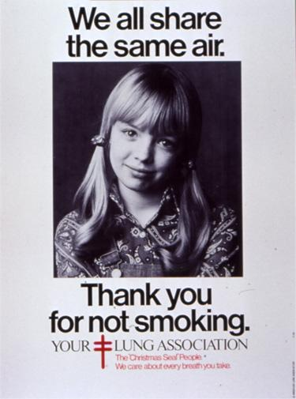
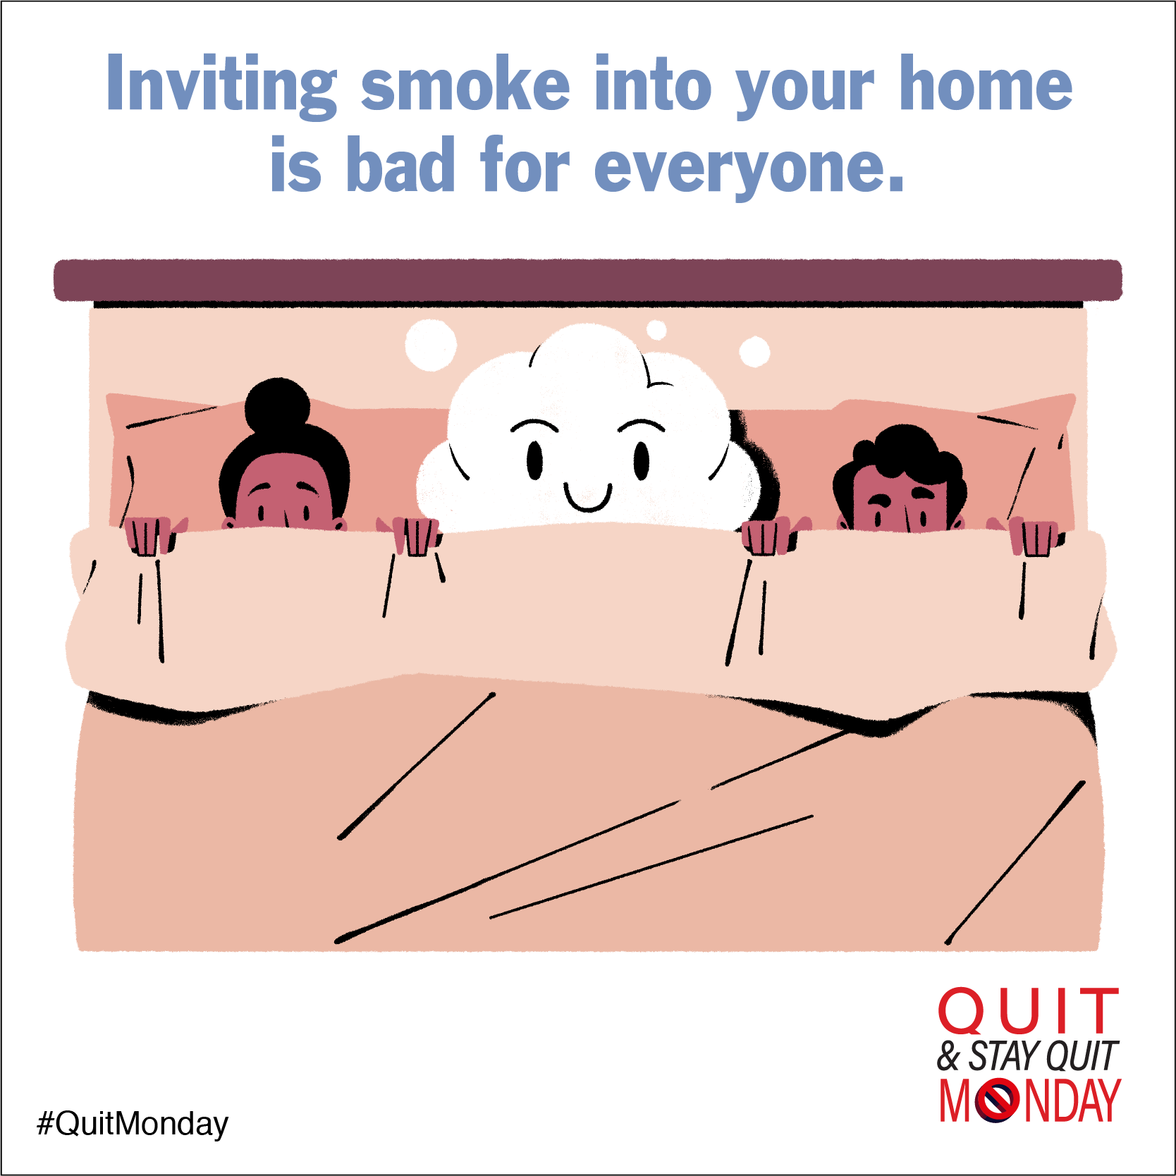
Secondhand Smoke
tobaccopreventiontoolkit.stanford.edu
Why do you think these types of messages are effective?
Notes:
Teacher Talking Points:
Tobacco Control Policies were put into place, not only to encourage people who smoked to quit, but also to protect those who do not smoke.
The truth about the dangers of secondhand smoke became more well-known because of ads like these.
Secondhand smoke is smoke that is exhaled or comes from tobacco burning products.
This smoke can cause danger for anyone who inhales this smoke, even if they are not the ones smoking.
Even pets can be harmed from secondhand smoke.
Since 1964, about 2,500,000 nonsmokers have died from health problems caused by exposure to secondhand smoke, and many others face asthma and heart attacks.
(Click) Why do you think these types of messages are effective?

Slide 13
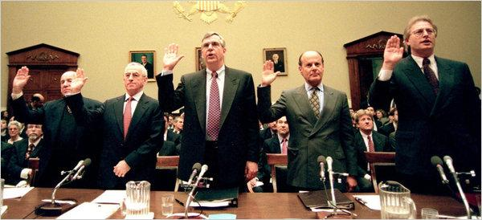
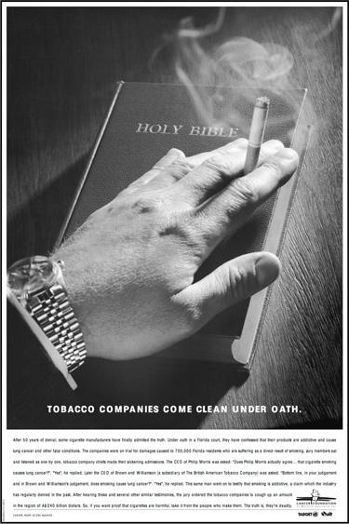
RICO Case
tobaccopreventiontoolkit.stanford.edu
From left, Laurence Tisch, of Loews; Geoffrey Bible, Philip Morris; Vincent Gierer, UST; Steven Goldstone, RJR Nabisco; and Nicholas Brooks, Brown & Williamson, at a 1998 House hearing. Credit Jessica Persson/Agence France-Presse
Do you think it was fair to treat tobacco executives like mob bosses? Why or why not?
Notes:
Teacher Talking Points:
In 1999, the U.S. Department of Justice filed suit against the cigarette companies for violating civil provisions of the Racketeer Influenced and Corrupt Organizations Act (RICO) and other laws.
This same law was used in the 1970s to prosecute the Mafia and others who engaged in organized crime.
In 2006, US District Court Judge Gladys Kessler convicted the big cigarette companies and their trade and scientific groups of forming an illegal racketeering "enterprise" to defraud the American people.
The court ordered the cigarette companies to publish "corrective statements" telling the public that they had lied about the dangers of smoking, secondhand smoke, and nicotine addiction.
The court also prohibited them from challenging the evidence that these statements are true, which is why the companies no longer do so (https://tobacco.ucsf.edu/step-forward-implementing-rico-ruling-against-big-tobacco).
Judge Kessler stated "The evidence in this case clearly establishes that Defendants have not ceased engaging in unlawful activity ... Their continuing conduct misleads consumers in order to maximize Defendants revenues by recruiting new smokers (the majority of whom are under the age of 18), preventing current smokers from quitting, and thereby sustaining the industry" (pages 1604-1605 of the opinion).
Do you think it was fair to treat tobacco executives like mob bosses? Why or why not?
Source: http://www.nytimes.com/2011/01/31/business/31tobacco.html?_r=0

Slide 14
Then and Now
tobaccopreventiontoolkit.stanford.edu
Notes:
Teacher Talking Points:
This may seem like ancient history but, as you may have noticed, tobacco companies aren’t the type to give up easily.
Tobacco Industry has created new marketing techniques to bring in new cigarette smoking customers.
And the Industry has developed new products and advertised them using their old ad techniques.
In our following lessons and activities, we will explore the new and recycled strategies that are being used by tobacco companies today.

