Slide 1

What’s So Bad About E-Cigarettes and Vape Pens?
© Stanford University

Slide 2
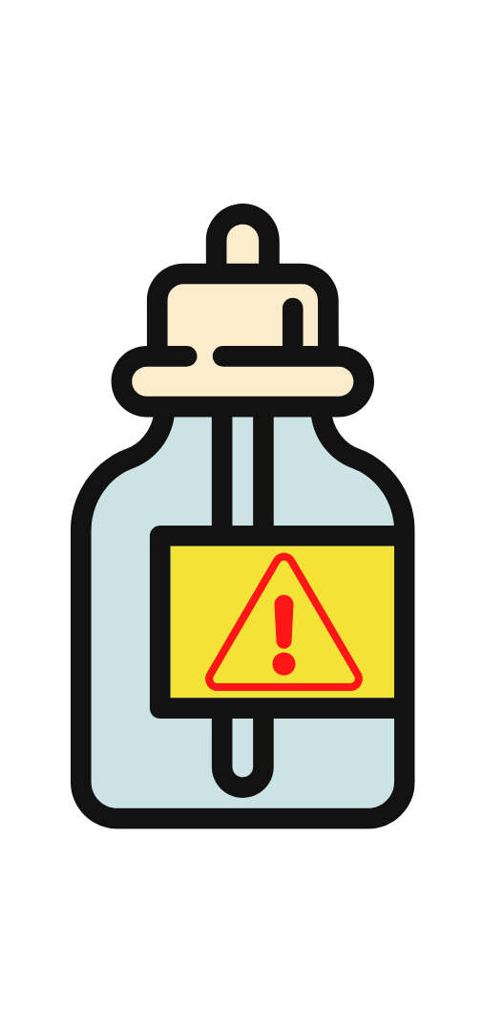
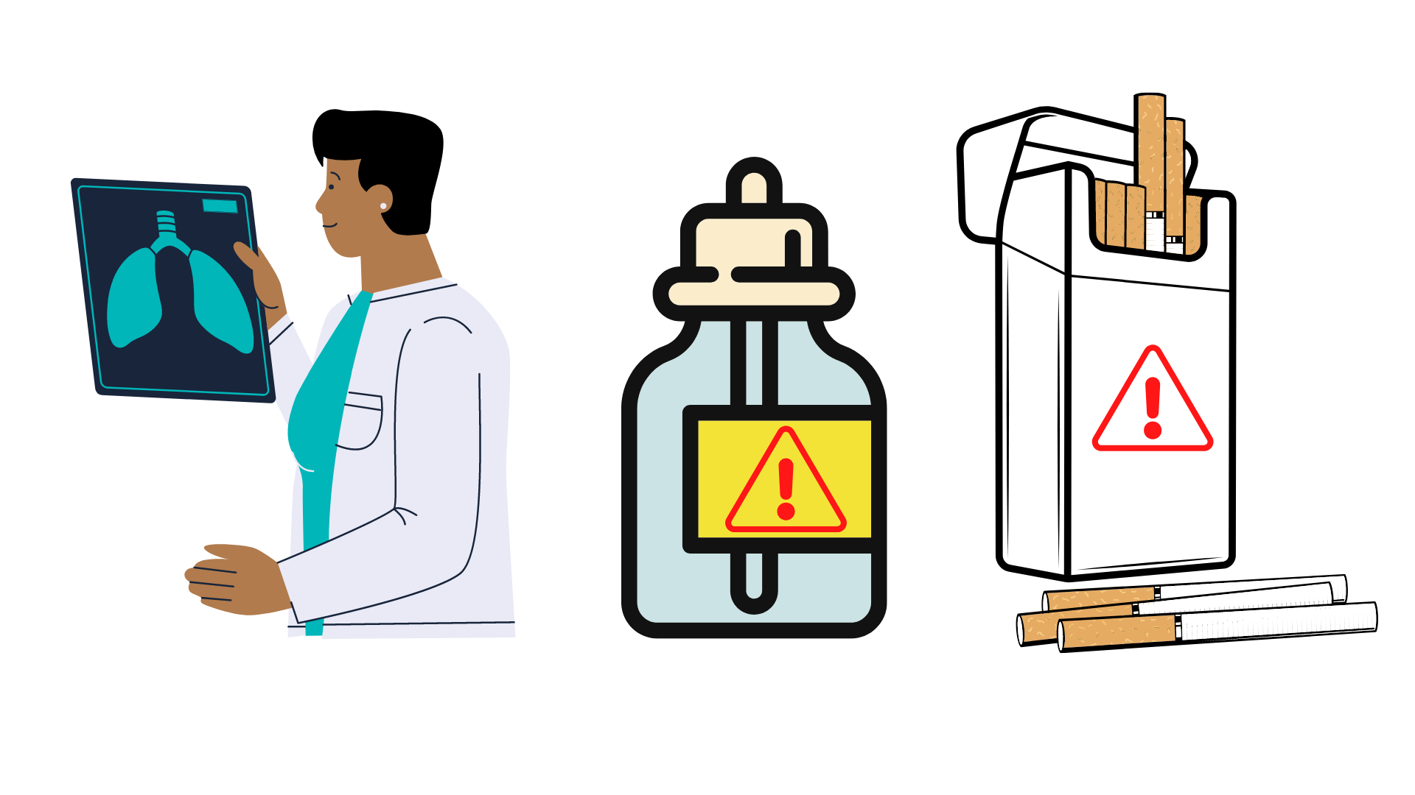
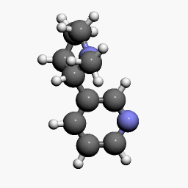
Effects of Nicotine
tobaccopreventiontoolkit.stanford.edu
Notes:
Teacher Talking Points:
Let’s start with talking about the specific effects of nicotine.

Slide 3
Pop Pre-Quiz
tobaccopreventiontoolkit.stanford.edu
Notes:
Teacher Talking Points:
You have probably heard of nicotine before, let’s see if you can answer a few questions about it.
(Click on the Image to follow the link to the online quiz)
www.Tinyurl.com/TPT-Nicotine-Addiction
1. Nicotine is: A) A drug, B) Not in E-Cigs/Vapes, C) Not addictive in small amounts
2. How addictive is nicotine? A) Not addictive at all B) Only addictive in large amounts C) Extremely Addictive
3. Who is most at risk for nicotine addiction? A) Young people B) Adult ages 30-55 C) Elderly adults 75-90
4. You have to use nicotine products daily to become addicted. A) True, B) False

Slide 4
Nicotine Molecule
What is Nicotine?
tobaccopreventiontoolkit.stanford.edu
Drug
Stimulant
Highly addictive
Causes changes in brain chemistry
Found in tobacco products
If nicotine is unsafe, why do you think people still choose to use products that have nicotine?
Notes:
Teacher Talking Points:
Nicotine is a drug that is a stimulant, meaning it raises levels of physical or psychological activity in the body, and it is toxic at high doses.
It is highly addictive since it causes changes in brain chemistry quickly and leaves the brain craving more.
Nicotine is found in tobacco products and nicotine exposure during fetal development has lasting adverse consequences for brain development as it can affect maternal and fetal health during pregnancy.
Data from studies of mice suggest that nicotine exposure during adolescence may have lasting adverse effects on brain development.
(Click) If nicotine is unsafe, why do you think people still choose to use products that have nicotine?

Slide 5

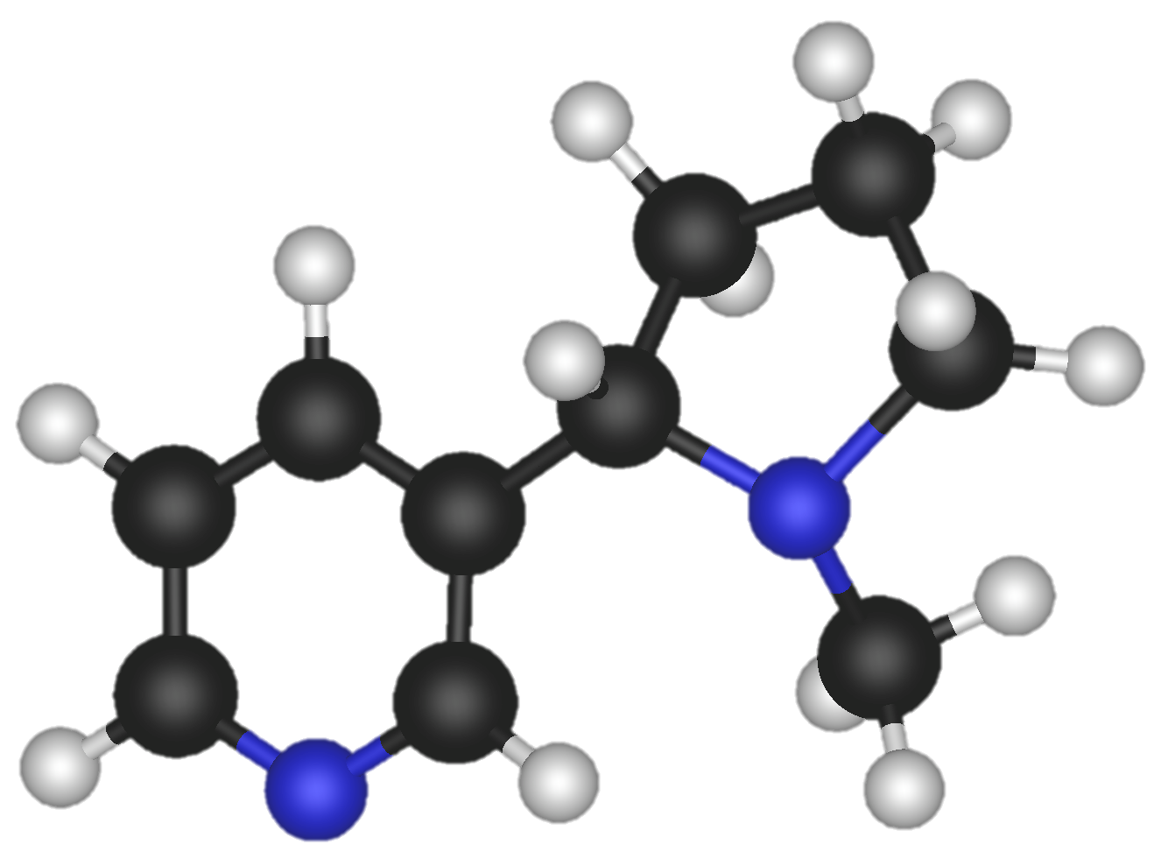
Nicotine in the Brain
tobaccopreventiontoolkit.stanford.edu
Notes:
Teacher Talking Points:
The reaction that nicotine has in the brain results in the stimulation of pleasure centers in the brain.
(Click) When inhaled, nicotine enters into the brain after passing through the lungs.
Then It binds to pleasure receptors in the brain.
(Click) That causes a release of pleasure chemicals such as dopamine, providing the user with a temporary feeling of pleasure.

Slide 6

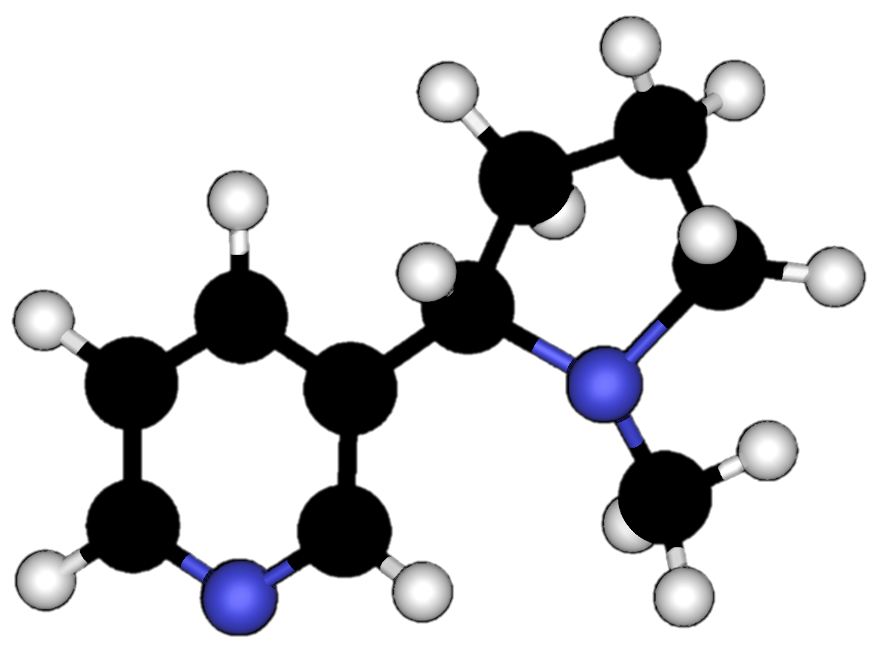
Nicotine Addiction
tobaccopreventiontoolkit.stanford.edu
Notes:
Teacher Talking Points:
This might not sound dangerous but in reality, the nicotine interferes with the body’s natural ability to experience/communicate pleasure.
Nicotine use creates floods of dopamine and intense feelings.
The pleasure centers in the brain adapts to drug use by sensing the extra dopamine and then begins to produce less of it.
This means that the user has a hard time creating natural feelings of pleasure without nicotine.
The user needs the nicotine just to feel normal.
Additionally, the pleasure centers in the brain creates a memory of nicotine and an appetite for it.
That appetite for nicotine, even despite its harmful consequences, is what we refer to as nicotine addiction.

Slide 7
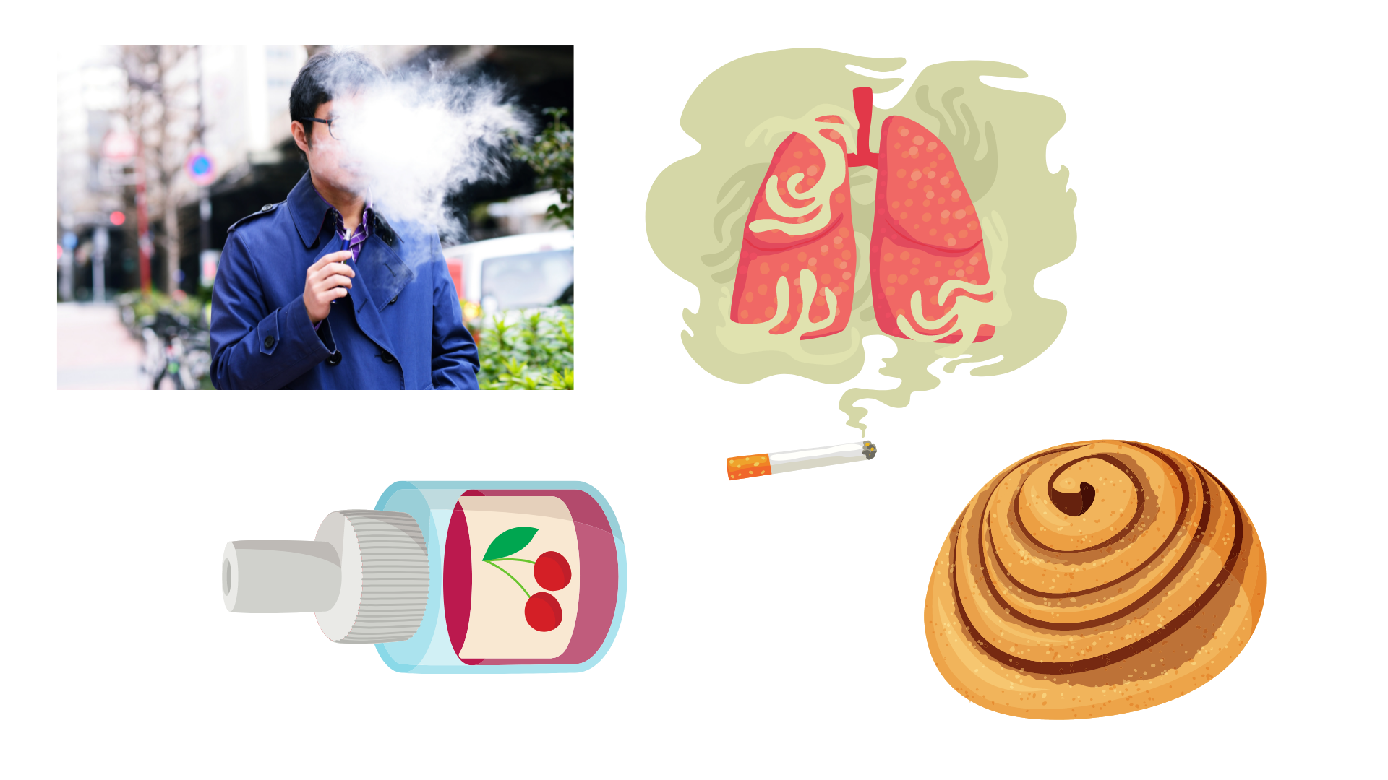
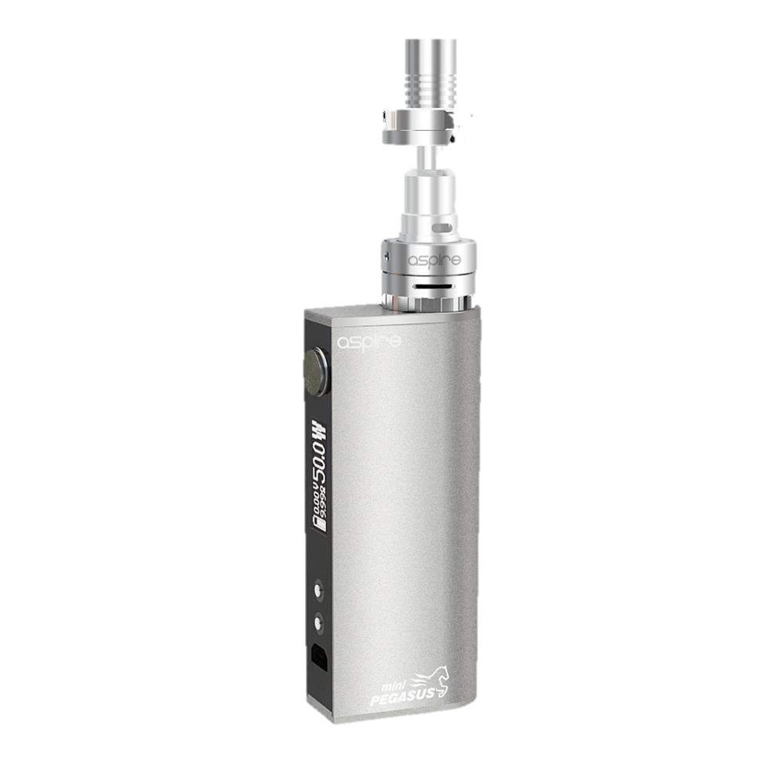
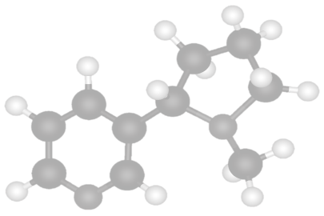
Cycle of Nicotine Addiction
tobaccopreventiontoolkit.stanford.edu
Notes:
Teacher Talking Points:
Nicotine is highly addictive. What that means is, the human brain can develop such a strong dependence on the drug that the nicotine user can no longer control their desire or smoking behaviors.
(Click) The cycle of nicotine addiction starts with bringing nicotine into the body. In this case it comes inhalation of cigarettes, hookah, and or e-cigs/vapes.
(Click) Nicotine enters the brain and activates the pleasure centers of the brain.
(Click) After, the level of nicotine in the body drops quickly.
(Click) This drop in nicotine levels causes the body to have a strong craving for nicotine that is satisfied by bringing more nicotine into the body.
This cycle is powered by the body’s biological reaction to nicotine and isn’t controlled by the person vaping.
Based on this information, what could you say to someone who says they won’t let themselves get addicted to nicotine?

Slide 8


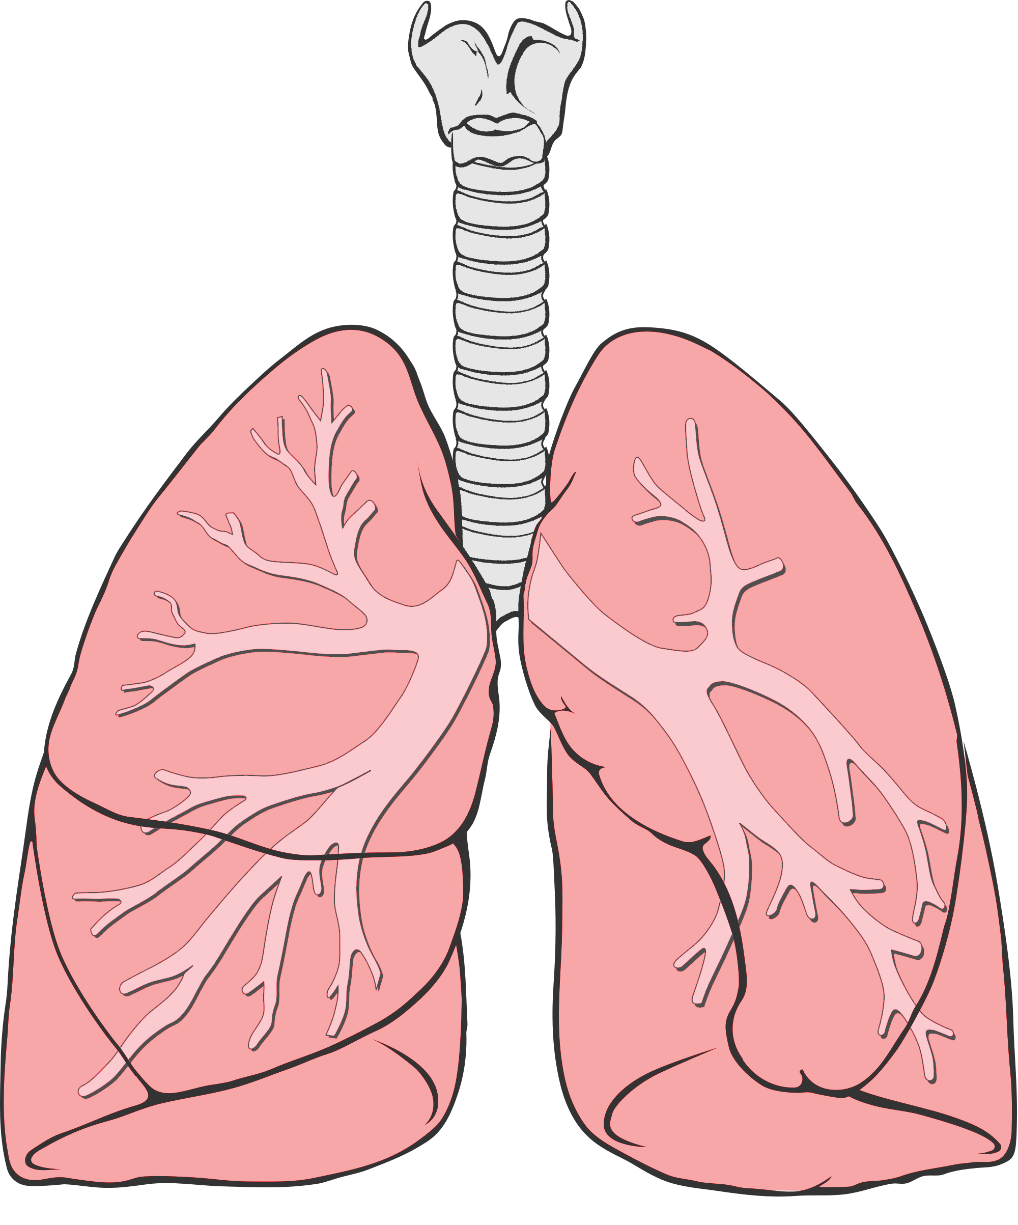
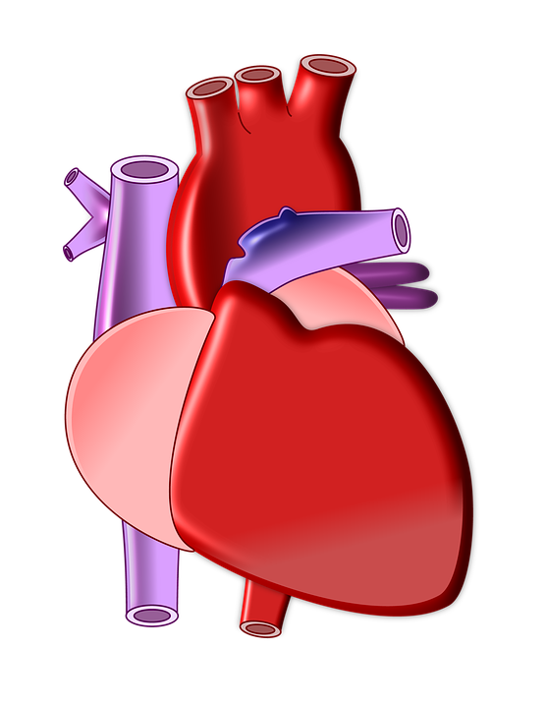
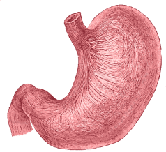
Nicotine Targets Your Whole Body
tobaccopreventiontoolkit.stanford.edu
Rewire and changes the brain
Heart beats faster due to ”fight or flight” response
Trouble breathing and damage to the lungs
Increased acid reflux
Notes:
Teacher Talking Points:
(Click) Nicotine rewires and changes a young person’s brain, making a person anxious when their brain is going through nicotine withdrawal. Nicotine doesn’t just affect your brain since there are “acetylcholine” receptors all over your body.
(Click) For example, using nicotine can make your heartbeat faster because it activates your “fight or flight response.”
Nicotine salt solutions in particular produce a faster and higher heart rate than other aerosolized nicotine solutions, which can put stress on the heart.
(Click) Outside of all the chemicals and toxins already in e-cigarettes, nicotine can independently cause trouble breathing and damage to the lungs. The lungs generally produce mucus and cough in response to the harmful chemicals inhaled.
(Click) Nicotine can also cause increased acid reflux, which leads to heartburn.
Last by not least, nicotine can even negatively impact your reproductive organs.
Reference:
http://www.ncbi.nlm.nih.gov/pmc/articles/PMC4363846/#ref1
https://patents.google.com/patent/CA2909967A1/en
Image Credit:
Pixabay.com, Deviantart.com, Wikimedia Commons

Slide 9

Effects of Flavors
tobaccopreventiontoolkit.stanford.edu

Slide 10


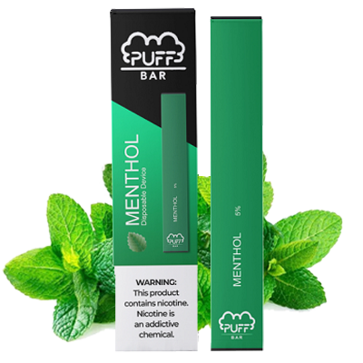
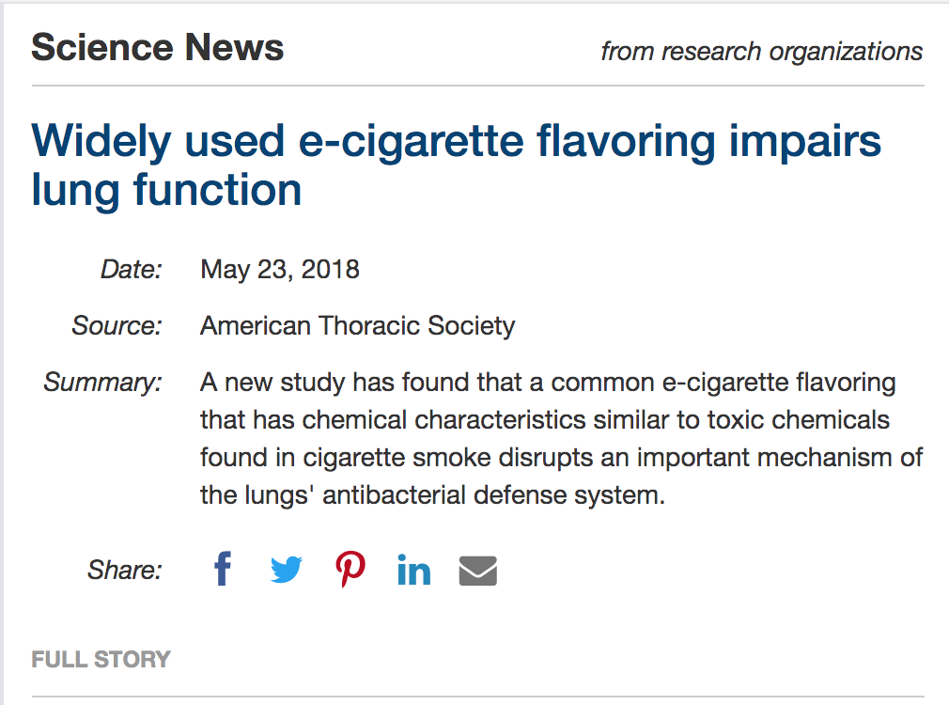



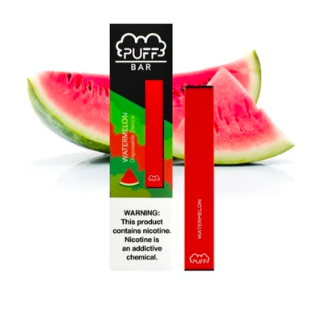


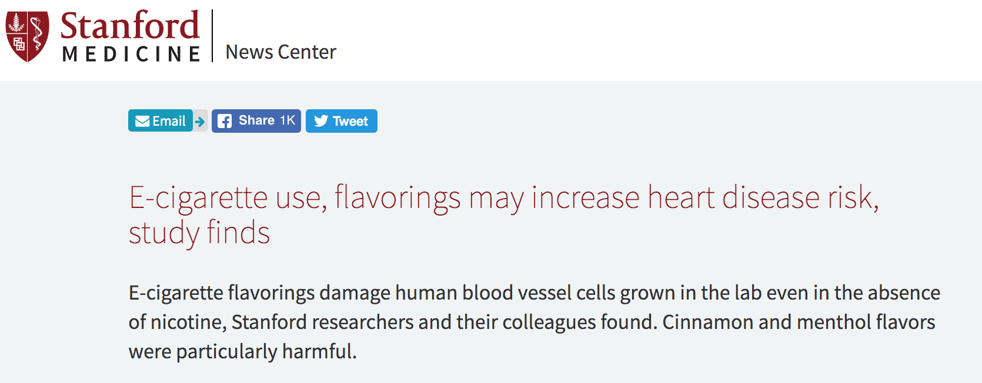

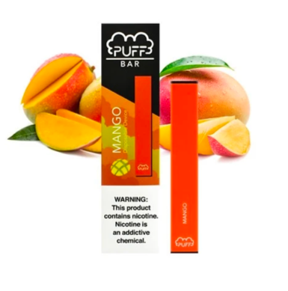


Why Flavors?
tobaccopreventiontoolkit.stanford.edu
Notes:
Teacher Talking Points:
Earlier we discussed how pod-based companies have fruity and sweet flavor pods along with colors.
(Click) Why would there be over 15,500 e-juice flavor options such as Banana Butt and Honey Doo Doo?
It’s important to be aware that this is another example of the pod-based companies following well-known advertising strategies from Big Tobacco’s playbook.
They know that flavors are a great way to attract young costumers because they are the group most interested in sweet flavors and bright colors.
This tactic is so effective that flavored cigarettes have been banned since 2009, since extensive research shows that they are more appealing to young people. The pod-based companies along with other e-cigarettes have yet to be regulated in this way.
(Click) More and more evidence is piling, proving that these flavors are dangerous in and of themselves.
(Click) So far we know that flavors can impair lung function and increase risk for heart disease.
But pod-based companies continue to use them because they know it makes their products seem appealing and safe to teens.
Reference:
https://www.flavorshookkids.org/
http://www.onlinejacc.org/content/73/21/2722
https://www.sciencedaily.com/releases/2018/05/180523172310.htm
Images:
http://www.liherald.com/rockvillecentre/stories/rockville-centre-coalition-for-youth-persists-to-stop-flavored-juul-sales,114268
https://thepodgod.shop/collections/puff-bars?page=1
https://thepodgod.shop/collections/puff-bars?page=2

Slide 11

Cytotoxic Flavors
tobaccopreventiontoolkit.stanford.edu
Cinnamon flavors may contain:
Cinnamaldehyde, 2-Methoxycinnamaldehyde
Cherry flavors may contain:
Benzaldehyde
Notes:
Teacher Talking Points:
When a chemical is cytotoxic it means that the chemical to toxic to living cells in your body.
Various cinnamon flavors contain cytotoxic compounds.
The cherry flavor, benzaldehyde, is cytotoxic as well.

Slide 12
Effects on Health
tobaccopreventiontoolkit.stanford.edu
Notes:
Teacher Talking Points:
Along with the harms from nicotine on its own, we know there are other health risks from these products.

Slide 13
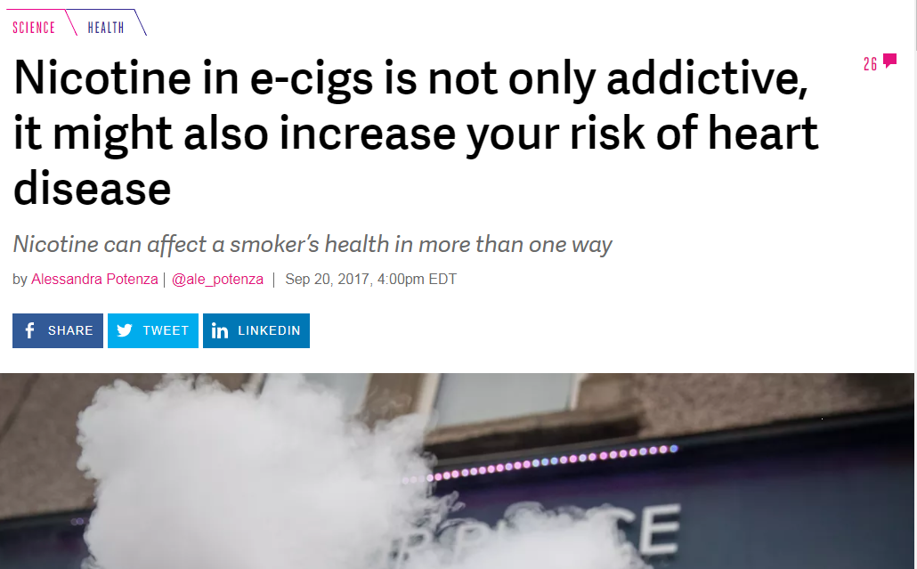






News Headlines of Health Effects
tobaccopreventiontoolkit.stanford.edu
Notes:
Teacher Talking Points:
(Click) The e-cigarette aerosol enters the lungs and leaves chemical residue behind. The lungs cannot break down these chemicals, so they damage air pathways and the air sacs that bring oxygen into the body. Over time this can increase the risk of lung disease.
(Click) The aerosol has also been shown to damage specific parts of your circulatory system or blood network, increasing your risk for heart disease.
(Click) Ear, eye and throat irritation is common among e-cigarette/vape pen users.
(Click) Scientists are still studying how these aerosol chemicals impact the brain.
(Click) We are only beginning to understand the long-term health effects of using e-cigarettes. It took over 25 years to see the long-term health impacts from smoking tobacco cigarettes because the damage done on the body isn’t always noticeable right away.
Every chemical found in an e-cigarette aerosol has not been studied in detail yet. Researchers have identified harmful substances in the aerosol, some even known to cause cancer.
We wish we could tell you all the ways that e-cigarettes are harmful, but the truth is we can’t. Since they are so new and researchers can’t fast forward into the future, all of the long-term consequences of these products are impossible to predict.
Taking that into consideration, how is the e-cigarette industry using your generation as test subjects?
Possible answers: 1. the companies don’t even know the long-term effects of their products, but are still selling them, 2. the companies market these products as a healthier alternative, even though they don’t have the science to prove it, 3. they have created e-cigarettes with higher levels of nicotine than any other tobacco/nicotine products.
Sources:
https://www.theverge.com/2017/9/20/16338902/e-cigs-vaping-nicotine-heart-disease-health-risk
https://medicalxpress.com/news/2018-08-e-cigarettes-dna.html
https://www.ajmc.com/newsroom/ecigarettes-boost-heart-attack-risk-emotional-stress-findings-show
Images:
thenounproject.com

Slide 14

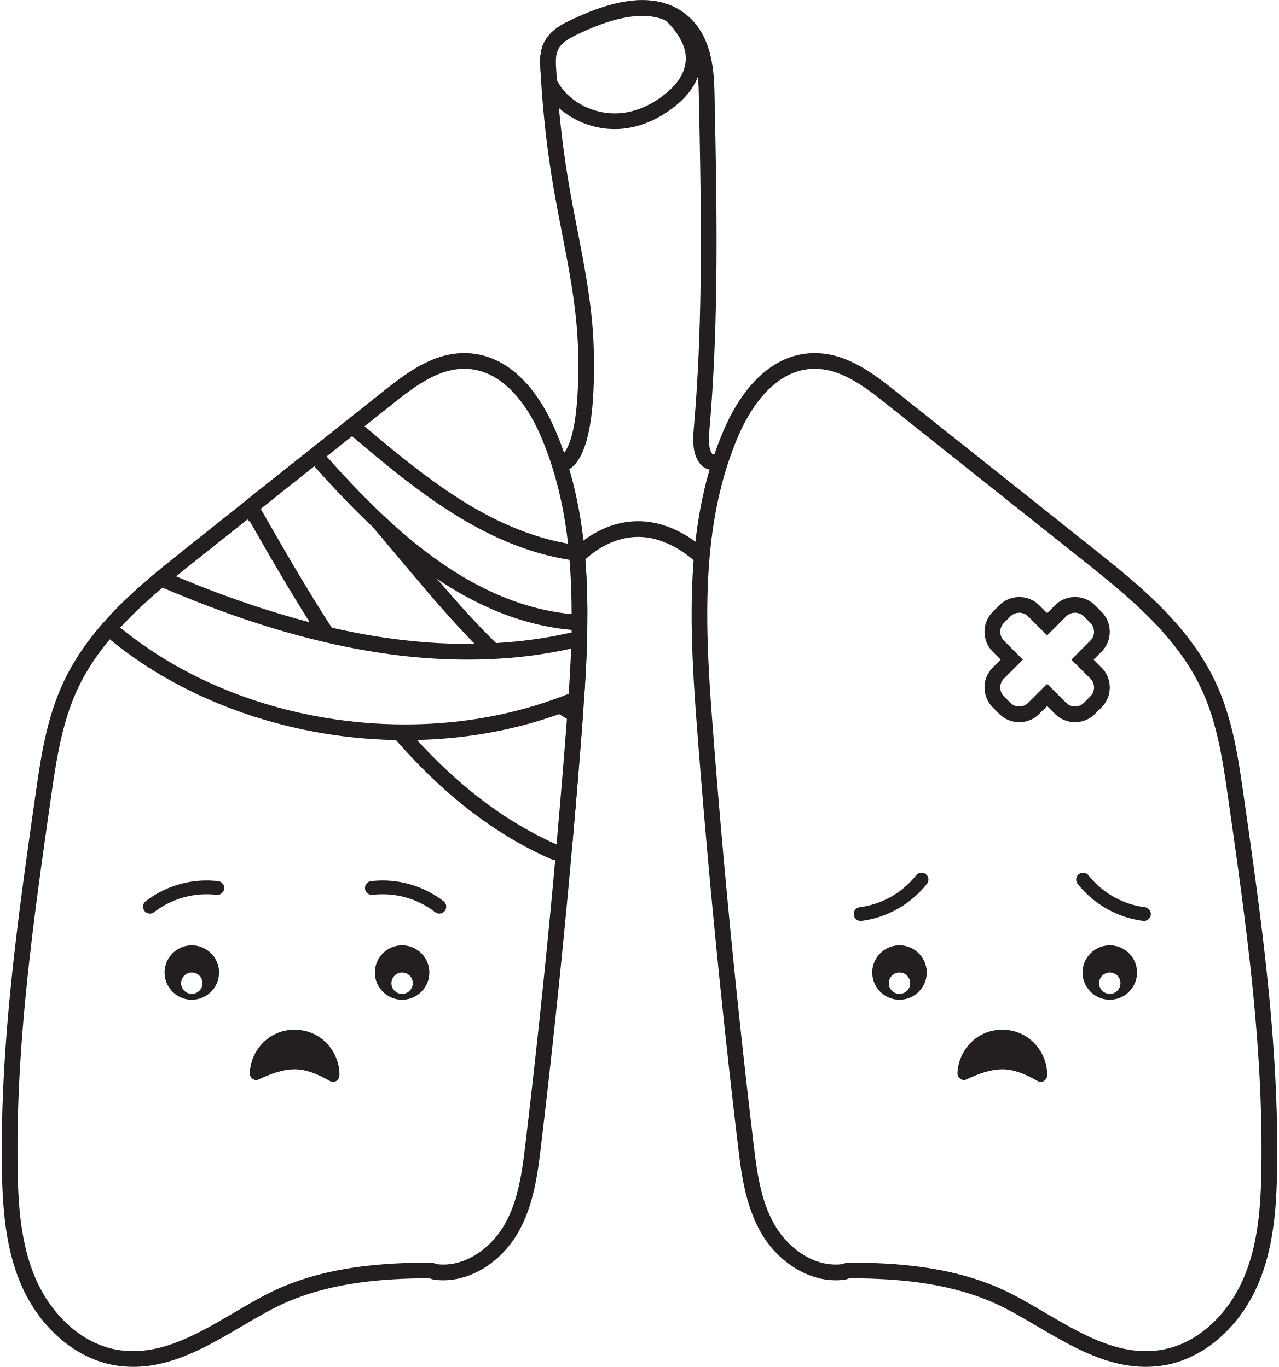

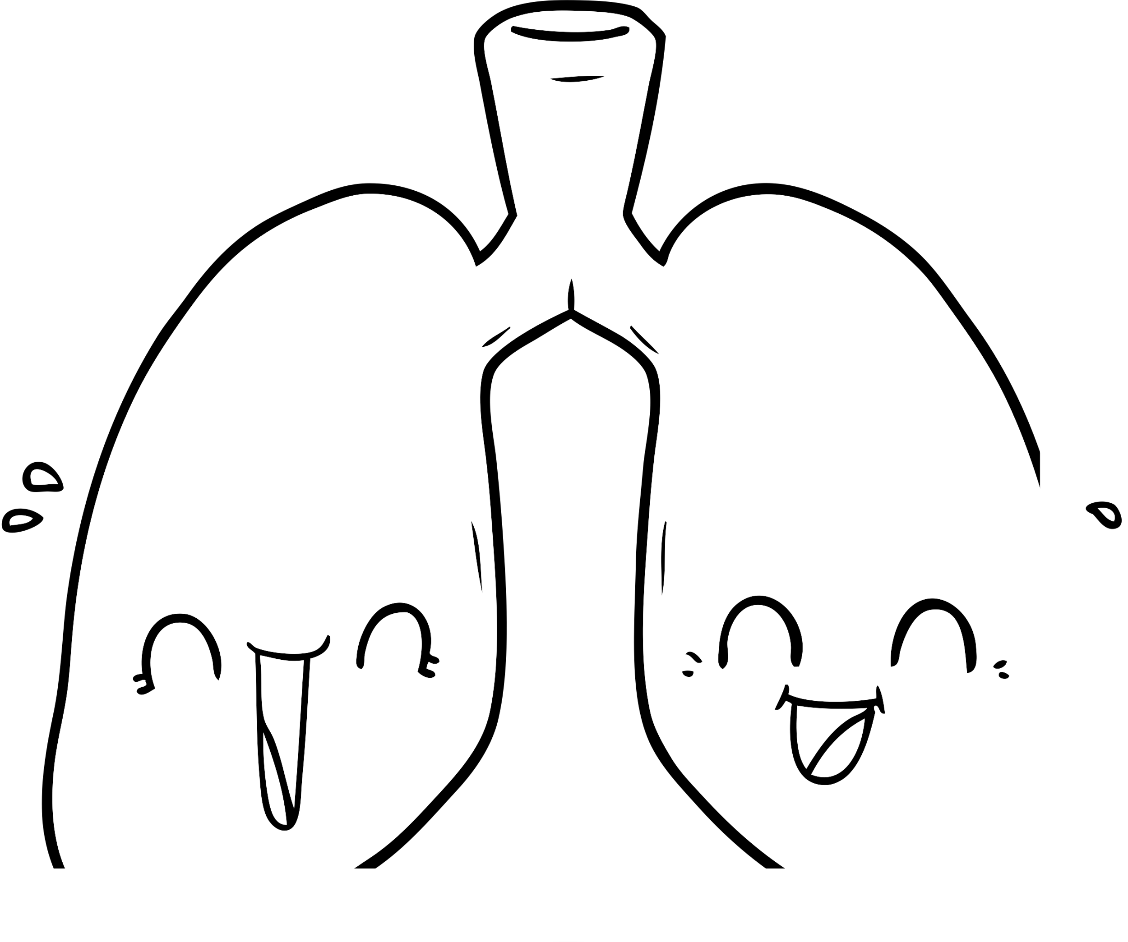
Hit or Miss, the Case of EVALI
tobaccopreventiontoolkit.stanford.edu
      For the first time, we have seen a vaping device cause sudden, immediate, serious and sometimes fatal damage to the lungs.
      The Centers for Disease Control and Prevention (CDC) recommends to not use THC-containing e-cigarette/vape products particularly from informal sources like family/friends, dealers, online or other sources.
      Since these products are not regulated, there is no guarantee that any part of an e-cigarette is safe for your health. Your lungs are the most happy and safe when you only breathe in oxygen and clean air.
Notes:
Teacher Talking Points:
We know that e-cigarette aerosol damages the lungs and increases the chances of developing a lung disease later in life. What if the aerosol or one chemical from vaping caused severe damage to the lungs after a few hits?
In August of 2019 this began to happen. People were hospitalized for injured lungs from vaping. This outbreak was later named EVALI which stands for E-cigarette or Vaping product use-Associated Lung Injury.
Most EVALI patients reported using THC-containing products and most said they got their products only from informal sources. THC is the chemical found in cannabis/marijuana that gives users a “buzz/high.”
Scientists found Vitamin E Acetate, an oily chemical found in some THC-containing e-liquid, in the lungs of EVALI patients and in e-cigarette/vape products that the patients said they used. Vitamin E Acetate was mostly likely the cause of the outbreak. Breathing in Vitamin E Acetate can cause inflammation of the airways and interfere with normal lung functioning.
What are some of your main takeaways after hearing about EVALI? (Wait for responses.)
To add to or summarize what you already said, some main takeaways for EVALI include:
(Click) This is the first time we’ve seen a vaping device cause sudden, immediate, serious and sometimes fatal damage to the lungs.
(Click) The Centers for Disease Control and Prevention, better known as the CDC, recommends to not use THC-containing e-cigarette/vape products particularly from informal sources like family/friends, dealers, online or other sources.
(Click) Since these products are not regulated by the government, there is no guarantee that any part of an e-cigarette is safe for your health. Something you can always be sure of is that your lungs are the most happy and safe when you only breathe in oxygen and clean air.
Reference:
https://www.cdc.gov/tobacco/basic_information/e-cigarettes/severe-lung-disease.html

Slide 15

Going Smoke-free or Vape-free
tobaccopreventiontoolkit.stanford.edu
Notes:
Teacher Talking Points:
We are going to watch a video that covers the benefits of going smoke-free or vape-free.
[Hover over slide and click the play button.]
If technical issues should arise then watch this video with your students on YouTube by using this link: https://www.youtube.com/watch?v=lYBWAQluuUg
Sources:
https://www.bmj.com/content/366/bmj.l5275
https://tobacco.ucsf.edu/comment/33096#comment-33096
https://www.scientificamerican.com/article/smoking-or-vaping-may-increase-the-risk-of-a-severe-coronavirus-infection1/?amp
https://journals.lww.com/cmj/Abstract/publishahead/Analysis_of_factors_associated_with_disease.99363.aspx

Slide 16




What the Industry Isn’t Telling Us
?
?
?
?
?
How do
ALL of
these parts affect
YOUR BODY and YOUR
COMMUNITY?
?
?
?
?
?
?
?
?
?
?
?
?
?
tobaccopreventiontoolkit.stanford.edu
Notes:
Teacher Talking Points:
If we take apart these devices, it is important to consider how each component will impact a young person’s health.
The plastic mouthpiece is coming in direct contact with the mouth, heavy metal parts are being heated up and degrading over time, and cartridges are being disposed of in the environment.
(Click) This raises concerns and the question of “How do all of these parts affect your body and your community?”
JUUL pods for example are single-used plastic pods. Like plastic straws, they take many years to break down and ultimately create more waste (click).
Because pod-based e-cigarettes can leak heavy metals and residual nicotine they are considered to be biohazard waste and e-waste.
We share this concern for all pod-based e-cigarettes (click).
Reference:
https://truthinitiative.org/research-resources/emerging-tobacco-products/3-ways-juul-harms-environment
Images:
https://www.theverge.com/2015/4/21/8458629/pax-labs-e-cigarette-juul
https://twitter.com/vaperankz/status/983474534945902594
http://jawwak-7eloo.com/wp-content/uploads/2019/05/smok_nord_pod_device_kit_black.png https://upload.wikimedia.org/wikipedia/commons/e/e7/History_of_e-cigarette.jpg
https://vaping.com/media/catalog/product/cache/1/image/602x465/9df78eab33525d08d6e5fb8d27136e95/s/u/suorin-drop-black.png

Slide 17

Unit 3, Activity 4: What is Secondhand & Thirdhand Aerosol?
tobaccopreventiontoolkit.stanford.edu
Notes:
Teacher Talking Points:
Someone might think that the individual using an e-cigarette or vape is the only person at risk for breathing in nicotine, heavy metals, and cancerous chemicals from the aerosol. That is not true though.
There are two major ways that aerosol from e-cigarettes can spread into the air and affect the health of others.

Slide 18

Secondhand Aerosol
tobaccopreventiontoolkit.stanford.edu
Nicotine
Heavy
Metals
Ultrafine
Particles
Cancerous
Chemicals
VOCs
Notes:
Teacher Talking Points:
(Click) You may be familiar with the concept of secondhand smoke. How would you define secondhand smoke?
Secondhand smoke is smoke from burning tobacco products, such as cigarettes, cigars, or pipes and is toxic when inhaled.
Secondhand aerosol, similar to secondhand smoke, is the plume of chemicals released into the environment directly from the e-cigarette/pod-based devices and from the lungs of the user.
Common places for exposure to secondhand aerosol include restaurants, parks, vehicles, and designated smoking areas.
Chemicals that are released (click) include harmful substances such as (click) nicotine, (click) heavy metals, (click) ultrafine particles that fall deep into the lungs, (click) cancerous chemicals, and (click) volatile organic compounds aka VOCs.
Exposure can lead to cancer, respiratory infections, and make someone’s asthma worse among other problems.
Reference:
https://tobaccofreeca.com/secondhand-smoke/secondhand-vapor-harmful/
Image:
https://www.cdc.gov/tobacco/infographics/secondhand-smoke/index.htm

Slide 19



Thirdhand Aerosol
tobaccopreventiontoolkit.stanford.edu
Nicotine & other chemicals
Notes:
Teacher Talking Points:
Another way that e-cigarettes/vape pens pose a danger to people other than the user is through thirdhand aerosol.
(Click) Thirdhand aerosol is the mixture of chemicals in e-cigarette/vape pen aerosol that remain on surfaces and in dust, even after the aerosol is gone, and react with other chemicals in the environment to form toxic chemicals.
These potentially harmful chemicals can be exposed to other people or animals through the respiratory system, through ingestions, and through skin exposure.
Small children are especially at risk for thirdhand aerosol exposure because they tend to put things into their mouths and they have more vulnerable skin.

Slide 20

Class Discussion
tobaccopreventiontoolkit.stanford.edu
Knowing what we do about e-cigs, and considering all the things we don’t know about e-cigs why do teens choose to use e-cigs/vapes?
Notes:
Facilitate a class discussion about this question. Remind students to be respectful. Correct any misinformation that students might express during the discussion.
Key Points to Consider:
Many teens wouldn’t use traditional cigarettes, why do they choose to use e-cigs/vapes?
How do you think traditional cigarette smokers felt when they learned about all the harmful health effects caused by cigarettes that were being covered up by tobacco companies?
How do you think an e-cig/vape user would feel if 10 years into the future they learned that e-cigs/vapes were just as harmful as traditional cigarettes?
How do you think advertising plays a role in a teen’s decision to use e-cigs/vapes?

