Slide 1
Why Do E-Cigarettes and Vapes Matter to Young People?
© Stanford University

Slide 2
Unit 4, Activity 1: What is the Appeal of E-Cigs/Vapes?
tobaccopreventiontoolkit.stanford.edu
Notes:
Teacher Talking Points:
We are going to do a series of activities on the marketing and appeal of e-cigarette/vape products.
Image Credit: Manuela Belli, Chameleon Design, Icon Island from Noun Project

Slide 3
Why do you think people your age use e-cigs/vapes?
tobaccopreventiontoolkit.stanford.edu
Notes:
Teacher Talking Points:
Why do people your age use e-cigs/vapes?
Allow for discussion between students. Use questions below to facilitate discussion if desired.
How do e-cig/vape commercials influence a teen’s choice?
How could friends influence a teen’s choice?
How could parents/family influence a teen’s choice?
In what ways could myths or misinformation about e-cigs/vapes affect a teen’s choice?
In what ways does social media influence a teen’s decision?
How do the many flavor options make e-cigs/vapes appealing?
Image:
Pixabay.com

Slide 4
Why do you think adults use e-cigs/vapes?
tobaccopreventiontoolkit.stanford.edu
Notes:
Teacher Talking Points:
Why do you think adults use e-cigs/vapes?
Allow for discussion between students. Use questions below to facilitate discussion if desired.
How does an adult’s social environment influence their decision to smoke?
How could someone’s job affect their choice to smoke?
In what ways does social media influence an adult’s decision?
How an adult’s past decision to smoke cigarettes affect their decision to use e-cigs/vapes
Image Credit: Canva.com

Slide 5
Why do you think people your age DON’T use e-cigs/vapes?
stan.md/capt
Notes:
Teacher Talking Points:
Why do people your age don’t use e-cigs/vapes?
Allow for discussion between students. Use questions below to facilitate discussion if desired.
How do e-cig/vape commercials influence a teen’s choice?
How could friends influence a teen’s choice?
How could parents/family influence a teen’s choice?
In what ways could information about e-cigs/vapes affect a teen’s choice?
In what ways does social media influence a teen’s decision
Image:
Pixabay.com

Slide 6
What do you notice about our responses? What similarities or differences stand out to you?
Class Reflection
tobaccopreventiontoolkit.stanford.edu
Notes:
Teacher Talking Points:
What do you notice about our responses? (Allow for discussion.)
What similarities or differences stand out to you? (Allow for discussion.)
It’s important to remember that individuals’ choices about whether to use e-cigs/vapes can be very different and can be influenced by many factors
E-cig/vape companies recognize these differences between individuals and have made ad campaigns meant to target groups of people based on these characteristics. Examples of these targeting tactics are discussed in Unit 4 Activity 2.

Slide 7
Unit 4, Activity 2: Flavors, Manipulation, and Targeting
tobaccopreventiontoolkit.stanford.edu
Notes:
Teacher Talking Points:
We discussed why people use or don’t use e-cigarettes/vapes. Now we’re going to dive into the deceptive marketing strategies that e-cigarette companies use.
Image Credit: Canva.com

Slide 8
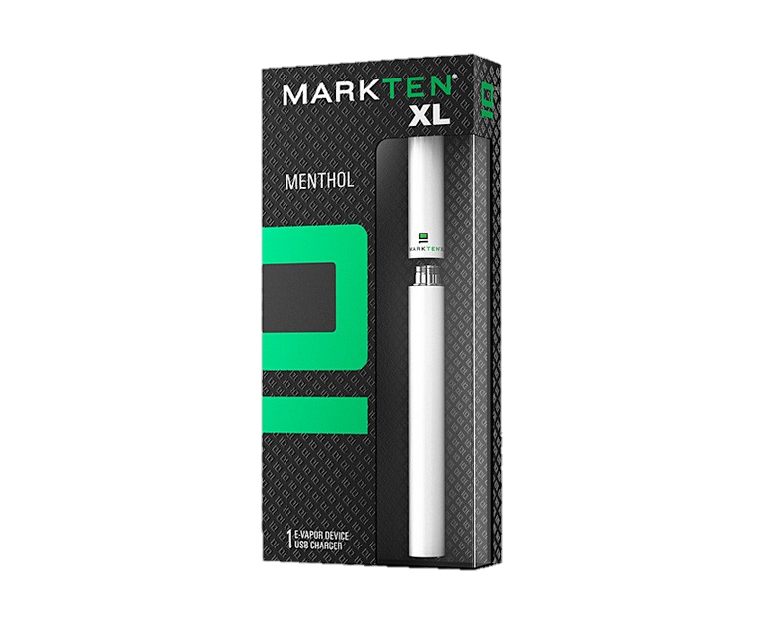
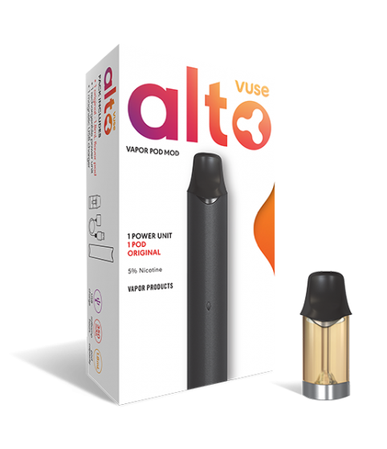
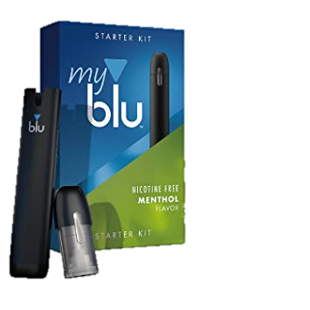
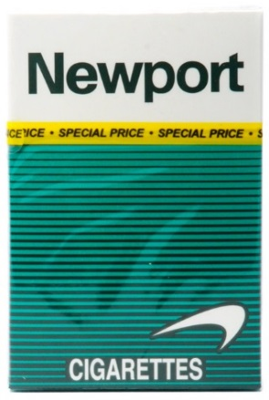
The Usual Suspects
tobaccopreventiontoolkit.stanford.edu
Notes:
Teacher Talking Points:
Some of the brands behind these new products are actually the same corporations that produced traditional cigarettes.
The company that sells Newport sells Blu, Marlboro used to sell Mark Ten, and Camel sells Vuse. They have kept up with products like JUUL, by releasing their own pod-based e-cigarettes (click).
Basically, these Big Tobacco corporations are replacing their old cigarette customers with new customers around your age that they hope to keep for a lifetime by promoting a new product.

Slide 9
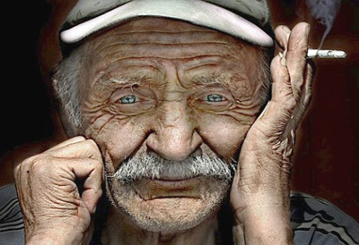
Who is going to replace the old smokers?
tobaccopreventiontoolkit.stanford.edu
Notes:
Teacher Talking Points:
The e-cigarette/vape pen industry knows that many of their customers are getting older and need to be replaced with new customers so they can make more profits.
Who do you think they see as the ideal customer?

Slide 10
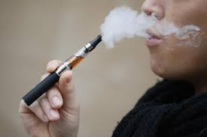
YOUNG PEOPLE
YOUR AGE
90% of adult smokers started before 18
tobaccopreventiontoolkit.stanford.edu
Notes:
Teacher Talking Points:
(Click) Young people like you!
The e-cigarette/vape pen industry sees young people as the perfect replacement customers.
They know if young people get hooked to their products early in life, they’ll have them as customers for years to come.
It’s well-known by health professionals and the e-cigarette/tobacco industry alike, many current smokers started smoking before adulthood.
So if you take a closer look at e-cigarette/vape pen marketing, you’ll notice the industry’s attempts to make e-cigarettes/vape pens trendy and appealing to youth.
Reference:
http://www.monitoringthefuture.org/pubs/monographs/mtf-overview2018.pdf
Image: https://shadowboxmvmnt.com/wp-content/uploads/YPOUTH-BLOG-HEADER-IMAGE_MVMNT-ARTICLE-1030x687.jpg

Slide 11
Behind the Scenes
tobaccopreventiontoolkit.stanford.edu
“Today's teen-ager is tomorrow's potential regular customer and the overwhelming majority of smokers first begin to smoke while in their teens. . .”
-March 31, 1981 Philip Morris Report (1)
“At least a part of the success of Marlboro Red during its most rapid growth period was because it became the brand of choice among teenagers who then stuck with it as they grew older. "
-March 31, 1981 Philip Morris Report (2)
Notes:
Teacher Talking Points:
Let’s look at some actual quotes from the tobacco industry that shows how the really see people your age.
(Click) Today's teen-ager is tomorrow's potential regular customer and the overwhelming majority of smokers first begin to smoke while in their teens.
(Click) At least a part of the success of Marlboro Red during its most rapid growth period was because it became the brand of choice among teenagers who then stuck with it as they grew older.
[Sources:
Quote 3: 1999 Philip Morris report, "Five-Year Trends 1988-1992." Bates No. 2044895379-484
Quote 4: September 30, 1974 R.J. Reynolds Tobacco Co. marketing plan presented to the company's board of directors. Bates No. 501421310-1335]
Image Credit: Canva.com

Slide 12
More Quotes from the Industry
tobaccopreventiontoolkit.stanford.edu
“The ability to attract new smokers and develop them into a young adult franchise is key to brand development.”
-1999 Philip Morris Report (3)
“They represent tomorrow's cigarette business. . . As this 14-24 age group matures, they will account for a key share of the total cigarette volume -- for at least the next 25 years.”
-September 30, 1974 R.J. Reynolds Tobacco Co (4)
Notes:
Teacher Talking Points:
(Click) The ability to attract new smokers and develop them into a young adult franchise is key to brand development.
(Click) They represent tomorrow's cigarette business. . . As this 14-24 age group matures, they will account for a key share of the total cigarette volume -- for at least the next 25 years.
How do you feel about you and others your age being talked about in this way?
[Sources:
Quote 3: 1999 Philip Morris report, "Five-Year Trends 1988-1992." Bates No. 2044895379-484
Quote 4: September 30, 1974 R.J. Reynolds Tobacco Co. marketing plan presented to the company's board of directors. Bates No. 501421310-1335]
Image Credit: Canva.com

Slide 13
How are e-cig companies reaching young people?
Notes:
Teacher Talking Points:
Imagine again that you are a tobacco executive, how would you try to lure in new, younger customers so that you can continue to make big profits?
So, if you take a closer look at e-cig marketing, you’ll notice the industry’s attempts to make e-cigs/vapes trendy and appealing to young people
Image Credit: Canva.com

Slide 14
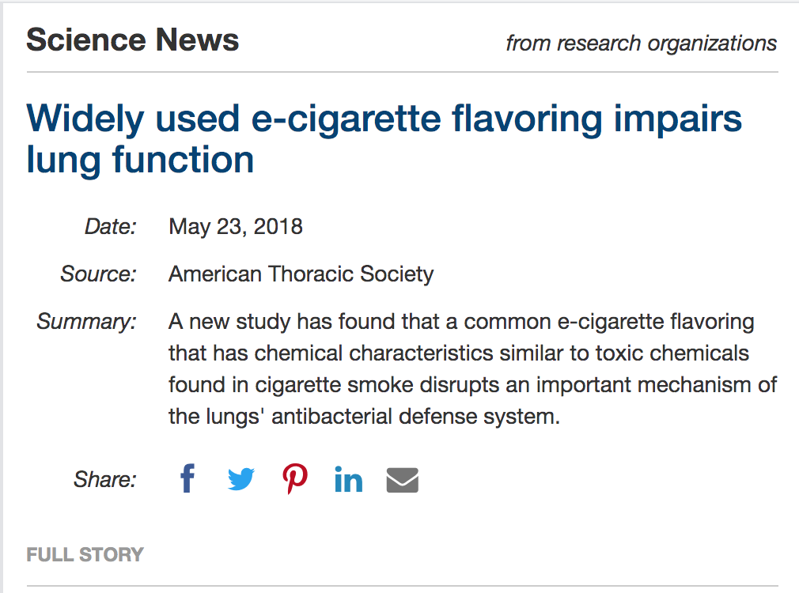
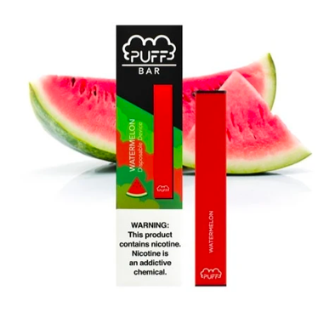
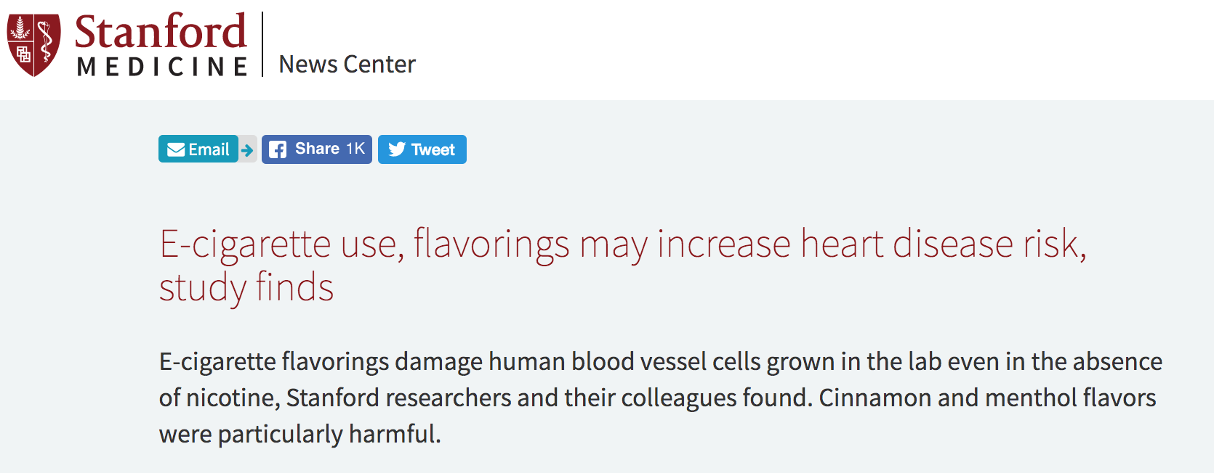
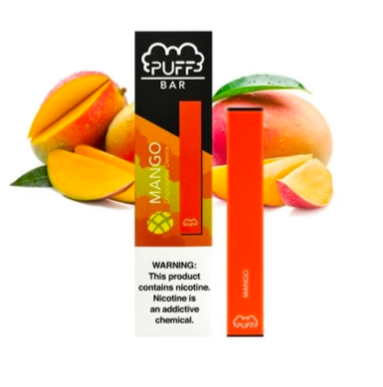
Why Flavors?
tobaccopreventiontoolkit.stanford.edu
Notes:
Teacher Talking Points:
Earlier we discussed how pod-based companies have fruity and sweet flavor pods along with colors.
(Click) Why would there be over 15,500 e-juice flavor options such as Banana Butt and Honey Doo Doo?
It’s important to be aware that this is another example of the pod-based companies following well-known advertising strategies from Big Tobacco’s playbook.
They know that flavors are a great way to attract young costumers because they are the group most interested in sweet flavors and bright colors.
This tactic is so effective that flavored cigarettes have been banned since 2009, since extensive research shows that they are more appealing to young people. The pod-based companies along with other e-cigarettes have yet to be regulated in this way.
(Click) More and more evidence is piling, proving that these flavors are dangerous in and of themselves.
(Click) So far we know that flavors can impair lung function and increase risk for heart disease.
But pod-based companies continue to use them because they know it makes their products seem appealing and safe to teens.
Reference:
https://www.flavorshookkids.org/
http://www.onlinejacc.org/content/73/21/2722
https://www.sciencedaily.com/releases/2018/05/180523172310.htm
Images:
http://www.liherald.com/rockvillecentre/stories/rockville-centre-coalition-for-youth-persists-to-stop-flavored-juul-sales,114268
https://thepodgod.shop/collections/puff-bars?page=1
https://thepodgod.shop/collections/puff-bars?page=2

Slide 15
Why So Many?
tobaccopreventiontoolkit.stanford.edu
Notes:
Teacher Talking Points:
Let’s see what the e-cig industry has to say about the many e-juice flavor options available.
This is a clip of California Senator, Barbara Boxer asking e-cig industry representatives about the topic.
(Hover over black square and click to play video.)
What do you think about the e-cig industry’s response?

Slide 16
If You Aren’t Convinced…
tobaccopreventiontoolkit.stanford.edu
Notes:
Teacher Talking Points:
If you aren’t convinced that e-juice flavor are targeting kids and young people watch this video.
(Hover over black square and click to play video.)
How do you feel about the kids’ responses to the flavored tobacco products?

Slide 17
Cigarette vs. E-Cig/Vape Ads
tobaccopreventiontoolkit.stanford.edu
1941, Philip Morris
2013, Blu
Notes:
Teacher Talking Points:
These marketing strategies are not new.
Tobacco companies have been using recycling old tactics that have been successful in the past.
Let’s compare some regular cigarette ads with recent e-cigs/vapes ads to prove that point.
What similarities between these two ads do you notice?
Why do you think these ads are successful in attracting customers?
Image Source: Stanford Research into the Impact of Tobacco Advertising (SRITA)

Slide 18
Cigarette vs. E-Cig/Vape Ads
tobaccopreventiontoolkit.stanford.edu
2015, Juul
1989, Capri
Notes:
Teacher Talking Points:
What similarities between these two ads do you notice?
Why do you think these ads are successful in attracting customers?
Image Source: Stanford Research into the Impact of Tobacco Advertising (SRITA)

Slide 19
Cigarette vs. E-Cig/Vape Ads
tobaccopreventiontoolkit.stanford.edu
2018, Juul
2000, Camel
Notes:
Teacher Talking Points:
What similarities between these two ads do you notice?
Why do you think these ads are successful in attracting customers?
Image Source: Stanford Research into the Impact of Tobacco Advertising (SRITA)

Slide 20
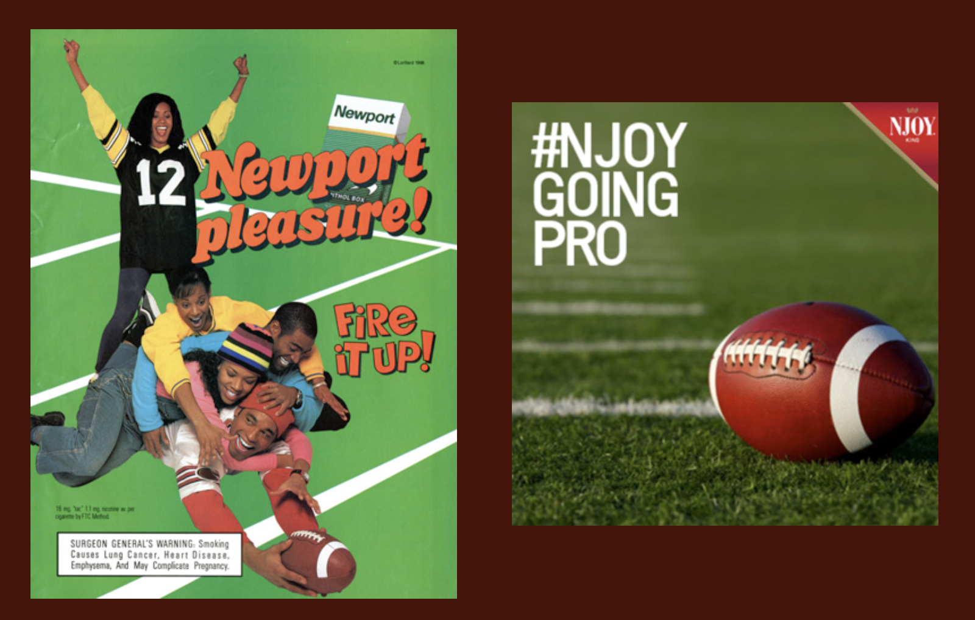
Cigarette vs. E-Cig/Vape Ads
tobaccopreventiontoolkit.stanford.edu
NJOY
Newport
Notes:
Teacher Talking Points:
What similarities between these two ads do you notice?
Why do you think these ads are successful in attracting customers?
Image Source: Stanford Research into the Impact of Tobacco Advertising (SRITA)

Slide 21
Enough is Enough
Notes:
Teacher Talking Points:
It is incredibly important that Black people, and other people of color, are represented in movies, magazines, and other media. It’s a different story when the product that is being sold is addictive and deadly.
It is even more frustrating to see how the Black community is targeted by tobacco companies when you know that smoking is a major cause of heart disease, the number one cause of death for people who are Black.
We are going to watch a video to see spoken word artist Six Footah The Poet’s take on menthol.
[Hover over slide and click the play button.]
If technical issues should arise then watch this video with your students on YouTube by using this link: https://www.youtube.com/watch?v=j-pzmb-85wQ

Slide 22
Truth About Menthol
tobaccopreventiontoolkit.stanford.edu
Use of flavors not allowed in cigarettes, except for menthol
Nearly 9 in 10 African-American smokers aged 12 and older use menthol cigarettes
Notes:
Teacher Talking Points:
Flavored cigarettes have been banned since 2009, but Big Tobacco fought to keep menthol as a flavor.
Historically, the Tobacco companies reinforced the popularity of menthol tobacco products by exploiting vulnerable communities. For example, in the African-American communities, a tobacco company would drive a van through districts and give away free cigarettes.
And recent studies have concluded that menthol cigarettes lead to increased smoking initiation among youth and young adults, greater addiction, and decreased success in quitting smoking.
Removal of menthol cigarettes from the marketplace would benefit public health in the United States, especially among communities of color and other vulnerable groups of people.
Images:
https://californiahealthline.org/news/flavor-bans-multiply-but-menthol-continues-to-divide/

Slide 23
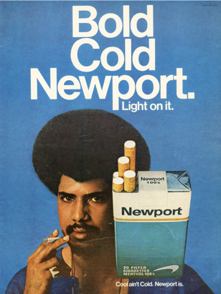
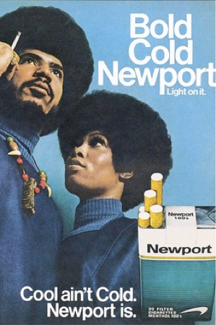
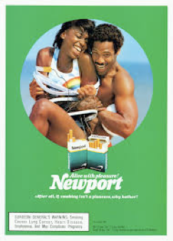
Truth About Menthol
tobaccopreventiontoolkit.stanford.edu
Notes:
Teacher Talking Points:
(Click) Here are a few examples of menthol ads targeting the African-American community.
The images in these ads take advantage of some important community values and use them to promote menthol cigarettes.
Strong bonds between couples are depicted.
There is a message of black empowerment and independence.
The ads of the African-American women show them as relaxed and cool.
Using community values to try and sell a deadly product to a community is one of the many horrible strategies that tobacco/nicotine companies have used in the past and continues to use today.
Slide Credit: Tiffani Mason, Derrick Kirk, Dr. Phillip Gardiner

Slide 24
Unit 4, Activity 3: Deconstructing & Reconstructing E-Cig Ads
tobaccopreventiontoolkit.stanford.edu
Notes:
Teacher Talking Points:
In this last activity we’re going to give you the opportunity to deconstruct and reconstruct e-cigarette advertisements.

Slide 25
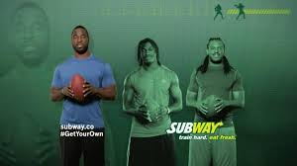
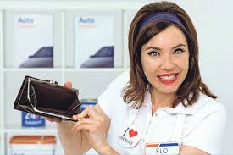
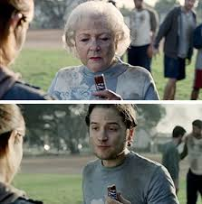
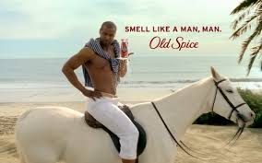
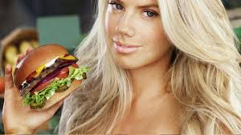
What is an advertisement that you really like, or one that really annoys you?
tobaccopreventiontoolkit.stanford.edu
Notes:
Teacher Talking Points:
Think of an advertisement that you really like
Now think of one that really annoys you
Turn to a partner and share the ad that you thought about and why
If you’re having trouble, you can use these examples for reference (click).
(After about 1-2 minutes, ask for a few volunteers to share an ad that came to mind.)
What are some of the things that the different ads have in common? [Record responses on the board or easel paper.]
What are some of the things that the advertisers did to get your attention? (i.e., funny, famous spokesperson, attractive people, etc.) [Record responses on the board or easel paper.]

Slide 26
Buying Your Attention
tobaccopreventiontoolkit.stanford.edu
$110
Million
Notes:
Teacher Talking Points:
Companies spend a lot of money figuring out how to get the attention of the people who they would like to buy their product.
E-cigarette companies are no different. In 2018, e-cig/vape companies spent $110 million on advertising for print, radio, television, Internet and outdoors.
Why do you think that companies are willing to spend so much money on advertising?
Reference: https://pubmed.ncbi.nlm.nih.gov/32108086/
Image Credit: Canva.com

Slide 27
Buying Your Attention
tobaccopreventiontoolkit.stanford.edu
Notes:
Teacher Talking Points:
Does anyone know what a target audience is?
Combine responses from a few students to form a class definition.
If needed, summarize with the following definition: A target audience is a specific group of people, for which a particular product is aimed.

Slide 28
Deconstruction and Reconstruction Activity
tobaccopreventiontoolkit.stanford.edu
Notes:
Instructions in document.

