Slide 1
Deconstructing Pod-Based Systems’ Advertisements
Activity
© Stanford University
Notes:
This PowerPoint does not contain Teacher Talking Points. Instead, under each slide there are a few Discussion Points and Hints to identify the issues with these specific ads.

Slide 2
Notes:
Discussion Starters/Hints:
Presenting a cup of coffee alongside flavored JUULpods gives young people the impression that JUULing is like snacking/indulging in a dessert.
JUUL Labs and other tobacco companies have targeted young people with flavors. As we see here, the “crème brulee” words are the biggest words. This can be misleading for sure!
The warning label is in a small font and selectively placed at the bottom of the picture.

Slide 3
Notes:
Discussion Starters/Hints:
The Blu flavor of “Strawberry Mint” on display does not match with the holiday drink presented.
Including Blu alongside a holiday staple of a hot chocolate drink depicts its potential for leisure use.
In an attempt to normalize its use, Blu is implying that this tobacco/nicotine product should not be forgotten during your holidays!
Source:
https://twitter.com/blucigs/media?lang=en

Slide 4
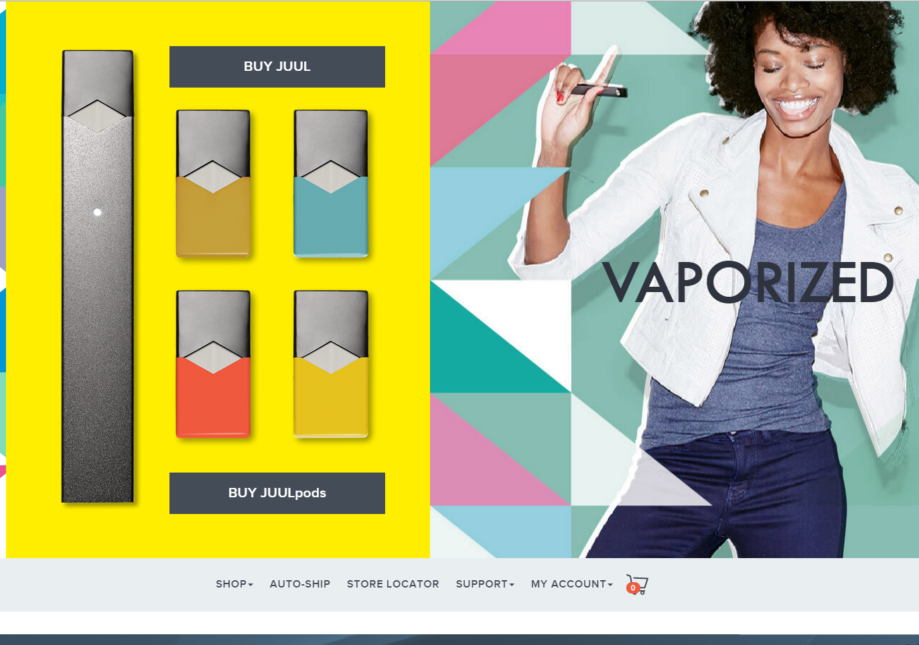
Notes:
Discussion Starters/Hints:
The geometric shapes and bright colors utilized in this ad alongside a young model caters to a younger, more energetic crowd.
There are not many words included in this ad, only links to buy the product. This can be seen as a marketing tactic employed to keep youth in the dark.
The ambiguity of it may appeal to youth who are curious about this product. This entices them to look it up!

Slide 5
Notes:
Discussion Starters/Hints:
In an attempt to normalize its use, PHIX is implying that this tobacco/nicotine product should not be forgotten during your holidays, in this case, Easter.
Presenting the pack of pods in a colorful and youthful environment, playing on the theme of an Easter egg hunt, a colorful package can be seen as a treasure to be found among the other Easter eggs!
The individual in the ad displays a tattooed-hand representing a specific consumer which could seem attractive to a younger crowd!
They are also seen wearing Nikes, attracting other athletic-focused individuals or Nike-brand enthusiasts!
Source:
Phix Facebook page

Slide 6
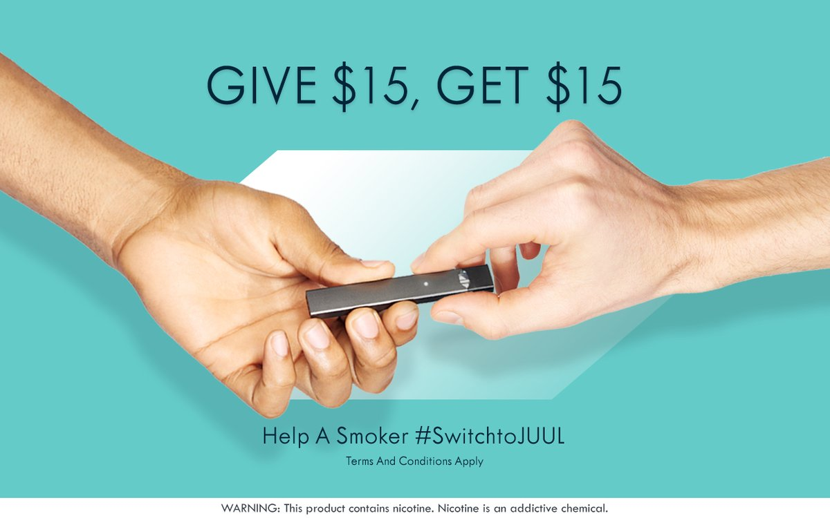
Notes:
Discussion Starters/Hints:
This ad clearly encourages young people to connect their friends with the product by placing an monetary incentive. JUUL is aware that young people may have limited money, so this message appeals to them.
The company is illustrating JUUL as a bridge for relationships. For young people, we know that relationships and social connections are important to them.
Warning label is in a small font and selectively placed at the bottom of the picture.

Slide 7
Notes:
Discussion Starters/Hints:
With its dark colors and sleek designs, the ad remains a mystery.
The only words on the ad are presented through a pun, with a play on words and a connection to the item itself!
“Get your PHIX” sends more than one message: for individuals to purchase PHIX, but also to feel satisfied and completed.
Source:
Phix Facebook Page

Slide 8
Notes:
Discussion Starters/Hints:
JUUL is being vague about their target audience in this ad by choosing to remove the face!
JUUL Labs have chosen to display JUUL as an appropriate gift, when we know that introducing young bodies to a high amount of nicotine and chemicals is harmful!
In an attempt to normalize its use, JUUL is implying that this tobacco/nicotine product can be a part of our holiday culture!
The wording wants young people to believe that it is empowering to JUUL, but what is empowering about exposing your body to nicotine and other chemicals?
Warning label is in a small font and selectively placed at the bottom of the picture.

Slide 9
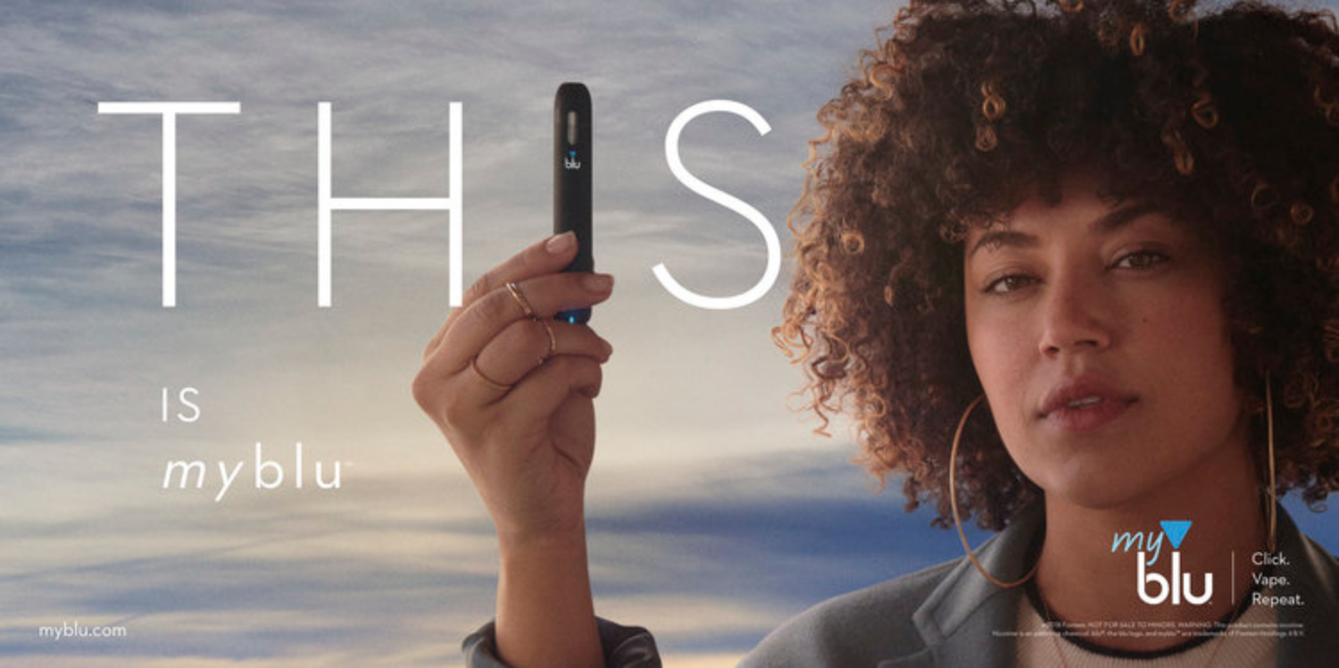
Notes:
Discussion Starters/Hints:
The person shown in this ad represents a youthful audience.
The ad identifies with people of color by choosing to present an Afro-Latina as the spokesperson for Blu.
An emphasis is placed on the item by positioning it between the word “this”, replacing the “I”; a form of self-identification.
This sense for social justice and attitude for change attracts young people. Notice that her hand is positioned in almost a fist in the air, a commonly used gesture in protests and demonstrations.
Source:
http://www.styleitholmes.com/advertising/

Slide 10
Notes:
Discussion Starters/Hints:
Young people are commonly encouraged to share and this message emphasizes that, as if sharing a JUUL with other young people is a good thing.
Warning label is in a small font and selectively placed at the bottom of the picture.

Slide 11
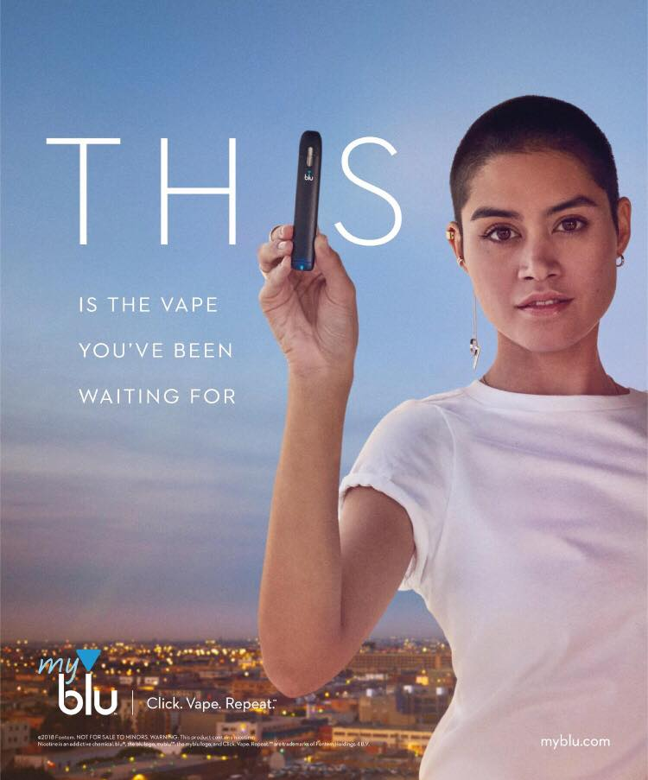
Notes:
Discussion Starters/Hints:
The person shown in this ad bares a strong resemblance with the Parkland Student Activist.
The ad identifies with gender minorities/LGBTQ+ by choosing to present a gender nonconforming individual as the spokesperson for Blu.
An emphasis is placed on the item by positioning it between the word “this”, replacing the “I”; a form of self-identification.
This sense for social justice and gender nonconformity attracts young people. Notice that her hand is positioned in almost a fist in the air, a commonly used gesture in protests and demonstrations.

Slide 12
Notes:
Discussion Starters/Hints:
Labeling it as an essential sheds light on it’s potential for addiction as seen by having to carry it everywhere.
The items and look of the suitcase make it seem hip and cool to have.
The message encourages trendy people to consider JUULs an essential.
Warning label is in a small font and selectively placed at the bottom of the picture.

Slide 13
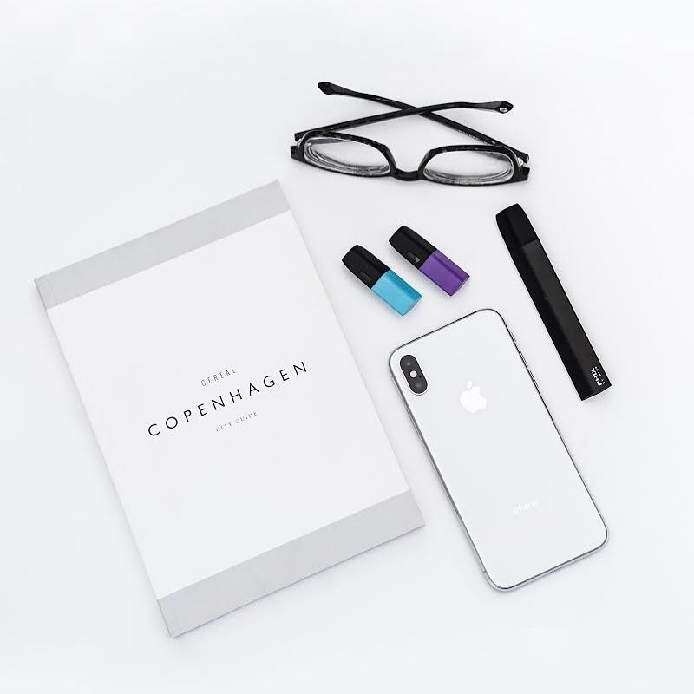
Notes:
Discussion Starters/Hints:
The ad presents very clean aesthetics, including an iPhone with a simple and clean look, similar to the marketing of Apple products that appeal to young people!
Two pods attract the most attention, as they are the only ones with a pop of color in the ad!
The Copenhagen booklet can draw individuals interested in travel and adventure.
Source:
Phix Facebook page

Slide 14
Notes:
Discussion Starters/Hints:
JUUL aims to destigmatize the harm of its products, suggesting to young people that now they can also share their love for the item with others.
In an attempt to normalize its use, JUUL is implying that this tobacco/nicotine product can be a part of our holiday culture!
Warning label is in a small font and selectively placed at the bottom of the picture.

Slide 15
Notes:
Discussion Starters/Hints:
In an attempt to normalize its use, Blu is implying that this tobacco/nicotine product can be a part of your holidays, specifically for Valentine’s Day!
The ad provides a short message including the Blu packaging creatively shaped as a heart.
It presents little information which can be misleading, suggesting Blu as the gift to share with loved ones or as the loved one itself!
Source:
SRITA Stanford
http://tobacco.stanford.edu/tobacco_web/images/ecig_ads/u_majorbrands/blu/large/blu_506.jpg

Slide 16
Notes:
Discussion Starters/Hints:
JUUL is illustrated as a harmless, everyday item once again by being placed beside common household items and drinks like coffee.
This ad tries to subliminally equate the coffee vapor to the JUUL aerosol. Many assume JUUL releases harmless vapor, when in reality it’s an aerosol.
Warning label is in a small font and selectively placed at the bottom of the picture.

Slide 17
Reconstructing Pod-Based Systems’ Advertisements
Examples
© Stanford University

Slide 18
Propylene glycol…
Benzoic Acid…
…sounds more like a science experiment than a dessert.

Slide 19
It’s not all chocolate and flowers with nicotine…
Give your loved ones something else.

Slide 20
Not the heart-racing feeling I was looking for…
Give your loved ones something more.

Slide 21
Only one of these produces water vapors…

