Slide 1
Brain 101
© Stanford University

Slide 2
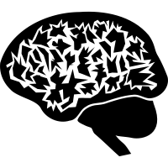
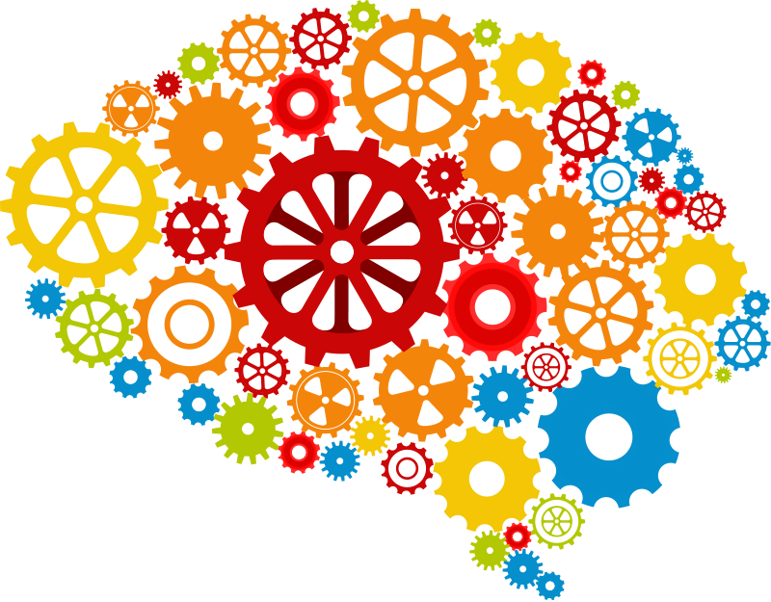
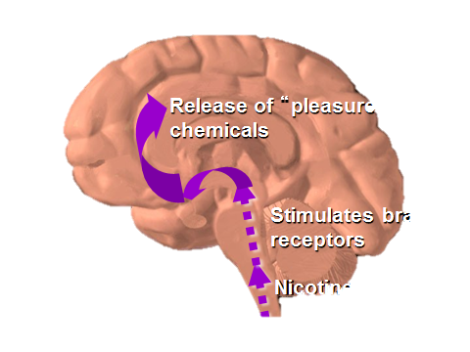
In This Presentation:
tobaccopreventiontoolkit.stanford.edu
Background on the Brain
The Teenage Brain
How Drugs Affect the Brain
Notes:
Teacher Talking Points:
In this presentation we are going to learn some background on the brain, discuss some of the unique features of the teenage brain, and talk about how drugs affect the brain.

Slide 3
Background on the Brain
Image Credit: Pixabay.com
Notes:
Teacher Talking Points:
In this section, we are going to go over some basic information about the brain, specifically how the brain communicates.

Slide 4
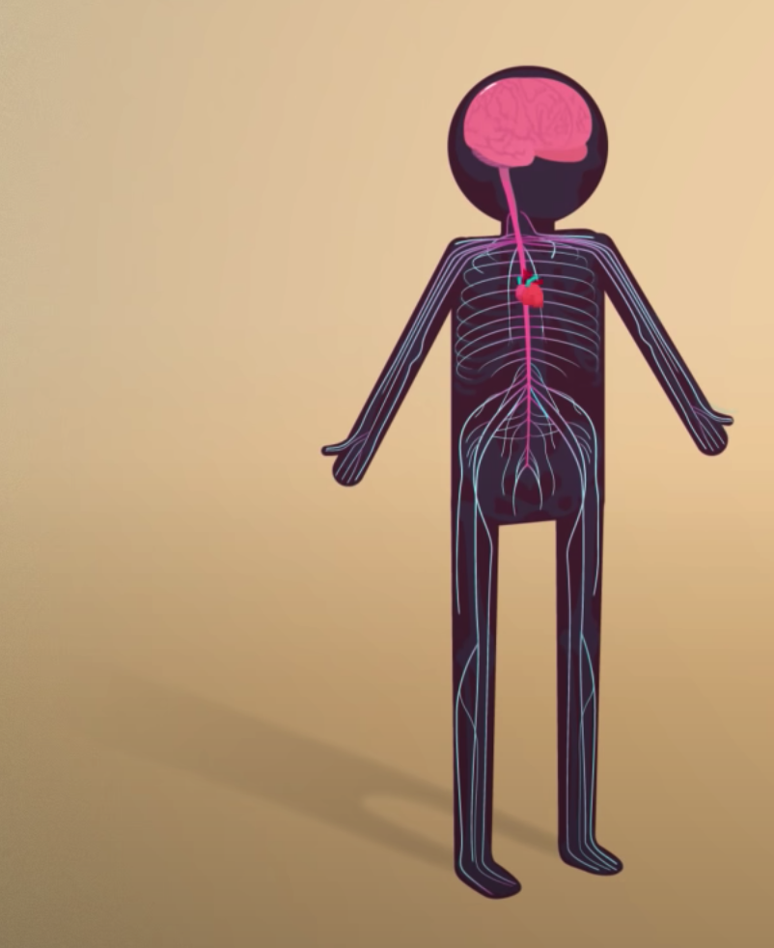
Brain Background
tobaccopreventiontoolkit.stanford.edu
Different parts of the brain control different behaviors and different parts of our body
Some parts of the brain do things without us thinking about while other behaviors we have more control over
Notes:
Teacher Talking Points:
Our brain affects how we experience the world around us. It keeps our body functioning and it also controls our behavior.
Some things our brain does without us thinking about it (like breathing) while other behaviors we have more control over (talking, singing).
There is even a part of the brain that controls speech and another that controls smell.
Multiple areas of the brain are often working at the same time to help us engage in different behaviors. For example, when we are walking, this involves using multiple areas of the brain starting from our decision to walk to us standing up and taking our first step.
Image Credit: https://youtu.be/qPix_X-9t7E

Slide 5
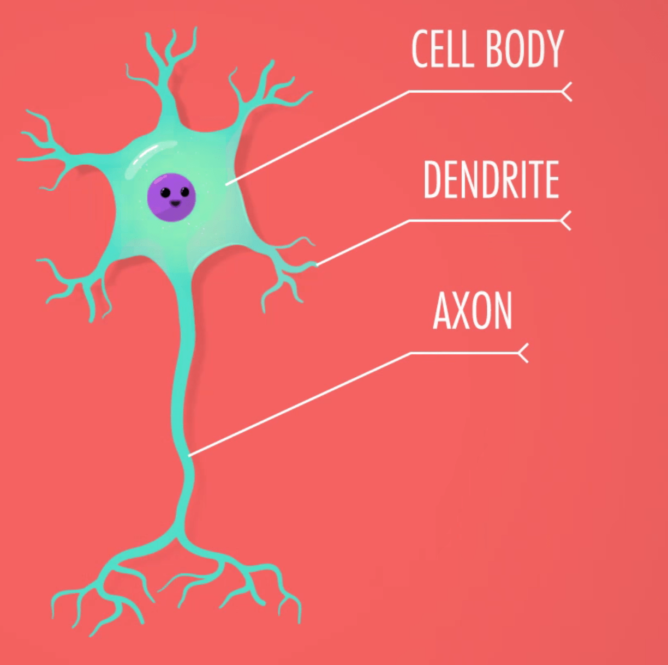
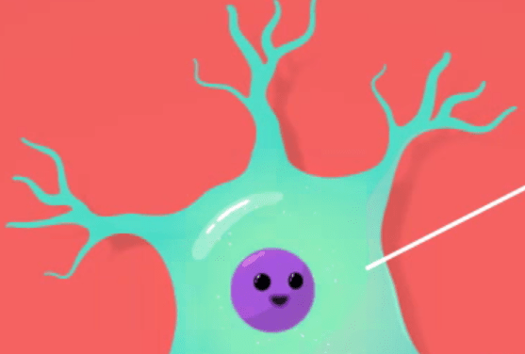
Brain Communication
tobaccopreventiontoolkit.stanford.edu
Cell Body: Control center of the cell
Dendrites: Gets messages from other neurons
Axon: The road that carries messages from the cell body to the synapse
Synapse: Where two neurons meet and communicate
Neurotransmitters: Chemical messages
SYNAPSE
Notes:
Teacher Talking Points:
For our bodies to function, the different parts of our brains need to communicate with each other.
The neuron is the signal cell of the nervous system. The communication between the billions of neurons in the nervous system is what allows our bodies to function and what allows us to think and move.
The neuron is made up of a few parts. The cell body, the control center of the neuron, where the nucleus is housed. The cell body gives the rest of the cell instructions on what to do.
The dendrites are the branches of the neuron that receive messages from other neurons.
The axon is the roads that carries information from the cell body to the synapse (the end of the neuron). The synapse is the part where two neurons communicate by sending chemical messages called neurotransmitters.
Reference:
https://psych.athabascau.ca/html/Psych289/Biotutorials/1/soma.shtml
Images: https://youtu.be/qPix_X-9t7E

Slide 6
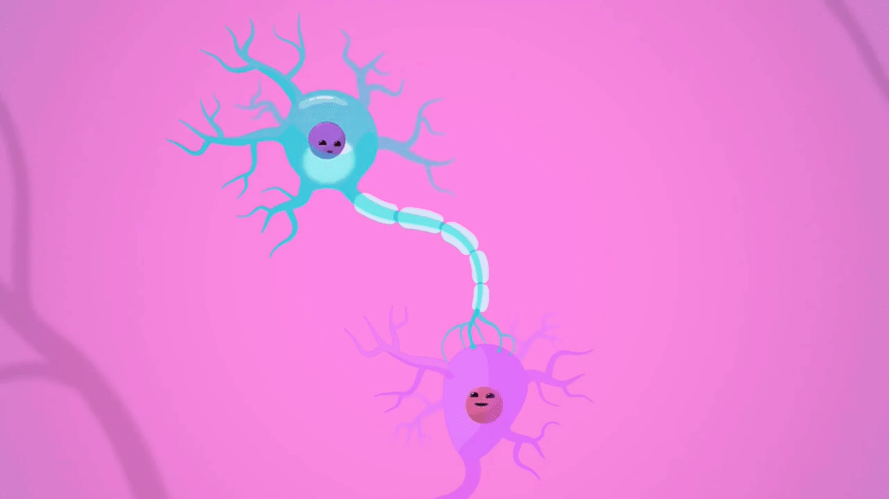
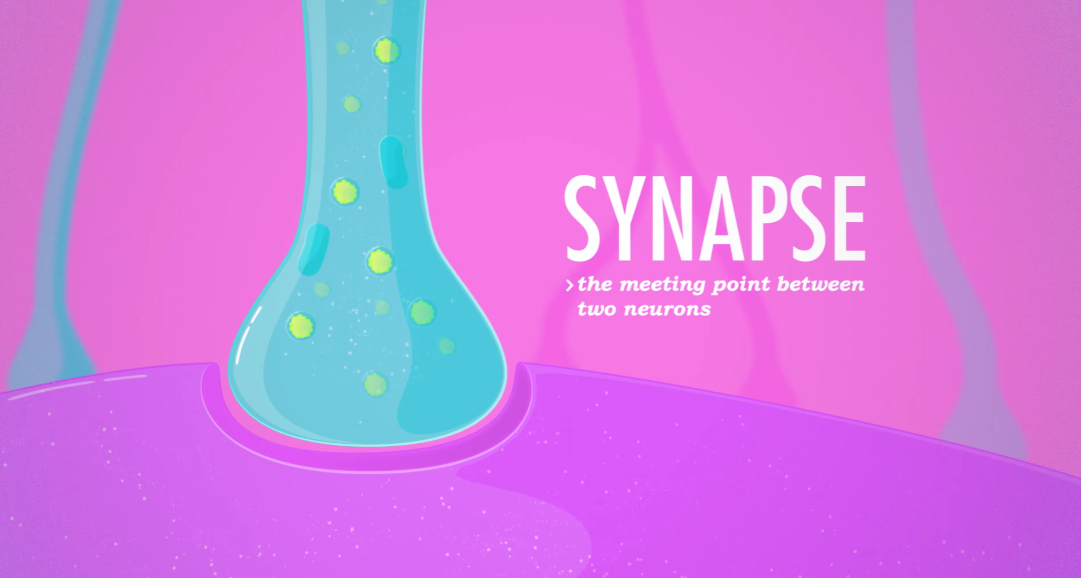
Brain Communication
tobaccopreventiontoolkit.stanford.edu
Electrical Message
Notes:
Teacher Talking Points:
For neurons to communicate, an electrical message travels between neurons.
The message starts from one neuron, travels through a space between neurons called the synapse, and then connects to the next neuron. (Click.)
The signal keeps going through a big web of connected neurons.
Another way to think about this is when you play “telephone” by stringing soup cans on a string. The message travels from one soup can to another through the string that connects them, allowing for communication between separate things.
Let’s zoom into the synapse.
Images: https://youtu.be/VitFvNvRIIY

Slide 7
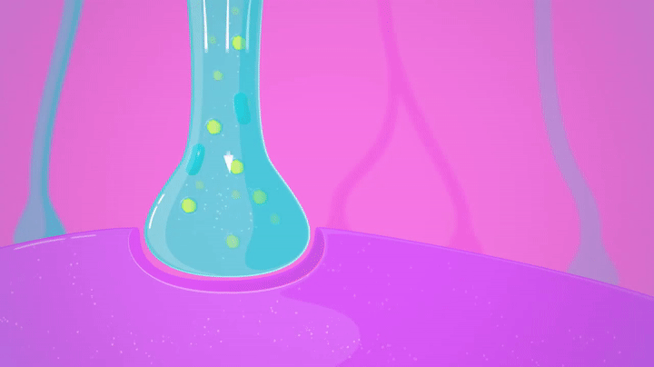
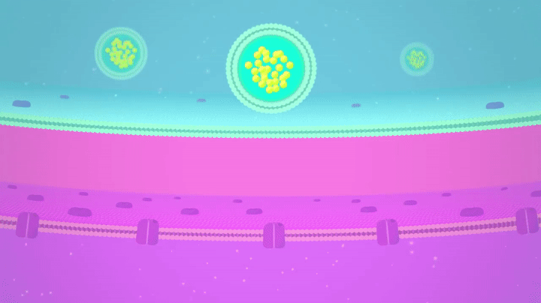
Brain Communication
tobaccopreventiontoolkit.stanford.edu
Signaling Neuron
Neurotransmitters
Neurotransmitters
Receiving Neuron
Notes:
Teacher Talking Points
Neurotransmitters are the chemical messengers used by the brain to communicate from one neuron to another (click).
Neurotransmitters are released from the signaling neuron into the space between neurons, then connect to the receptors of the receiving neuron. The neurotransmitters tell the receiving neuron to take action.
Different kinds of neurotransmitters communicate different messages and give different instructions to the neuron it connects to.
These tiny neurons make a huge network in the body and are the foundation for the body’s nervous system.
Ref: https://faculty.washington.edu/chudler/cells.html
Images:https://youtu.be/OZG8M_ldA1M

Slide 8
The Adolescent Brain:
A Work in Progress
Image Credit: Pixabay.com
Notes:
Teacher Talking Points:
Drugs can leave long-lasting effects on the brain, especially if you are a teenager. Next, we are going to talk about what makes the teenage brain unique.
Image: https://pixabay.com/static/uploads/photo/2015/10/26/18/58/brain-1007686_960_720.png

Slide 9
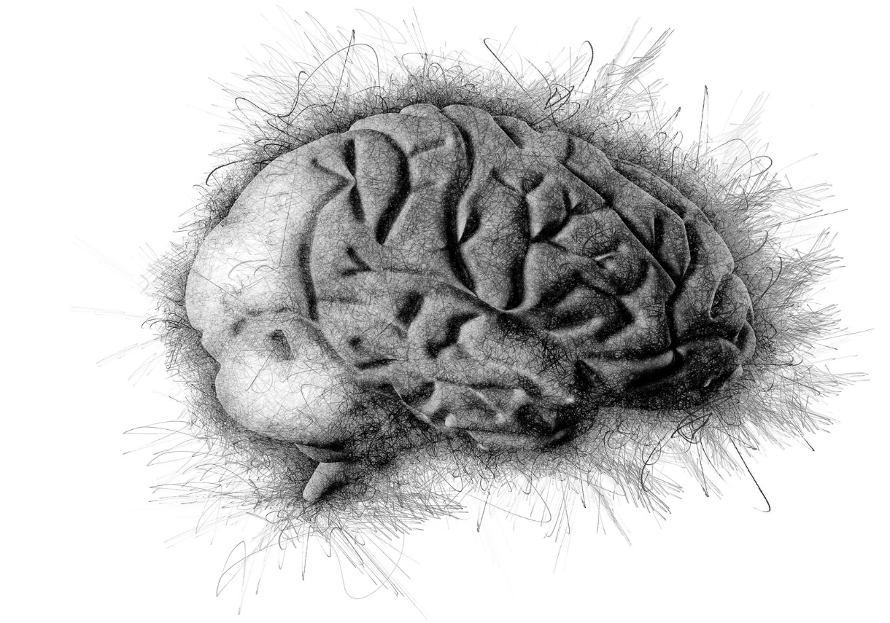
The Adolescent Brain: Dispelling Some Myths
tobaccopreventiontoolkit.stanford.edu
Yes, the adolescent brain is developing structurally.
But, it still functions!
It is elastic and has a great potential for learning new skills.
Notes:
Teacher Talking Points:
The teenage or adolescent brain is a work in progress- in a good way.
Your brain is doing a lot of growing and learning during your teenage years and even continuing into adulthood.
Structures in your brain are developing and adapting to all the things going on in your life.
It’s great time to learn new skills and hobbies because those things can become more cemented in your brain for the rest of your life.
However, risky behaviors, like using drugs, can also more strongly impact your brain during these years.

Slide 10
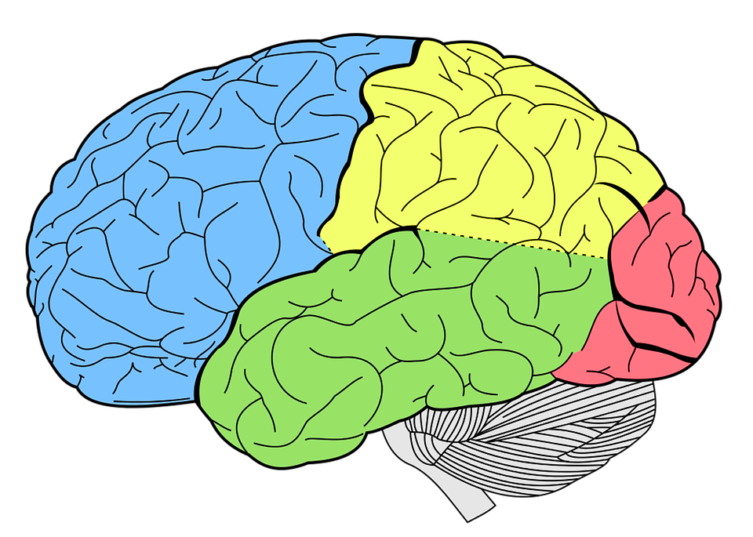
The Adolescent Brain: Dispelling Some Myths
tobaccopreventiontoolkit.stanford.edu
Front
Prefrontal Cortex
Back
Physical Coordination
Image Credit: Pixabay.com
Notes:
Teacher Talking Points:
Our brains develop in a “back to front” fashion over our childhood and teenage years (click).
Areas near the back of our brain, which control things such as coordination and vision develop first.
Areas in the middle of our brain called the limbic system, which control our emotions, develops next. This system is well-developed when we are teenagers.
During our teen years, the front part of our brain called the prefrontal cortex, which we use to help make decisions, is still continuing to develop. In fact, it doesn’t stop developing until we are around 25.
Reference: http://www.drugfree.org/why-do-teens-act-this-way/adolescent-brain-and-behavior/

Slide 11
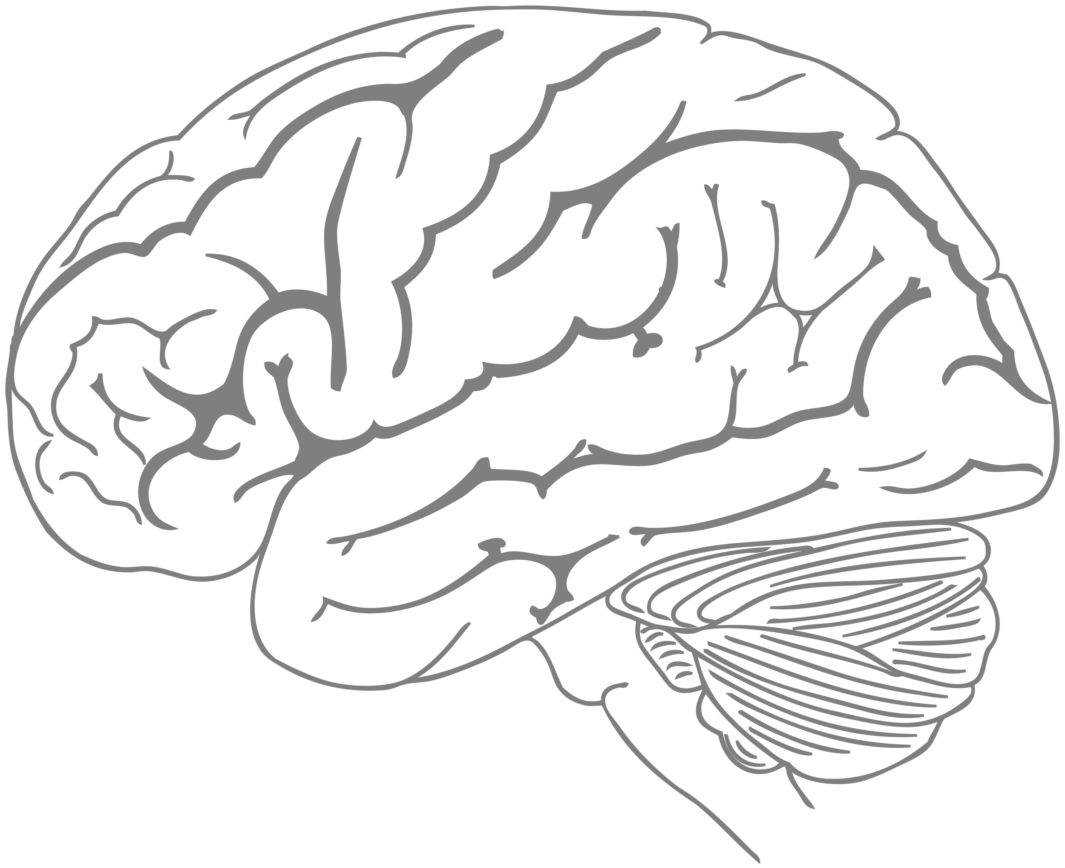
Adolescent Brain vs. Adult Brain
tobaccopreventiontoolkit.stanford.edu
Notes:
Teacher Talking Points:
So, to put it simply, this is what is happening:
During your teen years, your brain has a significant increase in synapses, the connections between neurons in the brain.
Your brain looks a little like the LA freeway system (click) - there a lot of new connections and roads going everywhere.
(Click) And there is a lot of traffic. Your brain is experiencing a lot of stimuli right now.
In essence, the chemicals in your brain feel like they are in bumper-to-bumper traffic on the highway. As such, while your brain functions well, sometimes there is a lot of traffic slowing down your information processing. This is totally normal!
Images:
Pixabay.com, Canva.com

Slide 12
Adolescent Brain vs. Adult Brain
tobaccopreventiontoolkit.stanford.edu
Notes:
Teacher Talking Points:
As you start to get older, your brain starts to “prune” away some of these additional connections to help consolidate your learning.
By the time you are in your early to mid twenties, your brain has reduced the number of synapses or “freeways” (click).
Also, during this time, your neurons are undergoing increased “myelination”. This is involves forming a type of “sheath” or connecting channel or “roads” between neurons. This allows for the processing of information (or travel between two places) to be smoother and more efficient.
(Click) As such, you have less traffic and information flows more smoothly.
Images:
Pixabay.com, Canva.com

Slide 13
Synaptic Pruning
tobaccopreventiontoolkit.stanford.edu
Notes:
Teacher Talking Points:
Let’s watch this video on the process of synaptic pruning.
Video link: https://youtu.be/rxPT78F_ZVE

Slide 14
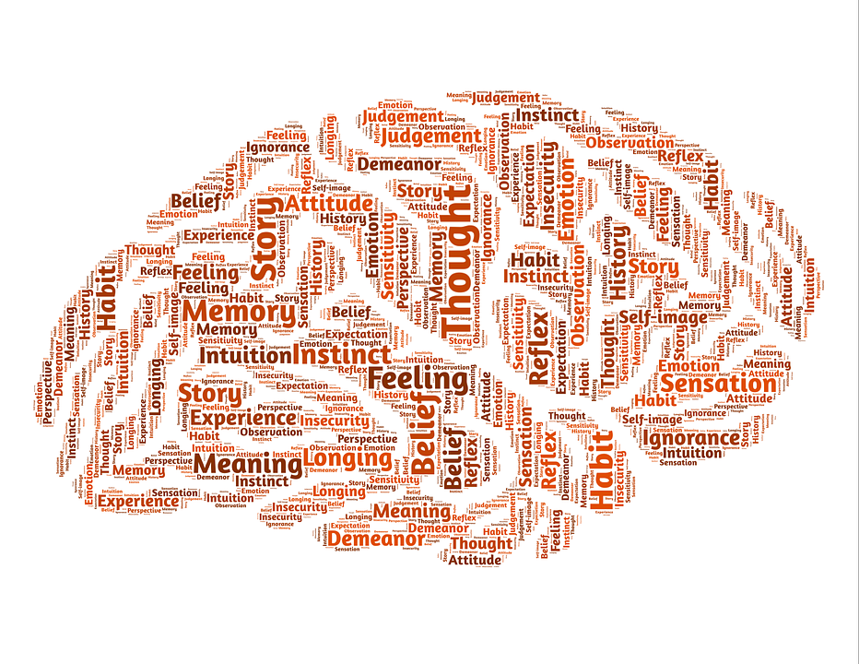
The Adolescent Brain: Dispelling Some Myths
tobaccopreventiontoolkit.stanford.edu
Notes:
Teacher Talking Points:
There is so much growth and development happening during the teenage years, which is great in many ways.
However, the brain is much more vulnerable to becoming addicted during this period of development.
If we use drugs during our teen years, it not only impacts how the brain works in the moment but it actually affects the development of our brain.
This is why teenagers who smoke get more addicted more quickly than adults and more likely to continue to be addicted to drugs when they become adults.

Slide 15
Why is This Important?
tobaccopreventiontoolkit.stanford.edu
Image Credit: TheFilterWales.org
Notes:
Teacher Talking Points:
The tobacco industry knows that teenagers are most vulnerable to getting addicted to drugs such as nicotine- that is why they target you as an age group!
Reference: http://the84.org/get-the-facts/tobacco-executive-quotes/

Slide 16
How Drugs Affect the Brain
Image Credit: Pixabay.com
Notes:
Teacher Talking Points:
Next, we are going to talk about how drugs affect the brain.

Slide 17
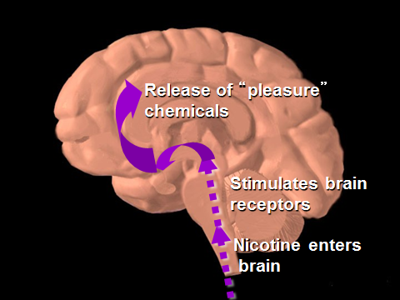
Drugs Affect the Brain
tobaccopreventiontoolkit.stanford.edu
Stimulates the “reward pathway”
Copies the natural chemical messengers (neurotransmitters)
Image Credit: NIDA and NIH via Wikimedia Commons
Notes:
Teacher Talking Points:
In general, there are two main ways that drugs can affect the brain.
Drugs can affect the brain by over-stimulating a part of the brain called the “reward pathway;” the reward pathway is what makes people feel good, it's how in this case nicotine makes people feel good.
or drugs pretend to be our natural chemical messengers (neurotransmitters) and takes advantage of the neurons that normally use those neurotransmitters.
Image Reference: https://www.drugabuse.gov/publications/drugs-brains-behavior-science-addiction/preface
http://teens.drugabuse.gov/drug-facts/brain-and-addiction

Slide 18
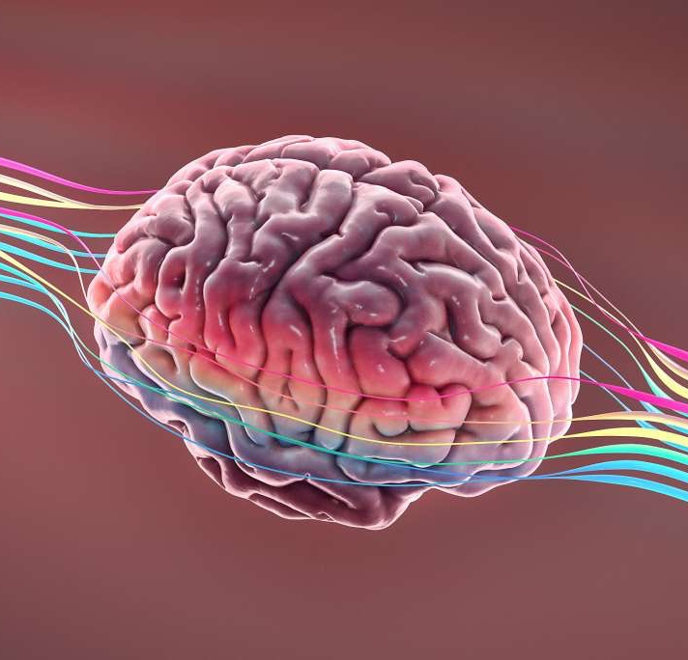
Dopamine
tobaccopreventiontoolkit.stanford.edu
Dopamine causes you to experience pleasure.
Your brain uses dopamine to teach your body what is good for you or important for survival.
Drugs don’t benefit your health or survival, yet they fool your brain into releasing dopamine.
Notes:
Teacher Talking Points:
Dopamine is an important neurotransmitter that plays a role in the brain’s response to drugs.
(Click) Dopamine causes you to experience pleasure. It’s responsible for making you feel good.
(Click) When you do something that is good for you or important for survival, your brain fires off dopamine.
Your brain uses dopamine to teach your body what is healthy and good for your survival. Over time your brain wants to do that action again since it brings you pleasure.
(Click) Drugs hijack the part of your brain that releases dopamine. Drugs fool the brain into releasing dopamine, often in greater amounts than the body has experienced before. So much dopamine is released that it’s easy for your brain associate this feeling with survival.
Image:
https://www.sfchronicle.com/culture/article/Dopamine-fasting-How-Silicon-Valley-is-trying-to-14811245.php
https://www.drugabuse.gov/publications/brain-power/grades-6-9/legal-doesn't-mean-harmless-module-2/background
https://teens.drugabuse.gov/teachers/mind-over-matter/nicotine/how-does-nicotine-act-brain
Reference: http://www.addictionsupport.aarogya.com/images/stories/neurochems%20dopamine%20serotonin.jpg

Slide 19
Reward
Pathway
Drugs and the Brain
tobaccopreventiontoolkit.stanford.edu
Image Credit: NIDA.NIH.gov, Canva.com
Notes:
Teacher Talking Points:
Drugs like to “hijack” and take control of your reward pathway so you no longer have control over it.
Drugs cause almost twice to ten times the release of dopamine from this pathway, and can occur almost immediately and last longer than the dopamine released from “survival activities.”
For example, when you use a cigarette, the nicotine in the cigarette causes dopamine to be released.
This is why people initially feel good after using a cigarette.
However, your brain continues to crave that dopamine release after you done, and you slowly lose control over your choice to use cigarettes, especially since these drugs artificially release more dopamine than your body naturally does.
This is how people become addicted to cigarettes.
Reference: http://www.addictionsupport.aarogya.com/images/stories/neurochems%20dopamine%20serotonin.jpg

Slide 20
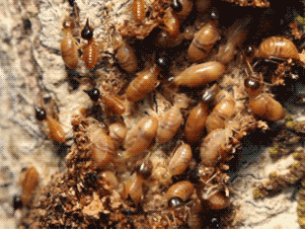
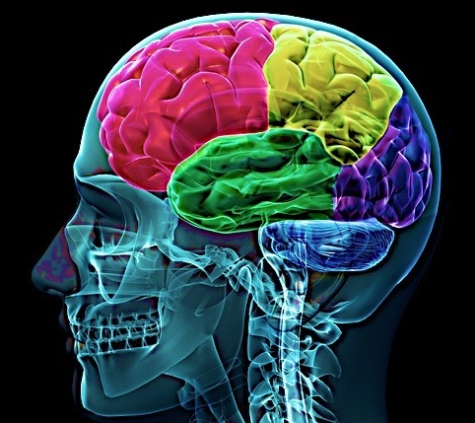
The Brain on Nicotine
tobaccopreventiontoolkit.stanford.edu
Nerve Cell
with
Acetylcholine
Synapse
Acetylcholine
Receptors
Nicotine
Image Credit: By United States: National Institute of Health via Wikimedia Commons
Notes:
Teacher Talking Points:
Another important neurotransmitter is acetylcholine.
Nicotine mimics the structure of acetylcholine, a neurotransmitter in our body, and binds to wherever there are acetylcholine receptors in the brain.
However, since nicotine isn’t actually acetylcholine, it affects acetylcholine binding and prevents it from doing the job it is supposed to do in the brain.
(Click) Your brain is a perfect target for nicotine because you already have receptors there that are willing and ready to bind to nicotine because it think it is something different. Nicotine is taking advantage of the way your brain is already set up to manipulate it.
One way to think about it is termites coming into your home. (Click) Your home is a structure that is already built, for you to live in. Termites come in and take advantage of this structure to build a place to live, altering the original use for the house.
References:
https://www.drugabuse.gov/publications/brain-power/grades-6-9/legal-doesn't-mean-harmless-module-2/background
https://teens.drugabuse.gov/teachers/mind-over-matter/nicotine/how-does-nicotine-act-brain

Slide 21
Denoble File #3: Earmuffs
tobaccopreventiontoolkit.stanford.edu
DeNoble File #3: Earmuffs
Arizona Department of Health Services
Notes:
Teacher Talking Points:
This video can help us better understand how the brain’s function can be hijacked by drugs and addiction.
The narrator is a former tobacco scientist, Dr. Victor DeNoble, who testified to Congress against the tobacco industry and now provides education about the science of drug addiction.
(Click on image to follow link to YouTube video.)
(https://youtu.be/uFX9F-KD7co?list=PLeL9ROmy1WLSIfA5-Njp_TKwz1vZpaRcP)

Slide 22
Unit Quiz
tobaccopreventiontoolkit.stanford.edu
Notes:
Click image to follow link- http://tinyurl.com/TPT-The-Brain

