Slide 1
Addiction 101
© Stanford University

Slide 2
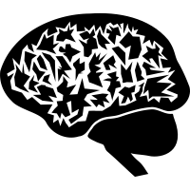
In this presentation:
tobaccopreventiontoolkit.stanford.edu
Definition of Addiction
Addiction Myths
Addiction Physiology
Effects of Addiction
Notes:
Teacher Talking Points:
We’ll discuss the definition of addiction, talk about the physiology of addiction, addiction myths, and the effects of addiction.

Slide 3
Definition of Addiction
Image Credit: Pixabay.com
Notes:
Teacher Talking Points:
Drugs can leave long-lasting effects on the brain, especially if you are a teenager. Next, we are going to talk about what makes the teenage brain unique.
Image: https://pixabay.com/static/uploads/photo/2015/10/26/18/58/brain-1007686_960_720.png

Slide 4
Pair-Share Brainstorm
tobaccopreventiontoolkit.stanford.edu
How do you define “addiction”?
Give examples
Notes:
Teacher Talking Points:
Find a partner and together come up with your best definition for the term “addiction.”
Then list examples that fit your definition.
(Have each pair share their definition and examples, or take a few volunteers if you want to save time.)
What similarities or differences did you notice between the definitions?

Slide 5
What is Addiction?
tobaccopreventiontoolkit.stanford.edu
“Addiction is defined as a chronic, relapsing brain disease that is characterized by compulsive drug seeking and use, despite harmful consequences. It is considered a brain disease because drugs change the brain—they change its structure and how it works. These brain changes can be long-lasting, and can lead to the harmful behaviors seen in people who abuse drugs.”
-NIDA
Notes:
Teacher Talking Points:
Let’s start by looking at the definition from the National Institute on Drug Abuse (NIDA)
Addiction is defined as a chronic, relapsing brain disease that is characterized by compulsive drug seeking and use, despite harmful consequences. It is considered a brain disease because drugs change the brain—they change its structure and how it works. These brain changes can be long-lasting, and can lead to the harmful behaviors seen in people who abuse drugs.
Let’s break down this definition to better understand what it is saying.
(Reference: https://www.drugabuse.gov/publications/drugs-brains-behavior-science-addiction/drug-abuse-addiction)

Slide 6
What is Addiction?
tobaccopreventiontoolkit.stanford.edu
“Addiction is defined as a chronic, relapsing brain disease that is characterized by compulsive drug seeking and use, despite harmful consequences. It is considered a brain disease because drugs change the brain—they change its structure and how it works. These brain changes can be long-lasting, and can lead to the harmful behaviors seen in people who abuse drugs.”
-NIDA
Notes:
Teacher Talking Points:
Take a look at the first sentence, what does the term “chronic” mean?
What does “relapsing” mean?
How can we say “compulsive drug seeking” in a different way?
Lastly, what does NIDA mean when they say “despite harmful consequences.”

Slide 7
What is Addiction?
tobaccopreventiontoolkit.stanford.edu
“Addiction is a long-term disease where an individual has an overwhelming desire to find and use drugs, even though there are dangerous consequences. It is considered a brain disease because drugs change the brain—they change its structure and how it works. These brain changes can be long-lasting, and can lead to the harmful behaviors seen in people who abuse drugs.”
-NIDA
Notes:
Teacher Talking Points:
Let’s replace the first sentence with a simpler version and look at the last two sentences.
Can anyone think of a simpler way to say the same thing as the last sentences?

Slide 8
What is Addiction?
tobaccopreventiontoolkit.stanford.edu
“Addiction is a long-term disease where an individual has an overwhelming desire to find and use drugs, even though there are dangerous consequences. Addiction is a disease because it can result in long-term changes in the brain structure, function, and behaviors caused by drug use”
Notes:
Teacher Talking Points:
So, if we replace the NIDA sentences with a simplified definition then we get this.
Addiction is a long-term disease where an individual has an overwhelming desire to find and use drugs, even though there are dangerous consequences. Addiction is a disease because it can result in long-term changes in the brain structure, function, and behaviors caused by drug use
Moving forward, this will be the definition we’ll refer to for the rest of this unit.

Slide 9
Understanding Addiction as a Disease (Wait21)
tobaccopreventiontoolkit.stanford.edu
Notes:
Teacher Talking Points:
The brain is also important as it continues to grow and develop during adolescence. Anything you put into your brain changes it and makes you that much more likely to become addicted.
This video explains how addiction is a disease. The video uses alcohol as an example but the same is true for nicotine products.
Pay special attention to the description of the Hierarchy of Survival as we will discuss it again soon.
[Hover over slide and click the play button in the bottom left corner]
[After video is shown] I noticed that a few of you were laughing a bit while watching that, me too when I first saw it. It tries to get a point across about how addiction works in a funny but true way.
So, tell me...what did you think of the video? (Take a few responses) What part of this makes sense? Can you understand a bit how nicotine may work?
(https://www.youtube.com/watch?v=-w8n9UOiBxE)

Slide 10
Background on the Brain
Image Credit: Pixabay.com
Notes:
Teacher Talking Points:
In this section, we are going to go over some basic information about the brain, specifically how the brain communicates.

Slide 11
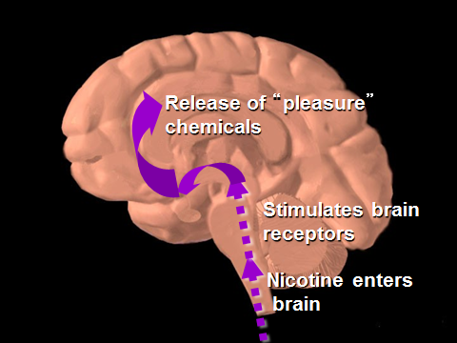
Reward Pathway
tobaccopreventiontoolkit.stanford.edu
Notes:
Teacher Talking Points:
There is a part of the brain called the "reward pathway." This pathway operates when you do things that make you feel good.
Whenever you do something that feels good, you release the neurotransmitter dopamine. And when we feel good, we are more interested in doing that same event over again.
This pathway was developed evolutionarily to help us pursue activities that would help us survive.
Drugs like to "hijack" and take control of your reward pathway so you no longer have control over it.
For example, when when a drug is used, it causes dopamine to be released. That is why people might initially feel good after using a drug.
However, the brain continues to crave the dopamine release afterward and the user slowly lose control over their choice to use drugs.
Reference: http://www.addictionsupport.aarogya.com/images/stories/neurochems%20dopamine%20serotonin.jpg

Slide 12
Increase in Tolerance Over Time
DAY
Withdrawal
Notes:
Teacher Talking Points:
(Click) Over time, drug use will cause the body to adapt, reducing the body’s response to the drug.
(Click) Eventually, the person using the drug will start craving more of the drug to feel the same high or even just to feel normal. This is referred to as an increase in tolerance.
If the person using the drug stops using the drug they will experience negative side effects known as withdrawal symptoms. (Click.)
(Click) The combination of increased tolerance and withdrawal symptoms causes the drug user to crave the drug and avoid withdrawals at all cost. This leads to the hijacking of the Hierarchy of Needs described in the last video.
The brain experiences physical changes as a result of the drug use and gets rewired to prioritize getting more of the drug, even if it causes physical, emotional, and financial harm.

Slide 13
Summary of Addiction Physiology
tobaccopreventiontoolkit.stanford.edu
Notes:
Teacher Talking Points:
This video summarizes some of the topics we just covered.
[Hover over slide and click the play button.]
If technical issues should arise then watch this video with your students on YouTube by using this link: https://youtu.be/VI4KZWtROt0

Slide 14
Addiction Myths
Image Credit: Pixabay.com
Notes:
Teacher Talking Points:
Now that you have a better understanding of what addiction really means, let’s think about how many people have the wrong idea about addiction.

Slide 15
Common Ideas Brainstorm
tobaccopreventiontoolkit.stanford.edu
When you hear the word “addiction,” what things come to mind?
Notes:
Teacher Talking Points:
What are some things that you have heard about addiction?
It doesn’t have to be something you believe or know for a fact, just things you have heard.
(Take responses from the class and clear up any misconceptions that you hear.)

Slide 16
Myths About Addiction
tobaccopreventiontoolkit.stanford.edu
MYTH
“Addiction is just a lack of self control”
“If I only use a drug occasionally then I can’t be addicted.”
“It’s always easy to tell when someone is addicted to a drug.”
RESPONSE
2.
3.
Notes:
Teacher Talking Points:
We are going to take a closer look at a few of the common myths (click) about addiction and see if we can use the information we learned to come up with responses to the misconceptions.
What could you say to someone who says, “Addiction is just a lack of self control?” (Click.) (Take responses from the class.)
What could you say to someone who says, “If I only use a drug occasionally then I can’t be addicted?” (Click.) (Take responses from the class.)
What could you say to someone who says, “It’s always easy to tell when someone is addicted to a drug?” (Click.) (Take responses from the class.)

Slide 17
Short Term and Long Term Effects
Image Credit: Pixabay.com
Notes:
Teacher Talking Points:
Let’s talk about how addiction can have real world effects.

Slide 18
How Addiction Changes Your Brain (CNN)
tobaccopreventiontoolkit.stanford.edu
Notes:
Teacher Talking Points:
This video briefly describes some of the changes drugs can have on the brain.
[Hover over slide and click the play button.]
If technical issues should arise then watch this video with your students on YouTube by using this link: https://www.youtube.com/watch?v=5f1nmqiHIII

Slide 19
Effects on Loved Ones
tobaccopreventiontoolkit.stanford.edu
Letter Writing Activity
Notes:
Teacher Talking Points:
There are many possible ways that addiction can affect loved ones.
In small groups, you will be assigned a role and you will write a short letter to your loved one who is battling addiction describing how you have been affected.
Assign small groups the following roles:
Parents
Best Friend
Romantic Partner
Coworker
** Disclaimer and debriefing - what to do with disclosure

Slide 20
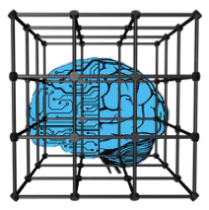
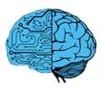
Health Effects
tobaccopreventiontoolkit.stanford.edu
Notes:
Teacher Talking Points:
Addiction causes involuntary changes to the body.
(Click) Addiction takes away the brain’s ability to think and act independently. Living with addiction is like being a robot who is controlled by an outside force.
(Click) Developing an addiction can also stunt physical and mental growth.
(Click) The ability to reproduce and have children in a healthy way can be comprised by addiction.
(Click) And one incredibly important fact to remember is, the earlier in life a person starts using drugs, the harder it is to break free from the addiction.

Slide 21
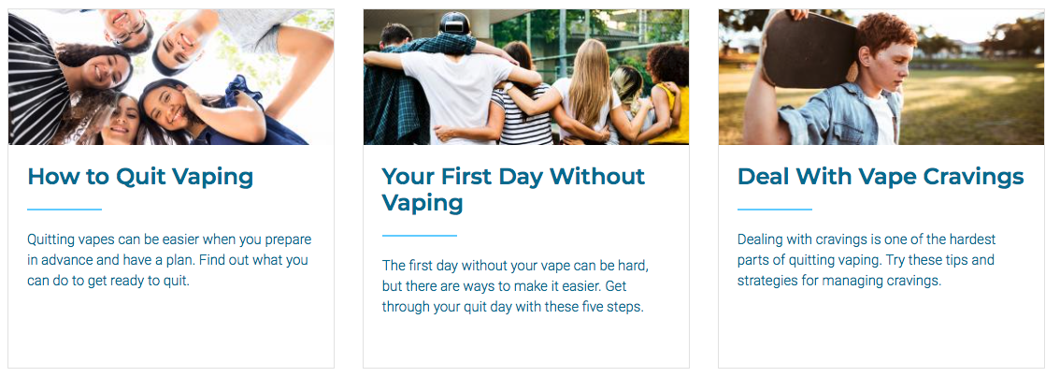
Teen.smokefree.gov
1-800-QUIT-NOW
(1-800-784-8669)
Notes:
Teacher Talking Points:
Quitting a tobacco product can be incredibly difficult and it’s important to utilize resources to help support someone who is quitting/going nicotine-free.
Here are additional resources about tobacco/nicotine cessation.
Here is a national website that offers information on quitting e-cig/vape use.
There is a national hotline, 1-800-QUIT-NOW (1-800-784-8669). When you call that number and give them the state you’re calling from, they will connect you to your state’s hotline.
Each state varies in the type of services offered (http://map.naquitline.org/).
References:
https://teen.smokefree.gov/
http://map.naquitline.org/

Slide 22
Text “DITCHJUUL” to 887-09
Daily quitting tips
Designed with feedback from teens and college students who have tried to quit, or have successfully quit
Notes:
Teacher Talking Points:
Here is another e-cigarette quit program. If you text “DITCHJUUL” to 887-09 then you will receive daily tips on how to quit vaping. It's easy to use and easy to stop if you don't want it.
Reference:
https://truthinitiative.org/what-we-do/quit-smoking-tools

Slide 23
California Smoker’s Helpline
1-844-8-NO-VAPE
1-844-866-8273
Notes:
Teacher Talking Points:
This resource is for people who live in California.
Free individual counseling and coaching is available to youth who want to quit e-cigs/vapes. You need to enroll first, which only takes 5 minutes to do. They can also email free reading materials if you want them.
Reference:
https://www.nobutts.org/

Slide 24
My Life, My Quit
https://mylifemyquit.com
Text “Start My Quit” to 855-891-9989
Notes:
Teacher Talking Points (outside California):
There is also a new youth tobacco/nicotine cessation program, available for free in Colorado, Hawai’i, Idaho, Iowa, Kansas, Kentucky, Massachusetts, Michigan, Minnesota, Montana, Nevada, New Hampshire, North Dakota, Ohio, Oklahoma, Pennsylvania, Rhode Island, Utah, Vermont, and Wyoming.
They provide structured, live coaching sessions for youth using multiple communication tools. Visit MyLifeMyQuit.com or text “Start My Quit” to 855-891-9989 to learn more. #MyLifeMyQuit #StartMyQuit.
Reference:
https://www.mylifemyquit.com/?utm_source=fb&utm_medium=soc&utm_campaign=TPT

Slide 25
Unit Quiz
tobaccopreventiontoolkit.stanford.edu
Notes:
Click image to follow link- http://tinyurl.com/TPT-Addiction-Quiz

