Slide 1
Nicotine Addiction 101
© Stanford University
Notes:
Teacher Talking Points:
This lesson will take a thorough look at nicotine addiction.

Slide 2
Definition of Addiction
Image Credit: Pixabay.com
Notes:
Teacher Talking Points:
We will start by defining addiction.

Slide 3
What is Addiction?
tobaccopreventiontoolkit.stanford.edu
“Addiction is defined as a chronic, relapsing brain disease that is characterized by compulsive drug seeking and use, despite harmful consequences. It is considered a brain disease because drugs change the brain—they change its structure and how it works. These brain changes can be long-lasting, and can lead to the harmful behaviors seen in people who abuse drugs.”
-NIDA
Notes:
Teacher Talking Points:
Let’s start by looking at the definition from the National Institute on Drug Abuse (NIDA)
Addiction is defined as a chronic, relapsing brain disease that is characterized by compulsive drug seeking and use, despite harmful consequences. It is considered a brain disease because drugs change the brain—they change its structure and how it works. These brain changes can be long-lasting, and can lead to the harmful behaviors seen in people who abuse drugs.
Let’s break down this definition to better understand what it is saying.
(Reference: https://www.drugabuse.gov/publications/drugs-brains-behavior-science-addiction/drug-abuse-addiction)

Slide 4
What is Addiction?
tobaccopreventiontoolkit.stanford.edu
“Addiction is a long-term disease where an individual has an overwhelming desire to find and use drugs, even though there are dangerous consequences. Addiction is a disease because it can result in long-term changes in the brain structure, function, and behaviors caused by drug use”
Notes:
Teacher Talking Points:
Let’s replace the NIDA sentences with this simpler definition.
Addiction is a long-term disease where an individual has an overwhelming desire to find and use drugs, even though there are dangerous consequences. Addiction is a disease because it can result in long-term changes in the brain structure, function, and behaviors caused by drug use
Moving forward, this will be the definition we’ll refer to for the rest of this unit.

Slide 5
Understanding Addiction as a Disease (Wait21)
tobaccopreventiontoolkit.stanford.edu
Notes:
Teacher Talking Points:
This video explain how addiction is a disease. The video uses alcohol as an example but the same is true for nicotine products.
Pay special attention to the description of the Hierarchy of Needs as we will discuss it again soon.
[Hover over slide and click the play button in the bottom left corner]
(https://www.youtube.com/watch?v=-w8n9UOiBxE)

Slide 6
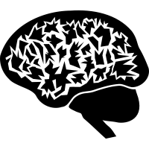
Addiction Physiology
Image Credit: Pixabay.com
Notes:
Teacher Talking Points:
Nicotine causes physiological changes in the body, leading to addiction.

Slide 7
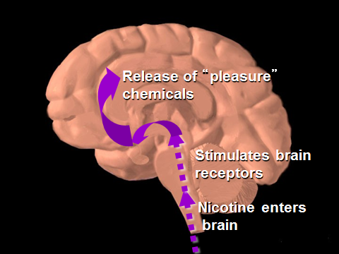
Reward Pathway
tobaccopreventiontoolkit.stanford.edu
Notes:
Teacher Talking Points:
There is a part of the brain called the "reward pathway." This pathway operates when you do things that make you feel good.
Whenever you do something that feels good, you release the neurotransmitter dopamine. And when we feel good, we are more interested in doing that same event over again.
This pathway was developed evolutionarily to help us pursue activities that would help us survive.
Drugs like to "hijack" and take control of your reward pathway so you no longer have control over it.
For example, when a drug is used, it causes dopamine to be released. That is why people might initially feel good after using a drug.
However, the brain continues to crave the dopamine release afterward and the user slowly lose control over their choice to use drugs.
This slide is made available to the public through the National Institute on Drug Abuse Web page, at http://www.nida.nih.gov/Teaching/largegifs/slide-9.gif. Adapted with permission by Dr. Rochelle D. Schwartz-Bloom, Duke University.
Leshner Al. Drug abuse and addiction are biomedical problems. Hosp Pract (special report) April 1997:2–4.

Slide 8
How Addiction Changes Your Brain (CNN)
tobaccopreventiontoolkit.stanford.edu
Notes:
Teacher Talking Points:
This video briefly describes some of the changes drugs can have on the brain.
[Hover over slide and click the play button.]
If technical issues should arise then watch this video with your students on YouTube by using this link: https://www.youtube.com/watch?v=5f1nmqiHIII

Slide 9
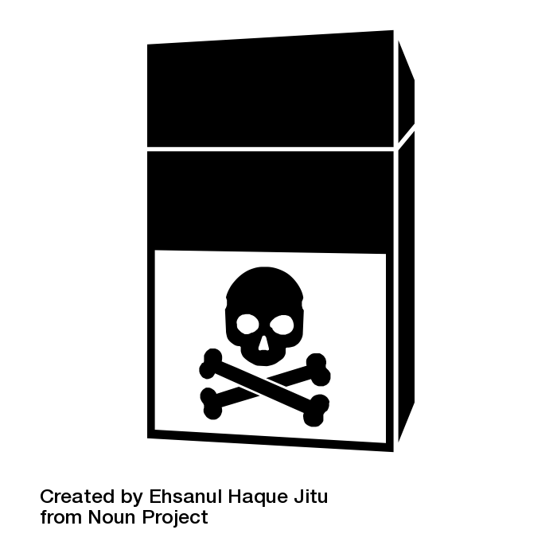
Nicotine Addiction
Image Credit: Pixabay.com
Notes:
Teacher Talking Points:
Let’s talk about nicotine addiction more specifically.

Slide 10
Pop Pre-Quiz
tobaccopreventiontoolkit.stanford.edu
Notes:
Teacher Talking Points:
You have probably heard of nicotine before, let’s see if you can answer a few questions about it.
(Click on image to follow link to http://tinyurl.com/TPT-Nicotine-Addiction)

Slide 11
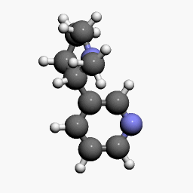
Nicotine Molecule
What is Nicotine?
tobaccopreventiontoolkit.stanford.edu
Drug
Stimulant
Highly addictive
Causes changes in brain chemistry
Found in tobacco products
If nicotine is unsafe, why do you think people still choose to use products that have nicotine?
Notes:
Teacher Talking Points:
Nicotine is a drug that is a stimulant, meaning it raises levels of physical or psychological activity in the body, and it is toxic at high doses.
It is highly addictive since it causes changes in brain chemistry quickly and leaves the brain craving more.
Nicotine is found in tobacco products and nicotine exposure during fetal development has lasting adverse consequences for brain development as it can affect maternal and fetal health during pregnancy.
Data from studies of mice suggest that nicotine exposure during adolescence may have lasting adverse effects on brain development.
(Click) If nicotine is unsafe, why do you think people still choose to use products that have nicotine?

Slide 12
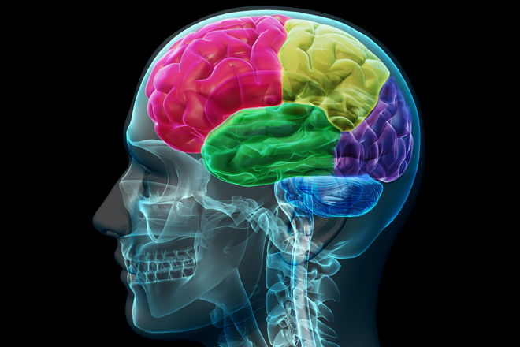
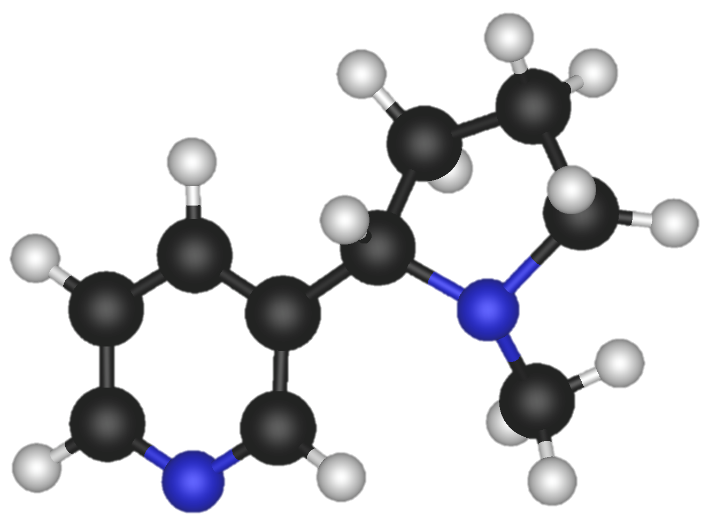
Nicotine in the Brain
tobaccopreventiontoolkit.stanford.edu
Notes:
Teacher Talking Points:
The reaction that nicotine has in the brain results in the stimulation of pleasure centers in the brain.
(Click) When inhaled, nicotine enters into the brain after passing through the lungs.
Then It binds to pleasure receptors in the brain.
(Click) That causes a release of pleasure chemicals such as dopamine, providing the user with a temporary feeling of pleasure.

Slide 13
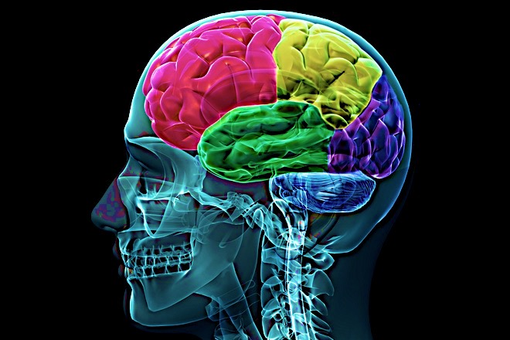
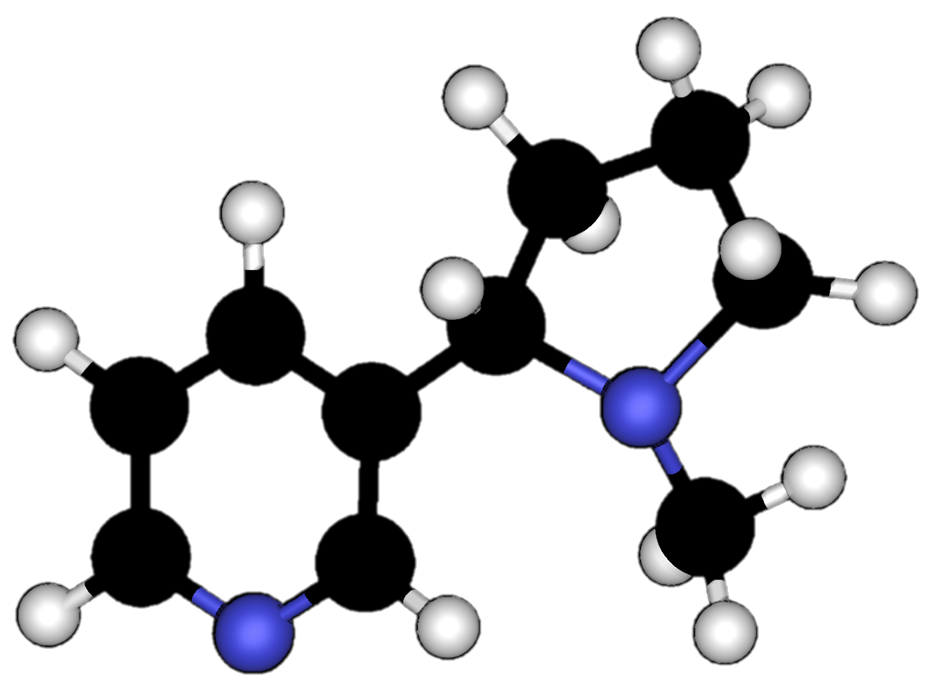
Nicotine Addiction
tobaccopreventiontoolkit.stanford.edu
Notes:
Teacher Talking Points:
This might not sound dangerous but in reality, the nicotine interferes with the body’s natural ability to experience/communicate pleasure.
Nicotine use creates floods of dopamine and intense feelings.
The pleasure centers in the brain adapts to drug use by sensing the extra dopamine and then begins to produce less of it.
This means that the user has a hard time creating natural feelings of pleasure without nicotine.
The user needs the nicotine just to feel normal.
Additionally, the pleasure centers in the brain creates a memory of nicotine and an appetite for it.
That appetite for nicotine, even despite it’s harmful consequences, is what we refer to as nicotine addiction.

Slide 14
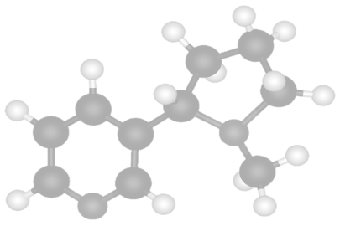
Cycle of Nicotine Addiction
tobaccopreventiontoolkit.stanford.edu
Notes:
Teacher Talking Points:
Nicotine is highly addictive. What that means is, the human brain can develop such a strong dependence on the drug that the nicotine user can no longer control their desire or smoking behaviors.
(Click) The cycle of nicotine addiction starts with bringing nicotine into the body. In this case it comes inhalation of cigarettes, hookah, and or e-cigs/vapes.
(Click) Nicotine enters the brain and activates the pleasure centers of the brain.
(Click) After, the level of nicotine in the body drops quickly.
(Click) This drop in nicotine levels causes the body to have a strong craving for nicotine that is satisfied by bringing more nicotine into the body.
This cycle is powered by the body’s biological reaction to nicotine and isn’t controlled by the person vaping.
Based on this information, what could you say to someone who says they won’t let themselves get addicted to nicotine?

Slide 15
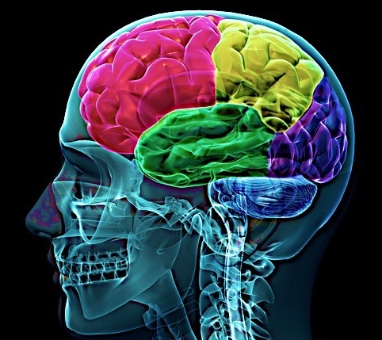
The Brain on Nicotine
tobaccopreventiontoolkit.stanford.edu
Nerve Cell
with
Acetylcholine
Synapse
Acetylcholine
Receptors
Nicotine
Image Credit: By United States: National Institute of Health via Wikimedia Commons
Notes:
Teacher Talking Points:
Another important neurotransmitter is acetylcholine.
Nicotine mimics the structure of acetylcholine, a neurotransmitter in our body, and binds to wherever there are acetylcholine receptors in the brain.
However, since nicotine isn’t actually acetylcholine, it affects acetylcholine binding and prevents it from doing the job it is supposed to do in the brain.
(Click) Your brain is a perfect target for nicotine because you already have receptors there that are willing and ready to bind to nicotine because it think it is something different. Nicotine is taking advantage of the way your brain is already set up to manipulate it.
One way to think about it is termites coming into your home. (Click) Your home is a structure that is already built, for you to live in. Termites come in and take advantage of this structure to build a place to live, altering the original use for the house.
References:
https://www.drugabuse.gov/publications/brain-power/grades-6-9/legal-doesn't-mean-harmless-module-2/background
https://teens.drugabuse.gov/teachers/mind-over-matter/nicotine/how-does-nicotine-act-brain

Slide 16
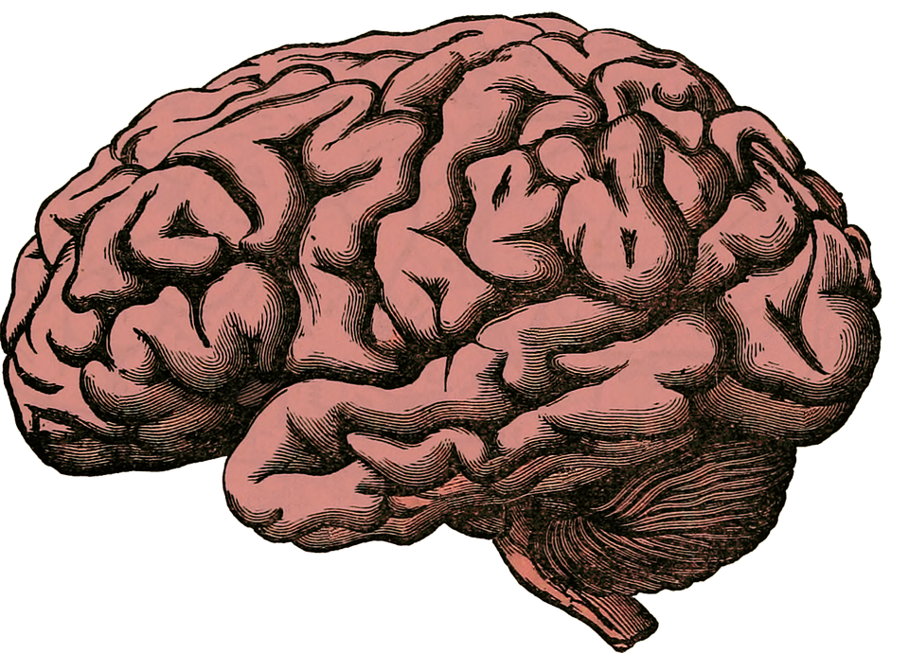
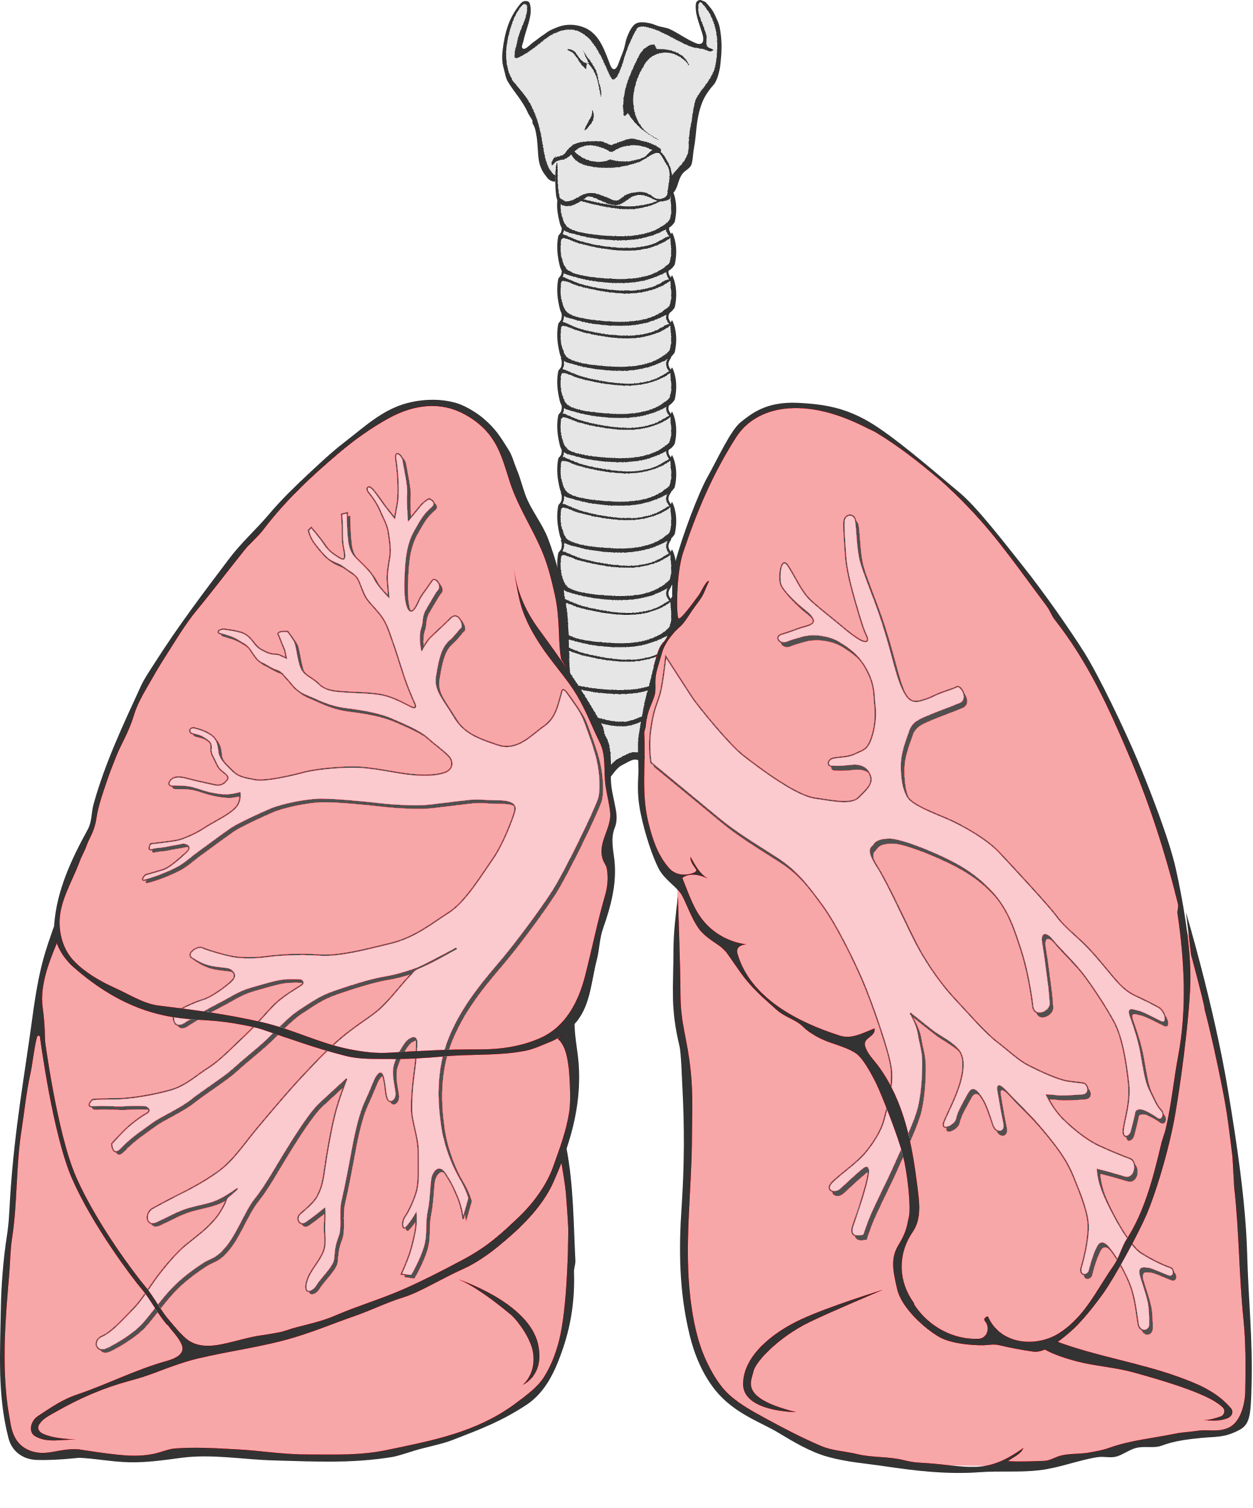
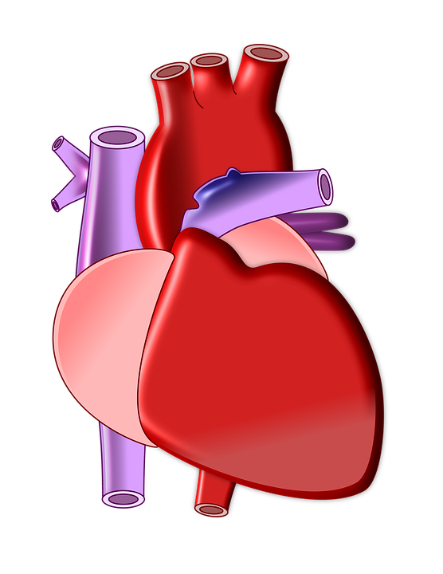
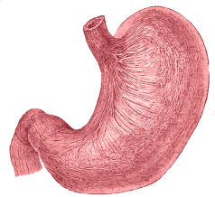
Nicotine Targets Your Whole Body
tobaccopreventiontoolkit.stanford.edu
Rewire and changes the brain
Heart beats faster due to ”fight or flight” response
Trouble breathing and damage to the lungs
Increased acid reflux
Notes:
Teacher Talking Points:
(Click) Nicotine rewires and changes a young person’s brain, making a person anxious when their brain is going through nicotine withdrawal. Nicotine doesn’t just affect your brain since there are “acetylcholine” receptors all over your body.
(Click) For example, using nicotine can make your heartbeat faster because it activates your “fight or flight response.”
Nicotine salt solutions in particular produce a faster and higher heart rate than other aerosolized nicotine solutions, which can put stress on the heart.
(Click) Outside of all the chemicals and toxins already in e-cigarettes, nicotine can independently cause trouble breathing and damage to the lungs. The lungs generally produce mucus and cough in response to the harmful chemicals inhaled.
(Click) Nicotine can also cause increased acid reflux, which leads to heartburn.
Last by not least, nicotine can even negatively impact your reproductive organs.
Reference:
http://www.ncbi.nlm.nih.gov/pmc/articles/PMC4363846/#ref1
https://patents.google.com/patent/CA2909967A1/en
Image Credit:
Pixabay.com, Deviantart.com, Wikimedia Commons

Slide 17
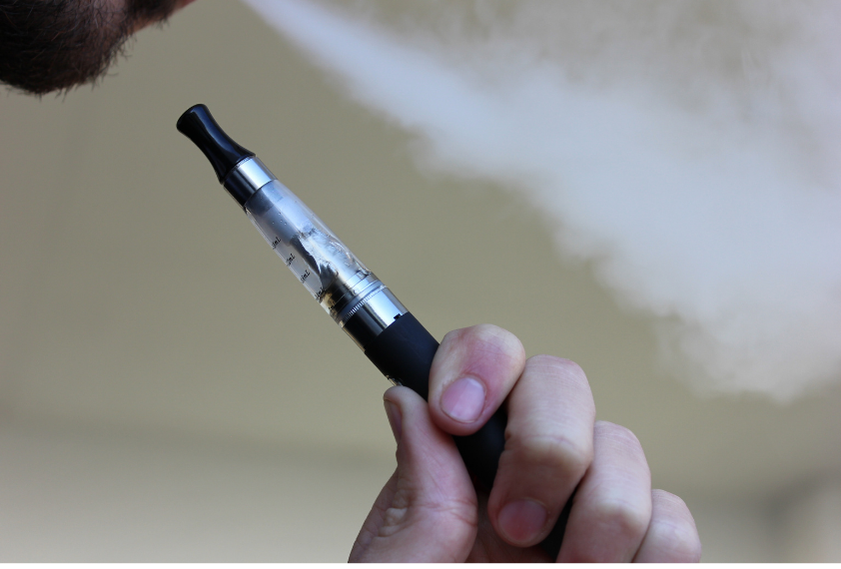
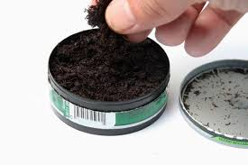
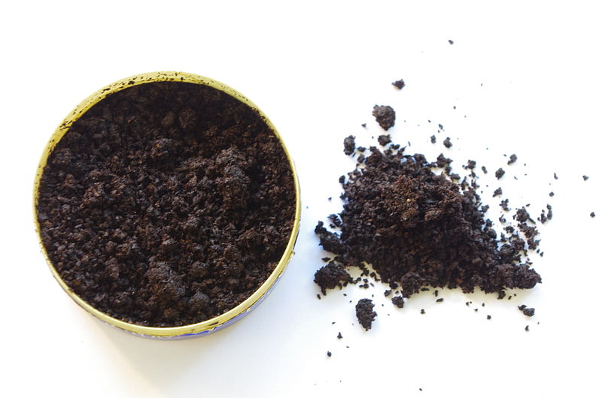
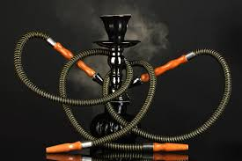
Smoked/Inhaled
Through Mucus
Membranes
CIGARETTES
Snuff
E-CIGS/ VAPES
Method of Delivery
Chew
CIGARS
Snus
HOOKAH
Notes:
Teacher Talking Points:
There are a variety of nicotine products available and their effects on the body can vary depending on the way the nicotine enters the body.
Products like cigars, cigarettes, e-cigs/vapes, and hookah are inhaled, bringing nicotine into lungs, which then sends it to the brain. This entire process takes about 7 to 10 seconds, giving the smoker a quick buzz from the drug.
Other products allow the user to absorb nicotine into the body through a mucous membranes. If you touch your tongue to the inside of your cheek, you can feel this lining that allows some substances to enter directly into the bloodstream.
The nicotine in snus and chewing tobacco is absorbed through the mucous membranes in the mouth. Snuff is sniffed and is absorbed by the mucous membranes in the nostrils.
The process of absorption through mucous membranes is a relatively slower process and takes about 10 to 20 seconds to create a buzz.

Slide 18
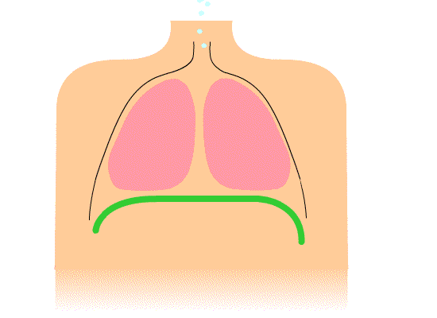
Seconds to Change
tobaccopreventiontoolkit.stanford.edu
Notes:
Teacher Talking Points:
You might be wondering why it matters that inhaled products take less time to cause a high.
Take a breath in (click) now hold it for 10 seconds. That’s all the time it takes nicotine to activate the reward pathway in the brain.
This occurs whether the nicotine is inhaled from a traditional cigarette or an e-cig/vape.
The effects of smoking are almost instantaneous because it is getting to the brain, and wears off quickly, leading to quick highs and lows. Over time this leads to addiction as the body works to avoid the lows and maintain the highs.

Slide 19
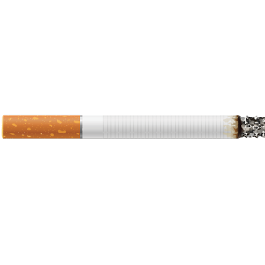
Increase in Tolerance Over Time
DAY
Withdrawal
Notes:
Teacher Talking Points:
(Click) Over time, drug use will cause the body to adapt, reducing the body’s response to the drug.
(Click) Eventually, the person using the drug will start craving more of the drug to feel the same high or even just to feel normal. This is referred to as an increase in tolerance.
If the person using the drug stops using the drug they will experience negative side effects known as withdrawal symptoms. (click)
(Click) The combination of increased tolerance and withdrawal symptoms causes the drug user to crave the drug and avoid withdrawals at all cost. This leads to the hijacking of the Hierarchy of Needs described in the last video.
The brain experiences physical changes as a result of the drug use and gets rewired to prioritize getting more of the drug, even if it causes physical, emotional, and financial harm.

Slide 20
Tobacco/Nicotine Industry
Image Credit: Pixabay.com
Notes:
Teacher Talking Points:
It’s important to consider that the addictiveness of tobacco products is not an accidental coincidence.
The use of nicotine in tobacco products is a choice made by tobacco industry executives to ensure consumers get hooked on their products.
From a business standpoint, having customers that are addicted to a product ensures they have customers for a long time.

Slide 21
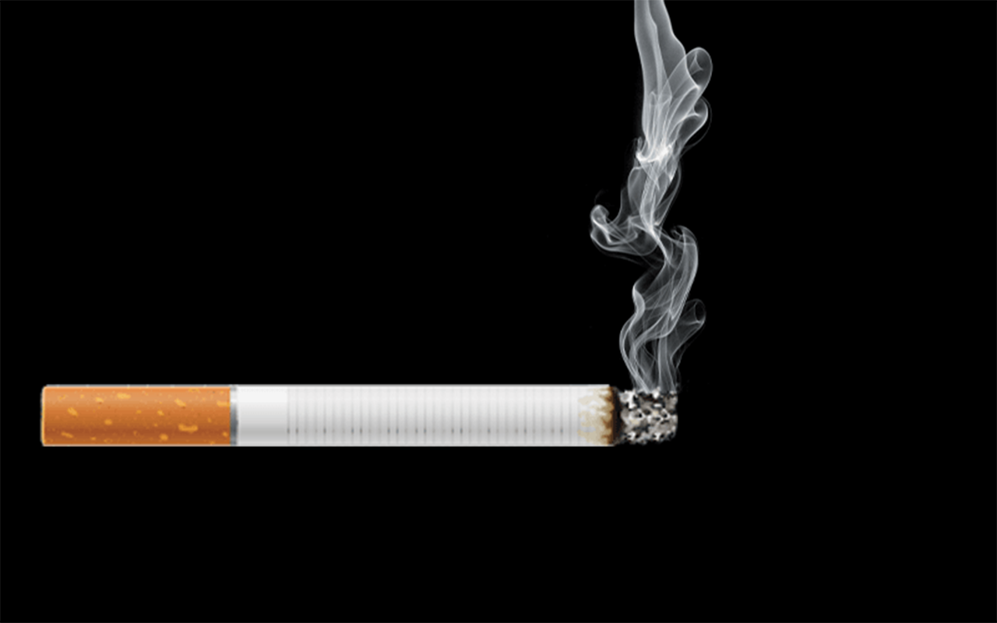
Increasing Addictiveness
Flavorings
Added flavors mask the harshness of smoke and make products more appealing to new users, especially young people
Bronchodilators
Added chemicals expand the lungs’ airways, making it easier for tobacco smoke to pass into the lungs
?
Increased Nicotine
Tobacco companies control the delivery and amount of nicotine to ensure addiction
Sugars & Acetaldehyde
Added sugars make tobacco smoke easier to inhale and form acetaldehyde, which enhances nicotine’s addictive effects
?
Menthol
Menthol cools and numbs the throat to reduce irritation and make smoke feel smoother
Ammonia Compounds
Adding ammonia compounds increases the speed with which nicotine hits the brain
Nicotine Salts
Behave like ammonia compounds, but also hide the harshness of nicotine
Notes:
Teacher Talking Points
There are several features of cigarettes that are designed to make them as addictive as possible.
(Click) The nicotine levels in cigarettes are controlled by the tobacco companies. This is true of both cigarettes and e-cigs/vapes.
(Click) Menthol is a substance found in mint plants that cools and numbs the throat to reduce irritation and makes smoking feel smoother, making it easier to keep smoking.
(Click) Added flavors mask the harshness of smoke and make products more appealing to new users. Flavors are still being used in new tobacco products like in the e-liquid used in e-cigs/vapes. Flavors are found to be especially appealing to young people.
(Click) Ammonia or ammonia compounds are added to cigarettes, which increase the speed at which nicotine is delivered to the brain.
(Click) Bronchodilators are chemicals that expand the lungs’ airways, making it easier for tobacco smoke to pass into the lungs, ultimately delivering more nicotine to the brain.
(Click) Adding sugars makes tobacco smoke easier to inhale and form acetaldehyde, which enhances nicotine’s addictive effects.
(Click) Don’t forget that this design applies to pod-based e-cigarettes as well. That shouldn’t surprise you though because e-cigarette companies followed the playbook from cigarette companies.
Some ingredients are still being identified in e-cigarettes, such as bronchodilators, sugars and acetaldehyde. Researchers are catching up with studying these recent devices.
(Click) Nicotine salts in pod-based e-cigarettes act like ammonia compounds but also hide the harshness of nicotine.
Reference: Campaign for Tobacco-Free Kids. (2014). Designed for Addiction: How the Tobacco Industry Has Made Cigarettes More Addictive, More Attractive to Kids and Even More Deadly.

Slide 22
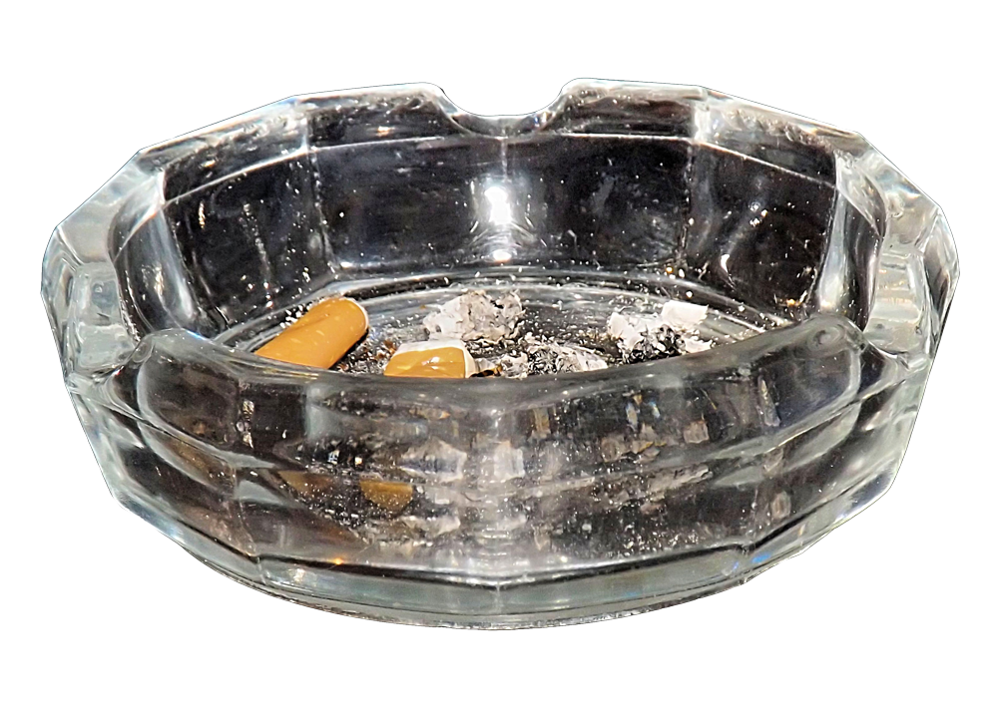
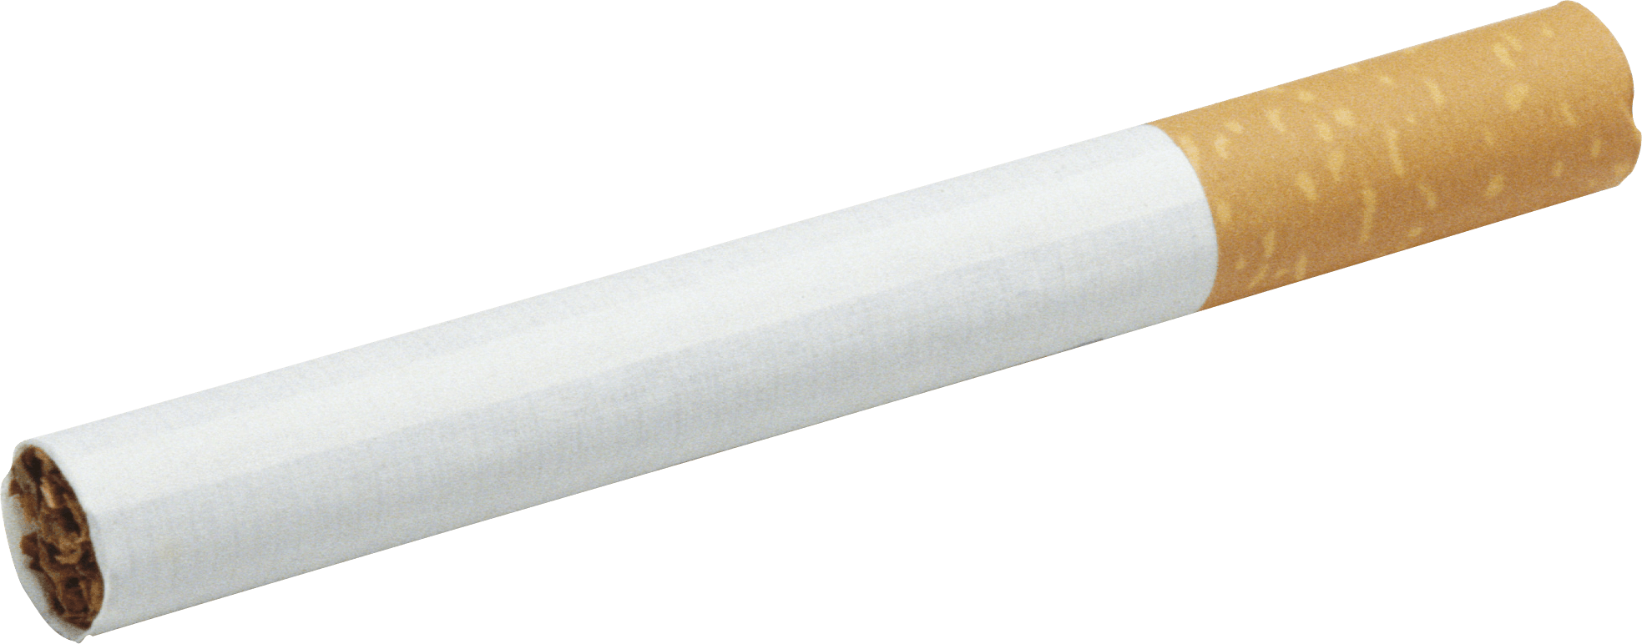
Cigs in a Pod
tobaccopreventiontoolkit.stanford.edu
1 Pack of Cigarettes
≈20 mg of nicotine
1 JUUL pod
≈41.3 mg of nicotine
1 Puff bar
≈50 mg of nicotine
1 Suorin pod
≈90 mg of nicotine
ALL PODS CONTAIN HIGH LEVELS OF NICOTINE
=20
CIGARETTES
≈41
CIGARETTES
≈50
CIGARETTES
≈90
CIGARETTES
Notes:
Teacher Talking Points:
If you don’t know, a standard pack of cigarettes contains 20 cigarettes (click). There is 1 mg of nicotine absorption per cigarette, so about 20 milligrams of nicotine delivered to the body from a whole pack of cigarettes.
Unlike other e-juices which may or may not contain nicotine, ALL salt-based e-juice contains nicotine!
According to JUUL Labs, one JUUL pod contains 41.3 milligrams of nicotine. This is equal to the amount of nicotine you’ll find in about 40 cigarettes (click).
How many packs of cigarettes would a JUUL pod then be equal to? Answer: about 2 packs
As mentioned before, this is a high amount of nicotine and can be intense for first-time users. Our concern is that young people are being introduced to a high amount of nicotine, developing a tolerance quickly, and becoming addicted as a result.
1 Puff bar contains 50 milligrams of nicotine (click), which is equivalent to 50 cigarettes. How many packs of cigarettes would a Puff bar then be equal to? Answer: about 2 ½ packs
1 Suorin Vagon cartridge contains up to 90 milligrams of nicotine or 90 cigarettes (click). How many packs of cigarettes would a Suorin pod then be equal to? Answer: about 4 and a half packs
(Click) No matter what pod device you are using, all of them contain high levels of nicotine which is extremely addictive, which keeps you coming back for more.
PLEASE SEE BELOW FOR A THOROUGH BREAKDOWN: ​
​
For the nicotine levels in these pod-based products, we looked at the amounts in milligrams per milliliter and/or percentage of nicotine by weight reported by these pod-based companies. Here is a stoichiometry breakdown:​
​
One JUUL pod is reported to contain 59 mg/mL (https://support.juul.com/home/learn/faqs/juulpod-basics), but one JUUL pod is only 0.7mL per pod. ​
​
[59 mg/mL] x [0.7mL] equals 41.3mg (NOTE: milliliter units cancel out)​
​
The makers of Puff bar report there being 50 milligrams of nicotine per Puff bar (​https://puffecig.com/puff-bar-disposable-device/).
​​
The Suorin Vagon cartridge/pod can hold an e-juice volume of 2mL (https://www.suorinusa.com/collections/suorin-vagon/products/suorin-vagon?variant=8436760281141). Suorin devices are semi-closed systems meaning that they are not pre-loaded like PHIX and JUUL, but Suorin still sells salt-based nicotine with nicotine by weight close to what JUUL and PHIX have. In their case, it is 4.5% (https://www.suorinusa.com/collections/blowsauce-salted/products/blowsauce-watermelon-lollipop-e-juice-by-dripfire-30ml-salted-edtion?variant=1053863936026).​
​
We used a simple conversion of 45mg/mL to represent the 4.5% nicotine by weight, so [45mg/mL] x [2mL] equals 90mg.​
​
We decided to use 41.3mg since it is the true amount of nicotine in one pod. One JUUL pod is equivalent to smoking anywhere from 26 to 40 cigarettes, which is more than 1 pack of cigarettes (20 cigarettes). This range depends on whether there is an uptake of 1mg or 1.5mg of nicotine per cigarette, for someone using. We decided on 1mg since it captures the maximum potential of nicotine uptake for these pod-based devices. ​
​
References: ​
https://www.ncbi.nlm.nih.gov/pubmed/6705448 ​
https://www.ncbi.nlm.nih.gov/pubmed/11208883​
https://www.drugabuse.gov/publications/research-reports/tobacco-nicotine-e-cigarettes/how-does-tobacco-deliver-its-effects
​
Images:​
Ashtray - https://www.actaturcica.com/2018/05/09/ashtray-png-transparent-image/​
Cigarette - https://www.istockphoto.com/ae/photos/package-of-cigarettes?excludenudity=true&mediatype=photography&phrase=package%20of%20cigarettes&sort=mostpopular​
JUUL pod - https://www.juul.com/shop/pods/mango-5-percent​
Puff bar - https://www.ievapor.com/puff-bar-menthol-disposable-pod-device-10pcspack-p-1930.html
Suorin pod - http://yetivape.com/suorin-vagon-pod/ ​

Slide 23
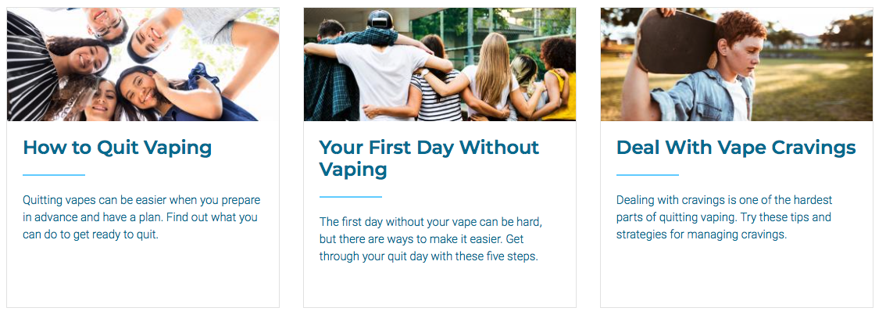
Teen.smokefree.gov
1-800-QUIT-NOW
(1-800-784-8669)
Notes:
Teacher Talking Points:
Quitting a tobacco product can be incredibly difficult and it’s important to utilize resources to help support someone who is quitting/going nicotine-free.
Here are additional resources about tobacco/nicotine cessation.
Here is a national website that offers information on quitting e-cig/vape use.
There is a national hotline, 1-800-QUIT-NOW (1-800-784-8669). When you call that number and give them the state you’re calling from, they will connect you to your state’s hotline.
Each state varies in the type of services offered (http://map.naquitline.org/).
References:
https://teen.smokefree.gov/
http://map.naquitline.org/

Slide 24
Text “DITCHJUUL” to 887-09
Daily quitting tips
Designed with feedback from teens and college students who have tried to quit, or have successfully quit
Notes:
Teacher Talking Points:
Here is another e-cigarette quit program. If you text “DITCHJUUL” to 887-09 then you will receive daily tips on how to quit vaping. It's easy to use and easy to stop if you don't want it.
Reference:
https://truthinitiative.org/what-we-do/quit-smoking-tools

Slide 25
California Smoker’s Helpline
1-844-8-NO-VAPE
1-844-866-8273
Notes:
Teacher Talking Points:
This resource is for people who live in California.
Free individual counseling and coaching is available to youth who want to quit e-cigs/vapes. You need to enroll first, which only takes 5 minutes to do. They can also email free reading materials if you want them.
Reference:
https://www.nobutts.org/

Slide 26
My Life, My Quit
https://mylifemyquit.com
Text “Start My Quit” to 855-891-9989
Notes:
Teacher Talking Points (outside California):
There is also a new youth tobacco/nicotine cessation program, available for free in Colorado, Hawai’i, Idaho, Iowa, Kansas, Kentucky, Massachusetts, Michigan, Minnesota, Montana, Nevada, New Hampshire, North Dakota, Ohio, Oklahoma, Pennsylvania, Rhode Island, Utah, Vermont, and Wyoming.
They provide structured, live coaching sessions for youth using multiple communication tools. Visit MyLifeMyQuit.com or text “Start My Quit” to 855-891-9989 to learn more. #MyLifeMyQuit #StartMyQuit.
Reference:
https://www.mylifemyquit.com/?utm_source=fb&utm_medium=soc&utm_campaign=TPT

Slide 27
Unit Quiz
tobaccopreventiontoolkit.stanford.edu
Notes:
Click image to follow link http://tinyurl.com/TPT-Nicotine-Addiction-Unit

