Slide 1
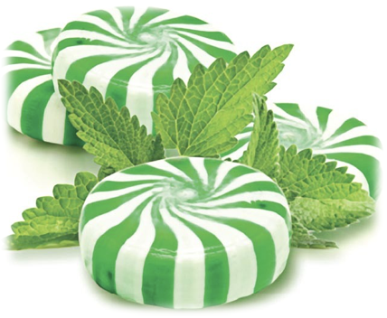

Targeting African Americans:
The Menthol Plan
© Stanford University
Notes:
Teacher Talking Points:
The large tobacco companies have targeted the African-American community since the early 1960’s.
But the history of African-Americans and tobacco dates back to the days of slavery.

Slide 2
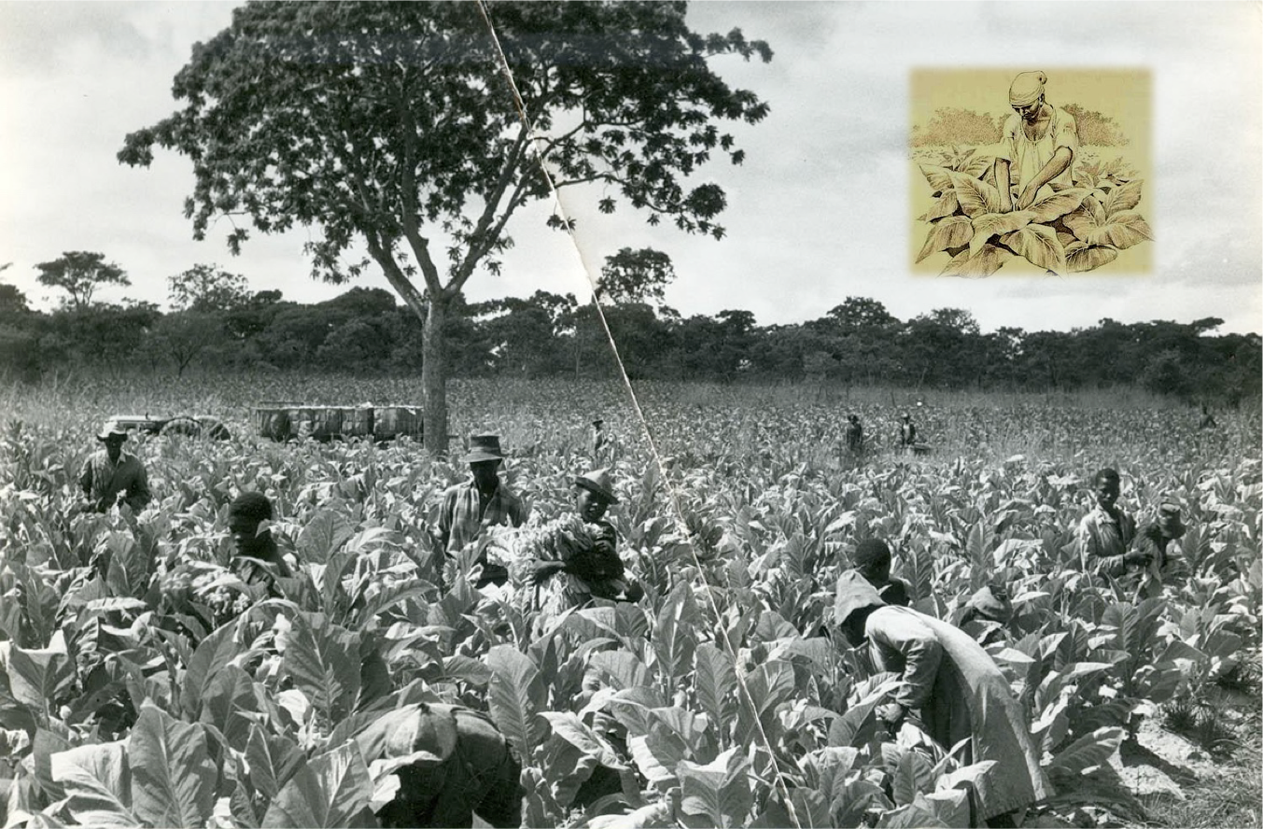
Notes:
Teacher Talking Points:
When the demand for tobacco outstripped even cotton, southern farmers increased their use of slaves as cheap labor.
First African-Americans harvested tobacco and now they are victims of big tobacco’s cigarette advertising.

Slide 3

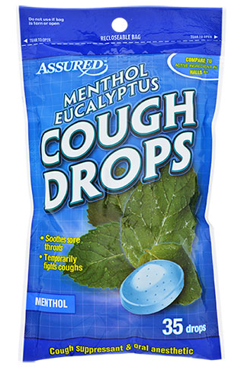
What is Menthol?
Mint extract that has a minty candy taste with a cooling sensation.
Activates taste buds and soothes the throat.
Anesthetic effects (numbing) make it easier to inhale.
Deeper inhalation; more nicotine taken in.
Notes:
Teacher Talking Points:
So what is menthol? [Have students discuss] (click).
(Click) We know that it is a mint extract with a minty taste and produces a (click) cool and soothing sensation on the throat.
It also (click) has anesthetic effects, which makes it easier to inhale.
(Click) This means that a deeper inhalation can occur and in turn more nicotine can be taken in without feeling it as much.
Inhaling more smoke means greater nicotine intake, making menthol flavored tobacco products more addictive and harder to quit (Levy, 2011).

Slide 4
What Tobacco Companies Are Saying
“Menthol has the ability to ‘undeniably impart a cooling influence’, and in doing so, reduces both harshness and tobacco taste.” - British American Tobacco, 1982
“Menthol’s cooling effect alleviates nicotine’s irritating effect.” - RJ Reynolds, 1983
“Menthol masks the taste of tobacco.” - Philip Morris, 1992
Notes:
Teacher Talking Points:
And this is what tobacco companies have been telling the public about menthol in cigarettes:
(Click) “Menthol has the ability to ‘undeniably import a cooling influence’, and in doing so, reduces both harshness and tobacco taste.”
(Click) “Menthol’s cooling effect alleviates nicotine’s irritating effect.”
(Click) “Menthol masks the taste of tobacco.”

Slide 5
“Menthol has no redeeming value other than to make the poison go down more easily.’’
Menthol Nicotine
Notes:
Teacher Talking Points:
“Menthol has no redeeming value other than to make the poison go down more easily.”
If menthol reduces irritation it increases the amount of smoke that is inhaled. Smokers inhale deeper and longer (Ton et al., 2015).
http://investigativereportingworkshop.org/articles/racial-politics-menthol-debate/
Image: https://www.nudenicotine.com/product/menthol-tobacco-2/

Slide 6
The African-Americanization of
Menthol Cigarette Use
Menthols boost nicotine’s effect on the brain
Menthols just mask the harsh tobacco flavor so are easier to smoke
Thus, they’re easier to start, harder to kick, and easier to go back to
Notes:
Teacher Talking Points:
Thus the Menthol Plan concludes:
(Click) Menthols aren’t per se more addictive than other cigarettes.
(Click) They’re just tastier and easier to smoke.
(Click) Thus, they’re harder to kick and easier to go back to.
Source: Thompson M.F. et al. Menthol enhances nicotine-induced locomotor sensitization and in vivo functional connectivity in adolescence.(link is external) Journal of Psychopharmacology.

Slide 7
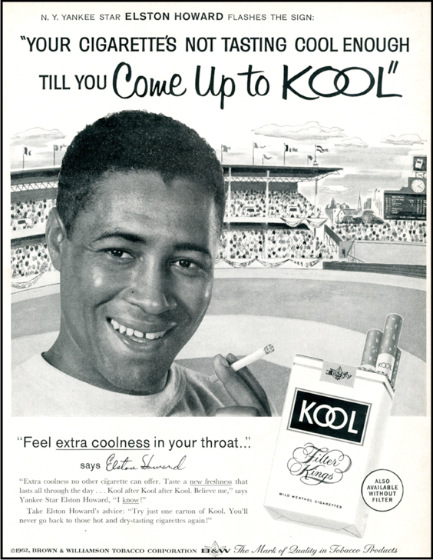
Notes:
Teacher Talking Points:
Yankee star Elston Howard became the first of many African-Americans to endorse menthol cigarettes in advertisements after tobacco companies recognized a slight preference in 1953 among African-American smokers for menthol brands.

Slide 8
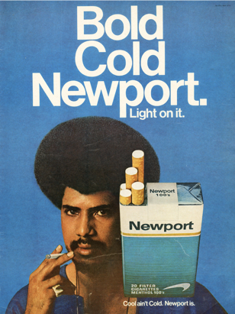
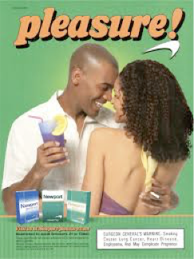
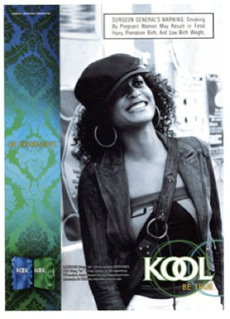
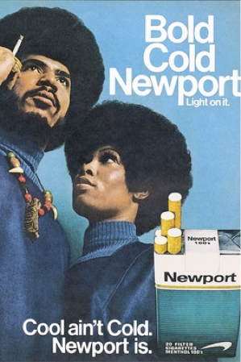
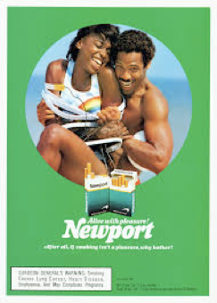
Notes:
Teacher Talking Points:
(Click) The African-Americanization of menthol cigarettes involves a number of misconceptions about menthol.
What do you think advertisers are trying to say with these menthol ads?
Here are some examples:
African-American way of life is shown to be supported by menthol cigarettes.
Strong bonds between couples are depicted.
There is a message of black empowerment and independence.
The middle ads of the African-American women show them as relaxed and cool.

Slide 9
“By the mid-1960s, Kools contained more tar and nicotine than either Salem or Newport.’’
Notes:
Teacher Talking Points:
[Give students time to read this slide].
Menthol cigarettes are not safer or cleaner.
It can contain more tar and nicotine!
In fact, some research indicates that menthol causes a chemical reaction making nicotine more powerful in a cigarette.

Slide 10
So how did tobacco companies reinforce the popularity of menthol brands?
Notes:
Teacher Talking Points:
[Ask questions to students]
Possible answers include:
Selling single cigarettes
Give-away in African-American neighborhoods
Driving a van through districts with free cigarettes

Slide 11

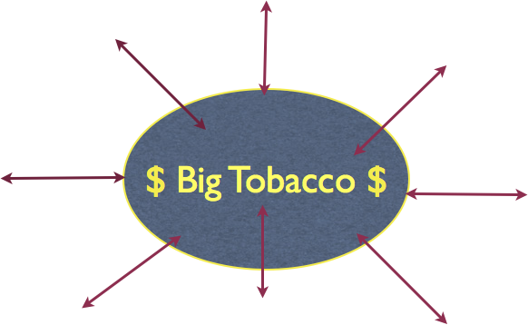
National Black Chamber of Commerce
African-American Politicians
AA social, cultural, and educational organizations
$
$
$
$
$
NAACP?
?????
$
$
$
National Org. of Black Enforcement
Congressional Black Caucus
Tobacco
Legislation
Notes:
Teacher Talking Points:
By sponsoring cultural events and pouring marketing dollars into black media, neighborhoods and organizations such as…
(Click) African-American politicians, National Black Chamber of Commerce, African American social, cultural, and educational organizations
Tobacco Legislation, National Organization of Black Enforcement, Congressional Black Caucus, and the NAACP
And many more that we may not know about (click)!

Slide 12
Negative Responses to
Menthol
Continues to Increase
Notes:
Teacher Talking Points:
Recent studies have concluded:
Menthol flavoring often makes it harder for smokers to quit.
Menthol cigarettes lead to increased smoking initiation among youth and young adults, greater addiction, and decreased success in quitting smoking.
Removal of menthol cigarettes from the marketplace would benefit public health in the United States.
Image: https://www.ciggiesworld.ch/product/marlboro-menthol/

Slide 13
Tobacco Exposure
Notes:
Teacher Talking Points:
Let’s examine some of the impacts on African-Americans of the Menthol Plan.
[Click for each line and discuss with students].
(Click) Who smokes more, White or African-American youth? (click)
(Click) Why would the African-American youth smoke more cigars than Whites? (click)
(Click, click) If African-American high school youth smoke less than Whites, than why are the percentages in adulthood similar?
(Click, click) Why are African-Americans less able to quite smoking than Whites?
(Click, click) What do you think are the reasons that black children are more exposed to second hand smoke than White children?
(Click, click) What does this statistic tell you, especially in relationship to the first line of this graph?

Slide 14
Tobacco (Menthol) Deaths
in the African American Community
45,000
Notes:
Talking Points:
So how many African Americans die yearly due to smoking? (Click) 45,000. Approximately 45,000! That’s more than homicides and AIDS, combined. (click) illness.
An estimated 1.6 million African Americans alive today, who are now under the age of 18, will become regular smokers; and about 500,000 of these will die prematurely from a tobacco-related disease.
HHS, “Tobacco Use Among US Racial/Ethnic Minority Groups—African Americans, American Indians and Alaskan Natives, Asian Americans and Pacific Islanders, and Hispanics: A Report of the Surgeon General,” 1998, http://www.cdc.gov/tobacco/data_statistics/sgr/1998/complete_report/pdfs/complete_report.pdf.

Slide 15
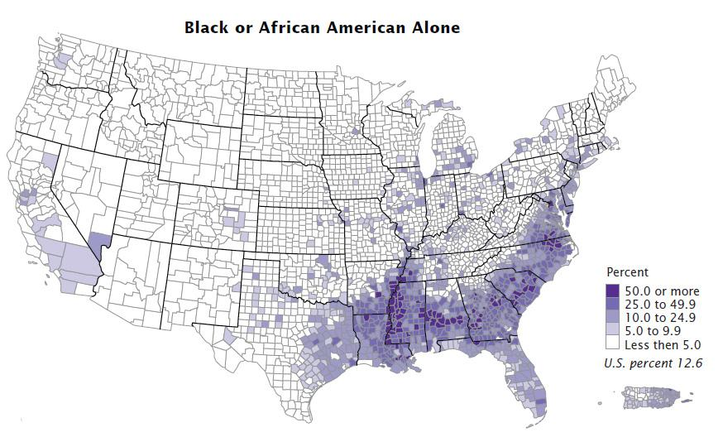
Existing Menthol Restrictions
Aspen, CO
Carbondale, CO
Glenwood Springs, CO
Snowmass Village, CO
Duluth, MN
Hennepin County, MN
Minneapolis, MN
St. Paul, MN
(+8 more MN cities)
Manheim, NY
Massachusetts
California
*Buffer zone in Chicago removed around middle schools in 2016/2017
Notes:
Teacher Talking Points:
Here is a map of the United States with the percentage of African Americans by zip code.
[Question to students] If you were part of a national Tobacco Control Coalition, which areas would want to target for banning menthol?
Many cities have adopted restrictions on flavored tobacco products, but many don’t include menthol.
Here are a list of some state and cities with existing menthol restrictions.
Out of over 290 localities that have passed flavored tobacco restrictions only about 100 of them have also restricted the sales of menthol cigarettes.
Why do you think menthol is not as regulated as other flavors?
Image: https://www.michiganradio.org/post/census-releases-numbers-black-population-us
Source: https://www.tobaccofreekids.org/assets/factsheets/0398.pdf

Slide 16
Take Home Message:
Menthol is a Social Justice Issue!
Notes:
Teacher Talking Points:
The marketing and targeting of menthol to African Americans is out-right discriminatory.
The tobacco industry is preying on the most vulnerable, poorest (lack of resources), and least informed sections of American society.

Slide 17
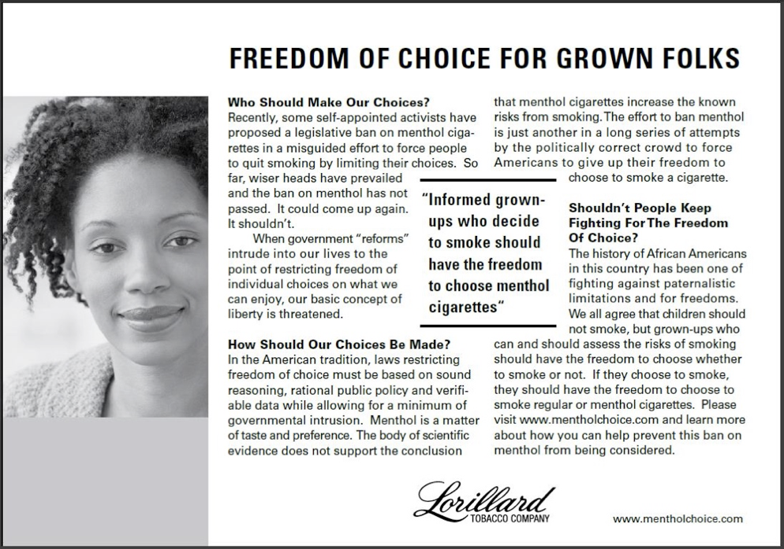
Notes:
Teacher Talking Points:
(Teachers should plan carefully if they are comfortable with the discussion that will result from the final two slides. They are powerful and will spark a great discussion, but are certainly optional. They lead the discussion, while related to menthol smoking, more to the issue of discrimination)
Big tobacco has turned use of menthol into a racial equality issue, rather than an issue of marketing and selling a highly addictive product to the African-American community.
Read this ad placed in African-American media and discuss whether tobacco companies have the best interests of African-Americans in mind or in selling more poison.

Slide 18
Youth between 11-23 who have experienced racism are
80% more likely to smoke than youth who have not.
Notes:
Teacher Talking Points:
Why do you think this is the case and would this also include the LGBTQ community?

Slide 19
Special Thanks
Derrick Kirk
Youth Development Specialist
Tobacco Use Prevention Education (TUPE)
Contra Costa County Office of Education
Tiffani Mason, MAT
Curriculum Specialist
Tobacco Use Prevention Education (TUPE)
Contra Costa County Office of Education
Phillip Gardiner, DrPh
UC Smoke and Tobacco Free Fellowship Awards Program Officer
Tobacco Related Disease Research Program (TRDRP)

